Slide 1
Mini-Course in Mechanical Engineering
Construction and Materials Technology
Triton Shoup, Chief Mechanical Judge

Slide 2
What are Some Mechanical Aspects of a Solar Car?

Slide 3
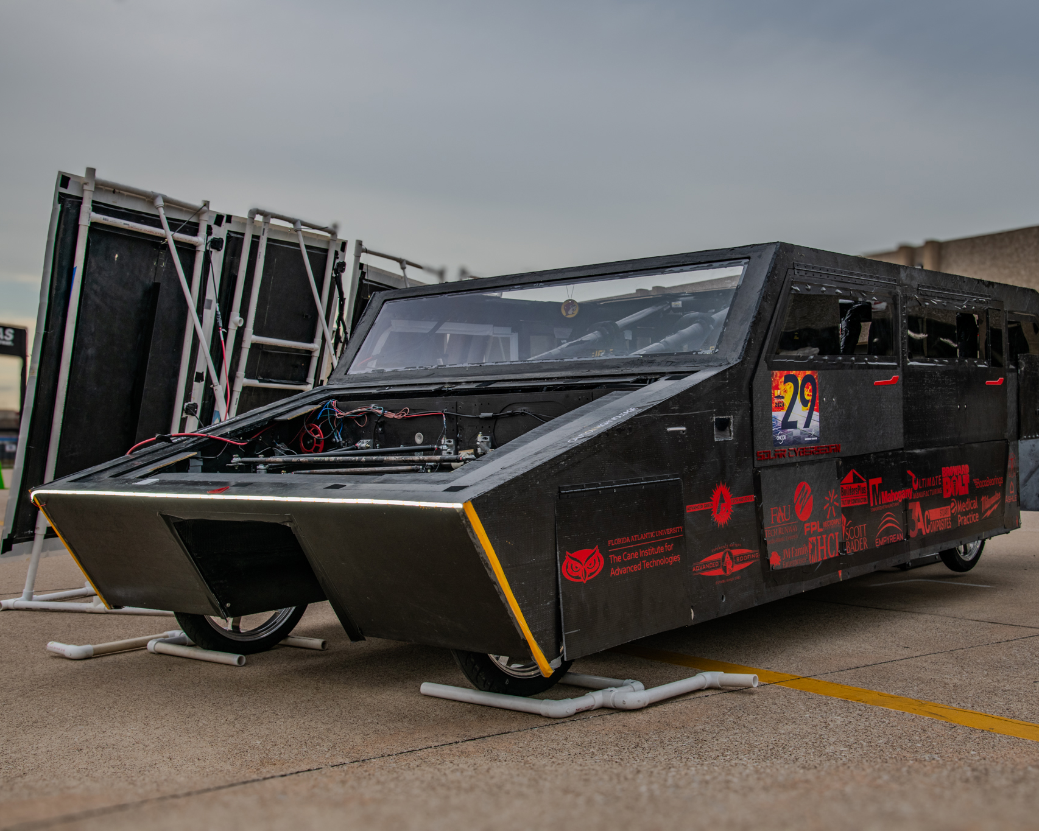
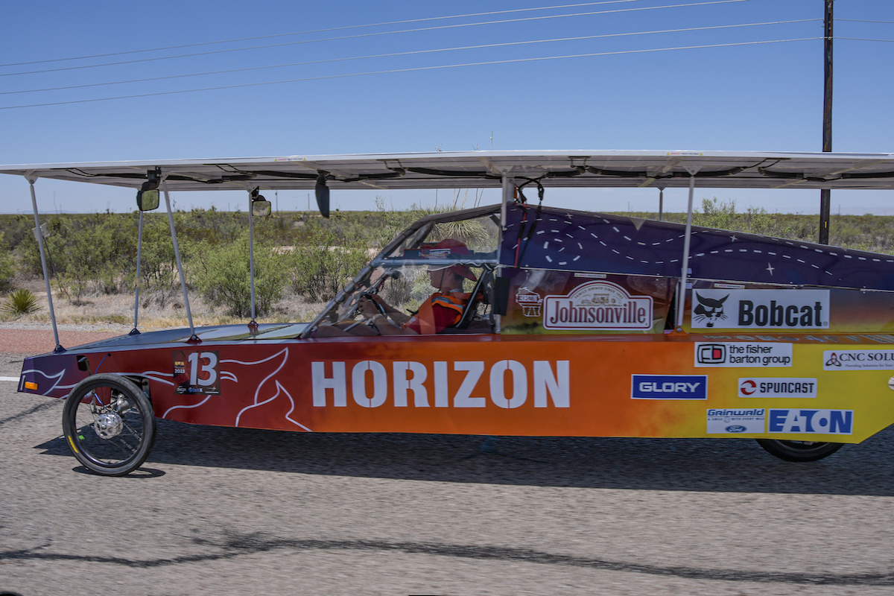
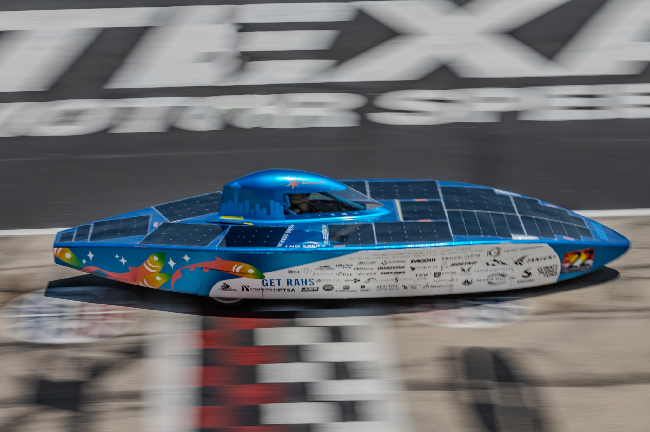
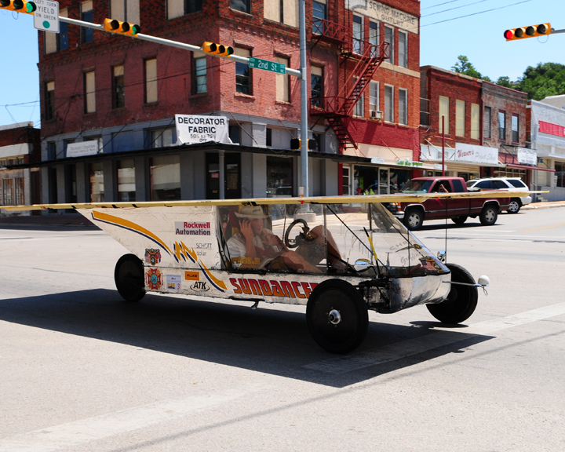
Building the Vehicle Frame
Materials
Safety Cell, Crush Zone and Roll Bar
Suspension and Steering
Wheels and Brakes

Slide 4
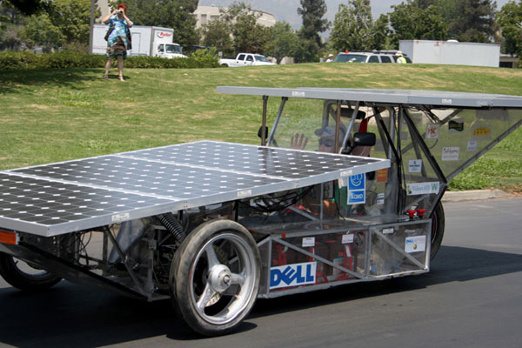
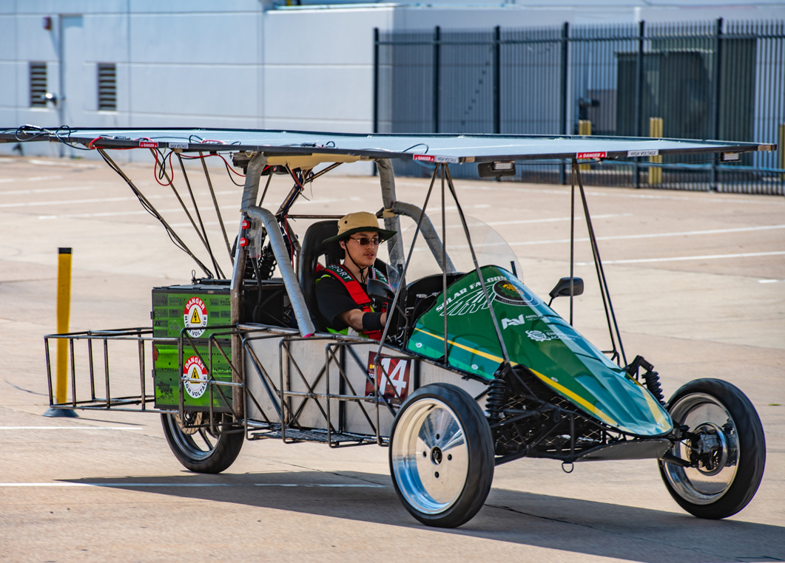
Material for the frame – Mid/Carbon Steel
Pros
  Really easy to work with (MIG welding)
  Inexpensive ($4.50/foot)
  Can be easily changed/modified
  Readily accessible
  Come in a large variety of sizes and wall thicknesses
Cons
  Will rust over time
  Heavy
    Most first-year cars around (800 – 1200lbs)

Slide 5
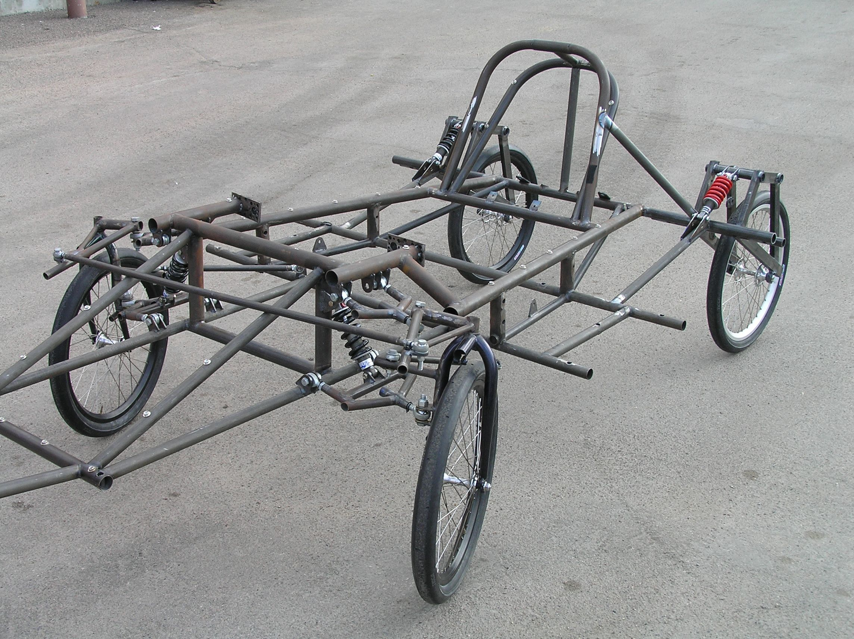
Material for the frame - Chromoly Steel
Pros
  Lightweight
  Can be easily changed/modified
  Can be welded to mild steel
Cons
  More expensive ($7/foot) (+welding wire @ $15/lb)
  MIG can be used but prefer approach is TIG

Slide 6
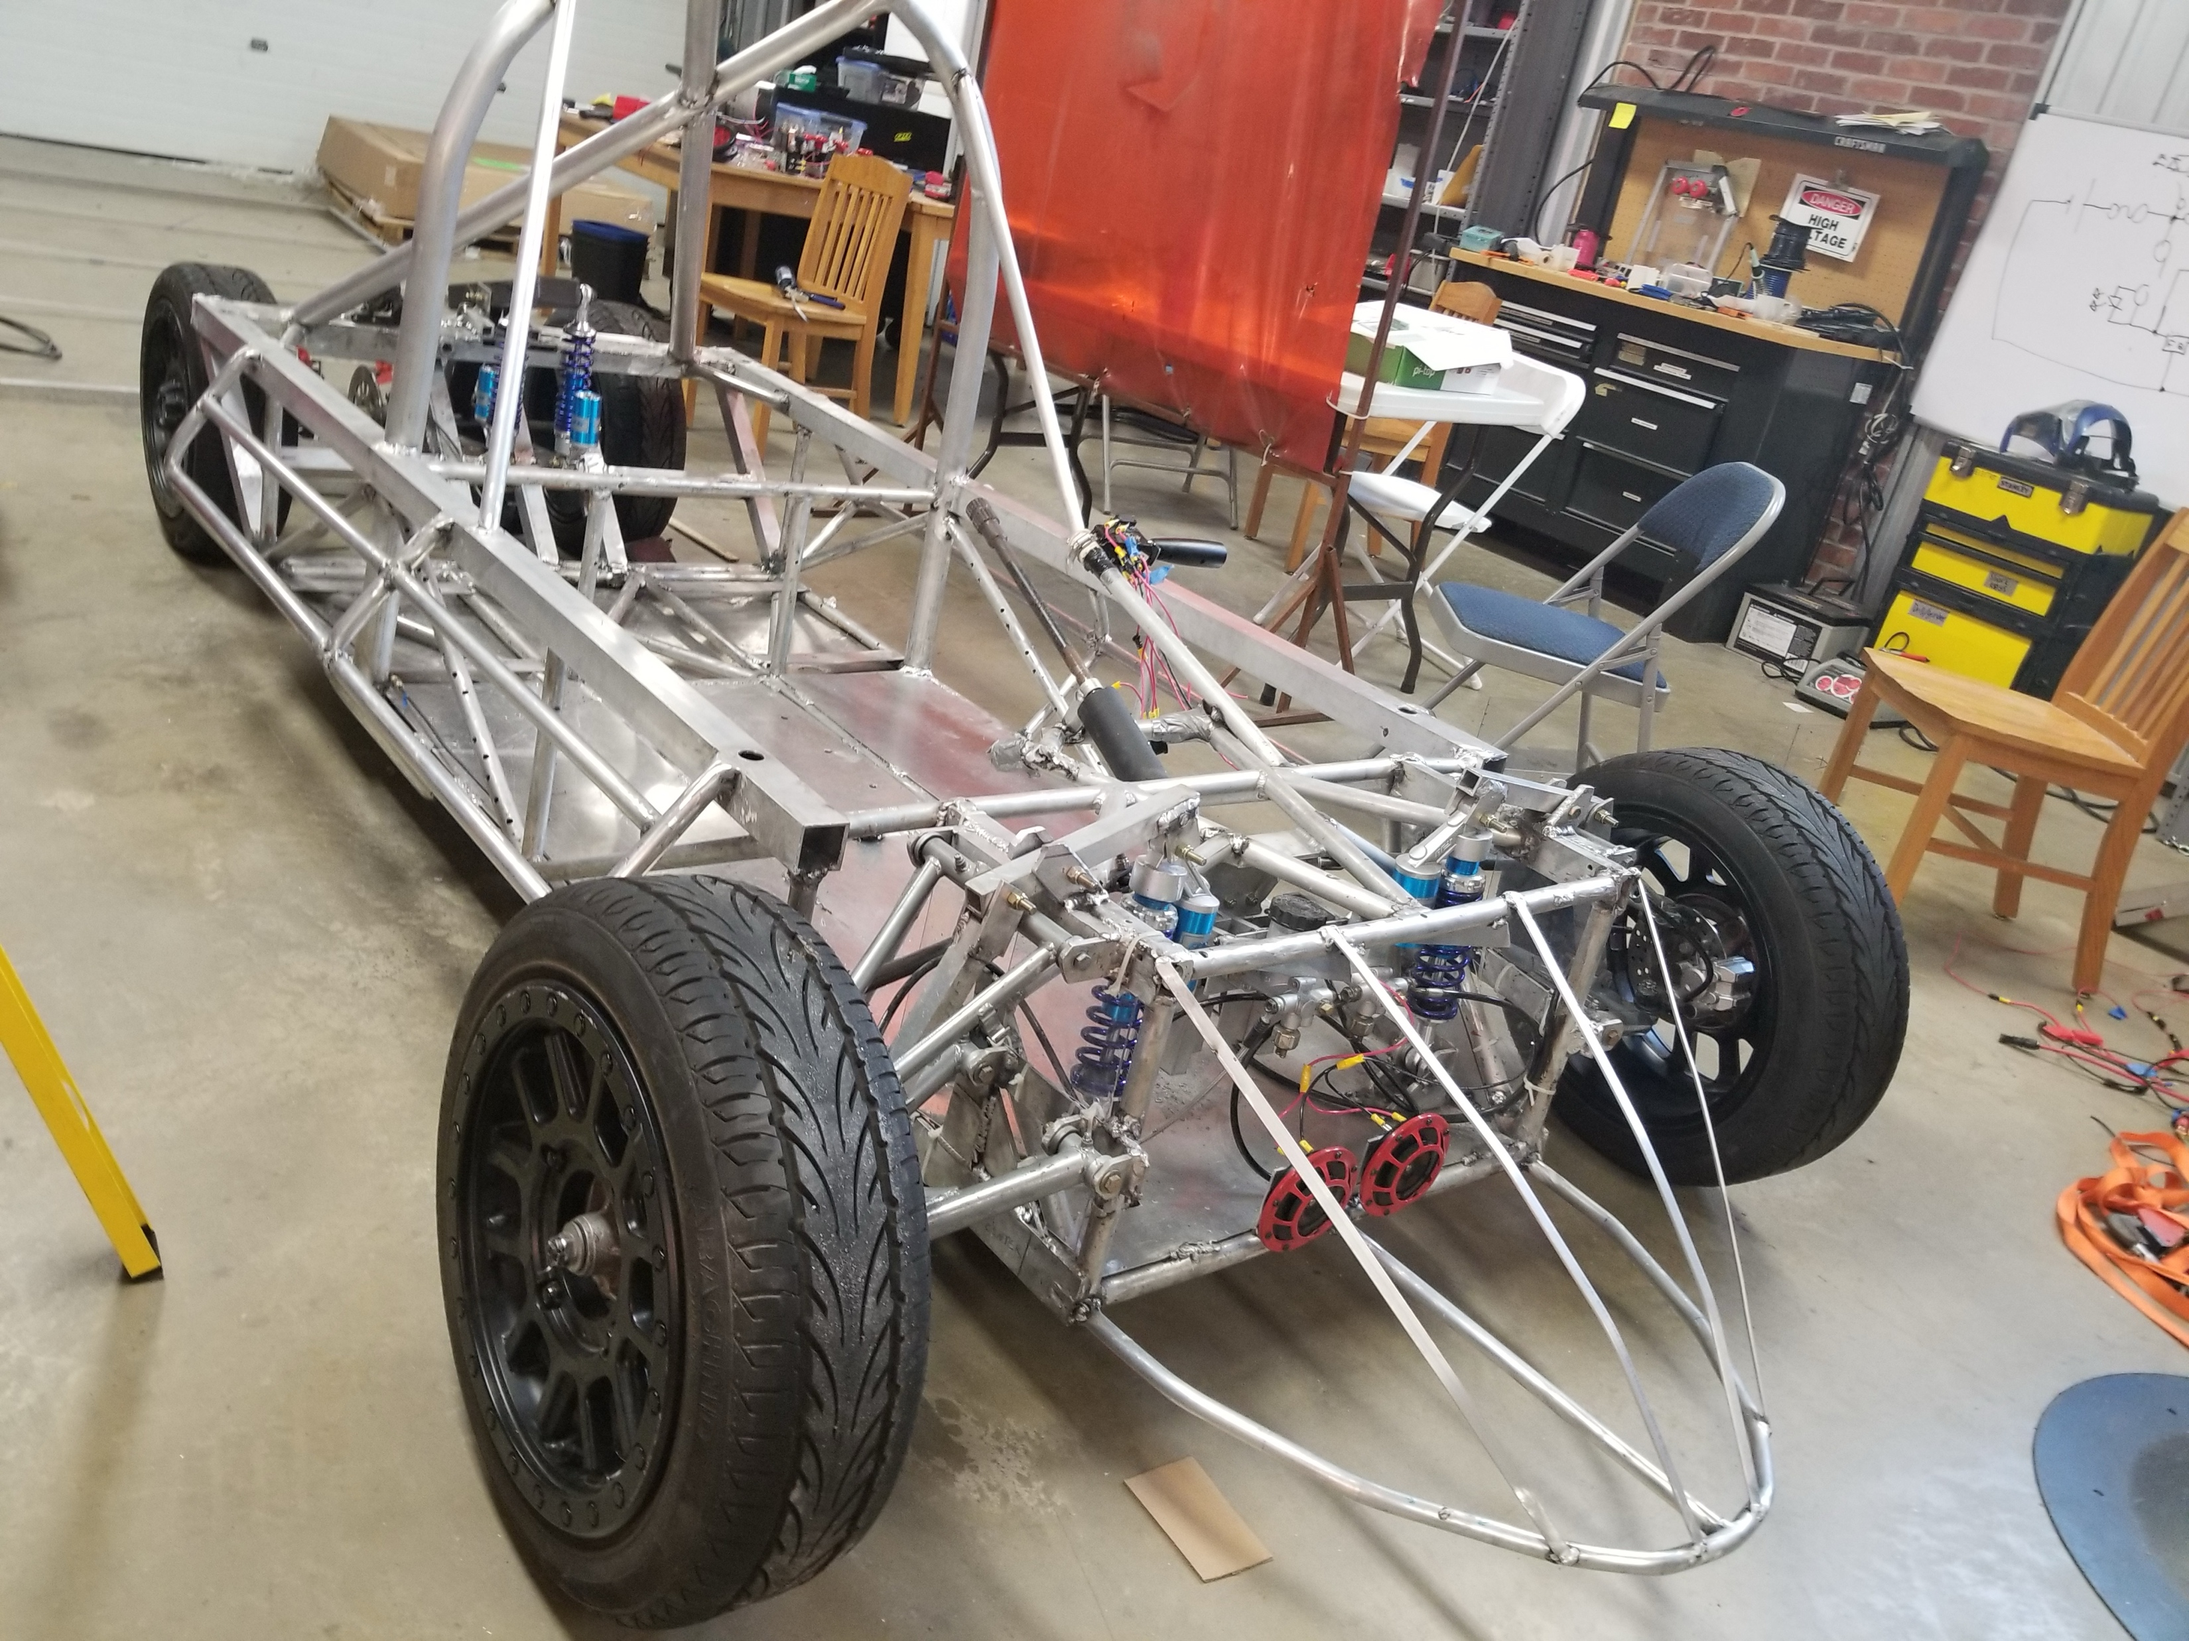
Material for the frame – Aluminum
Pros
  Lightweight
  Very stiff for its weight
  Relatively cheap ($5.50/Foot)
  Corrosive resistant
Cons
  Harder to weld (TIG) or spool gun for (MIG)
  Generally tubular; notch to get better fit
  Needs more material to resist fatigue
  Can be difficult to repair

Slide 7
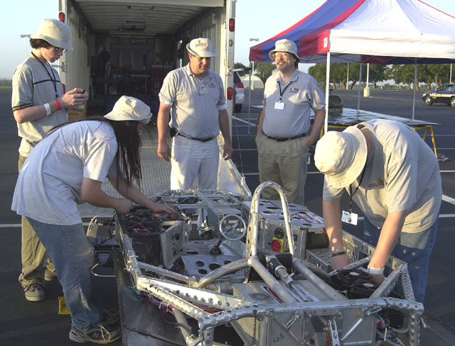
Material for the frame
Titanium
  Light
  Strong (but not stiff)
  Absorbs shock
  Hard to weld
  Expensive
  Limited sizes

Slide 8
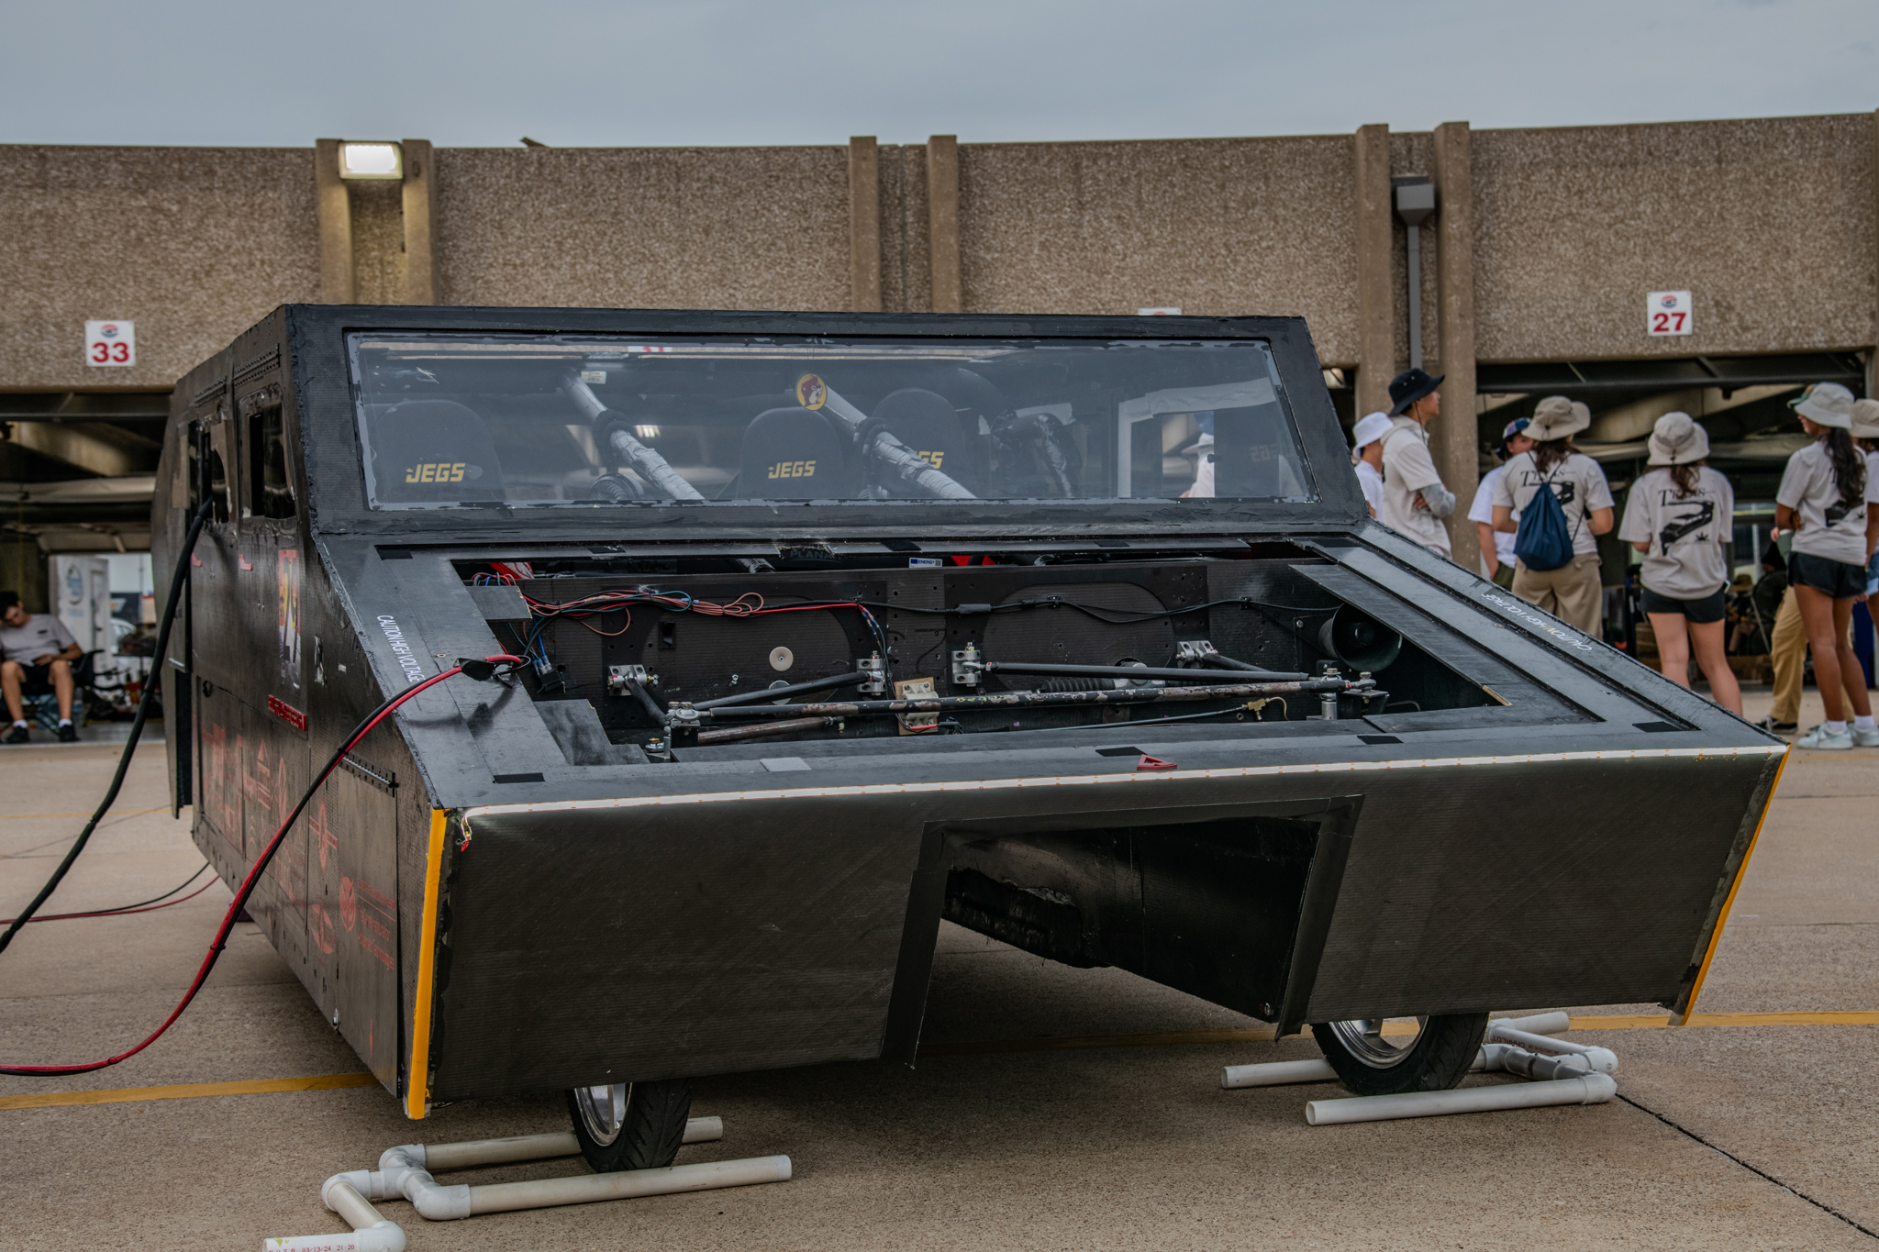
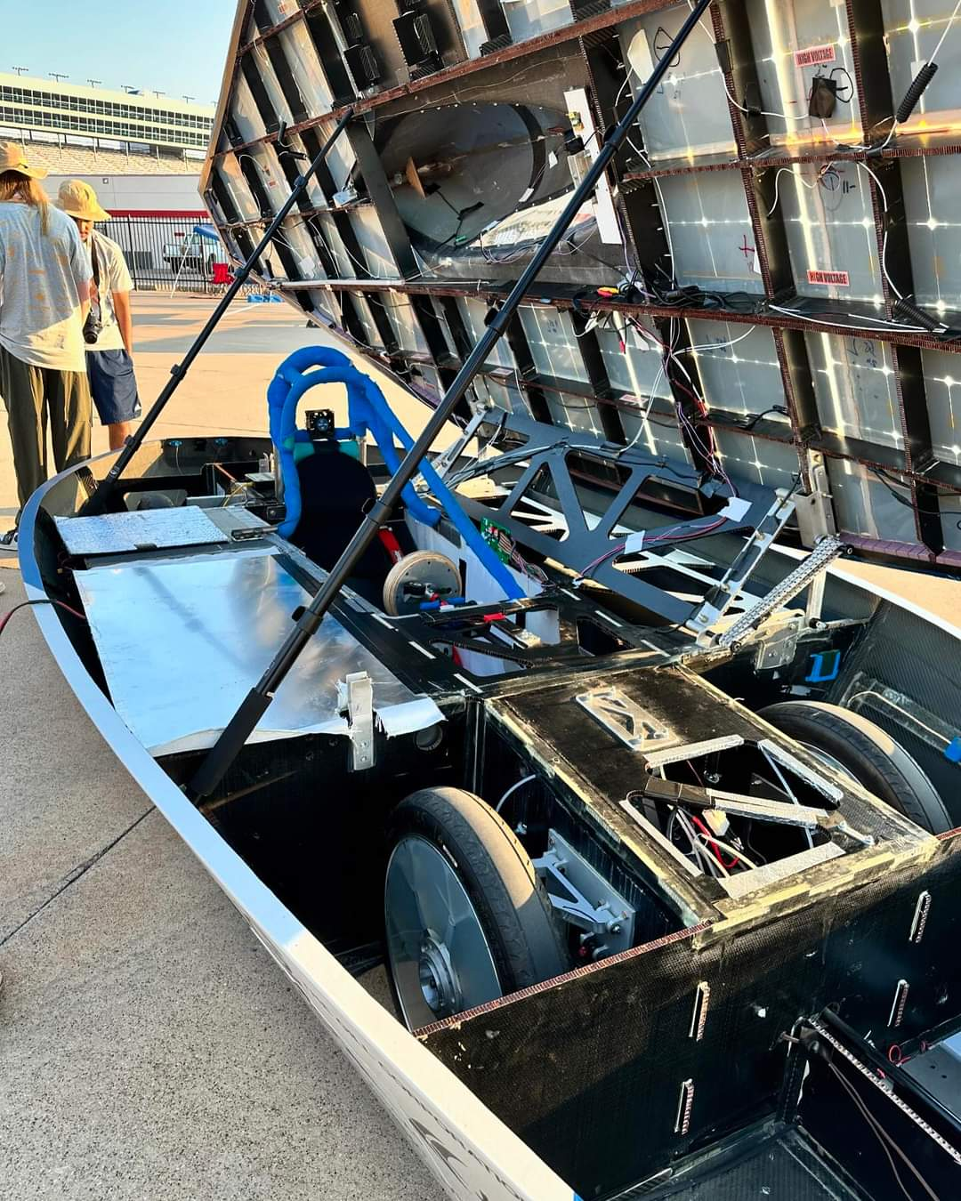
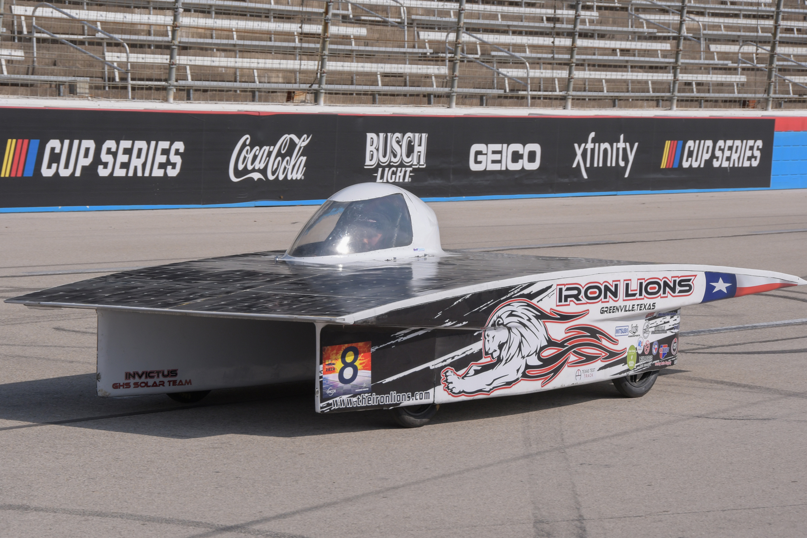
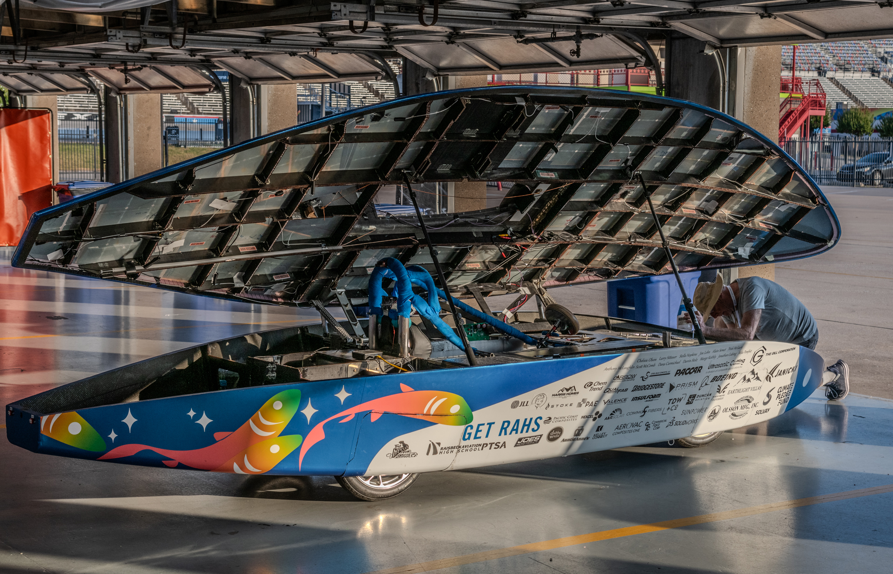
Material for the frame - Carbon Fiber (composites)
Pros
  Lightest and stiffest
  Can be formed to any shape
Cons
  Expensive
  Needs careful planning
  Learning curve is steep
  Very hard to repair on the side of the road
  NOTE:
  Need professional engineer certification if used for safety cell, roll bar, or crush zone

Slide 9
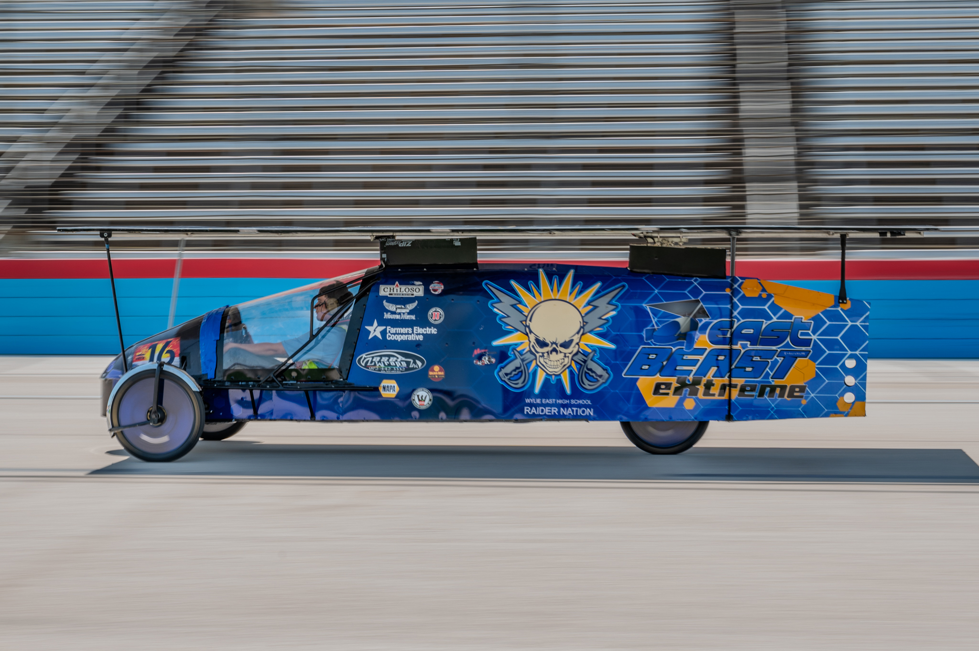
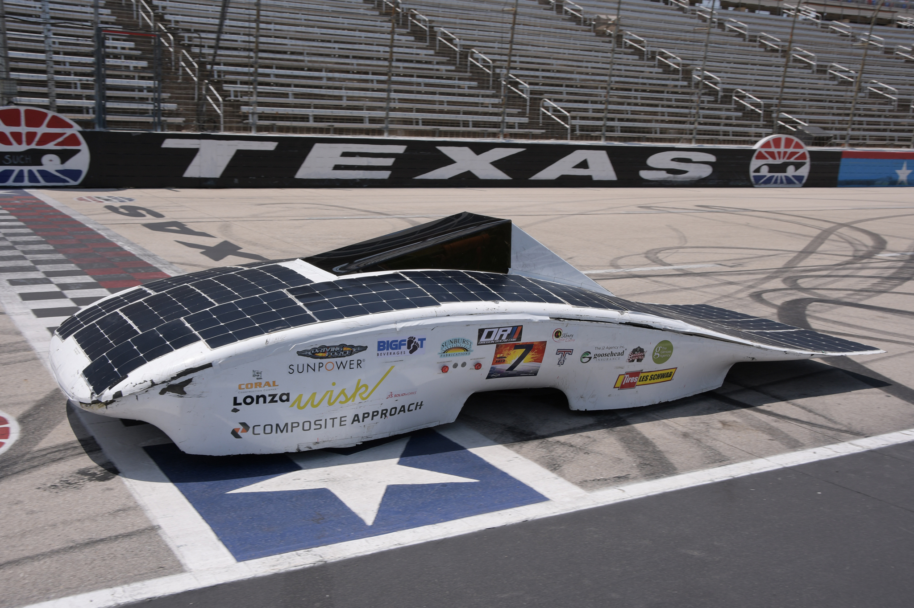
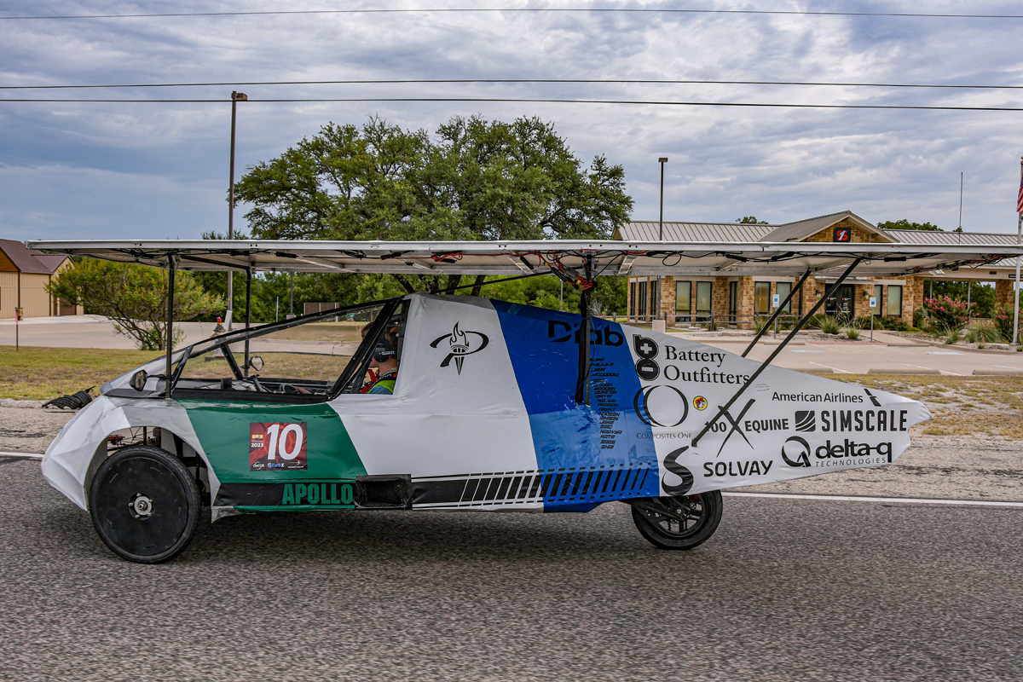
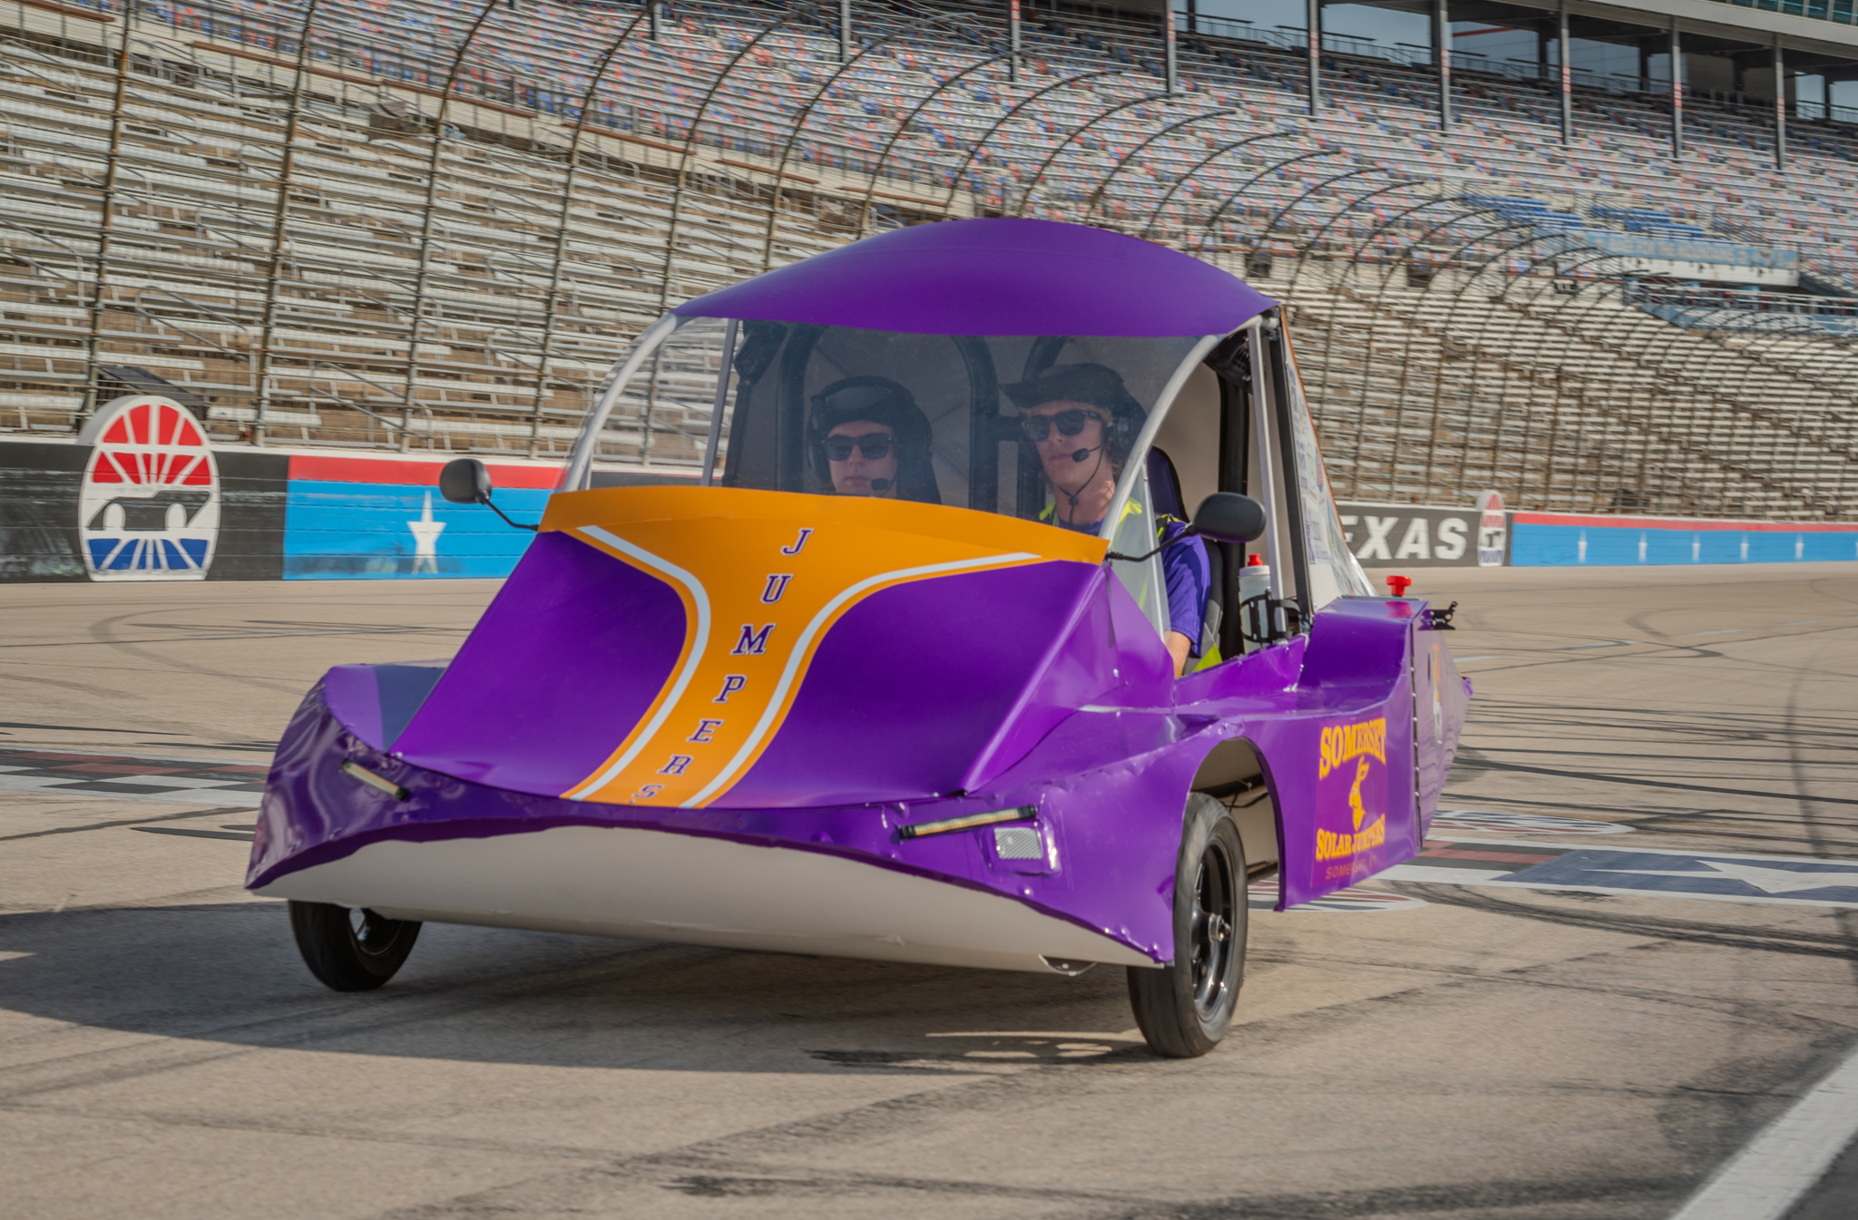
Building the Vehicle Frame
Materials
Safety Cell, Crush Zone and Roll Bar
Suspension and Steering
Wheels and Brakes

Slide 10
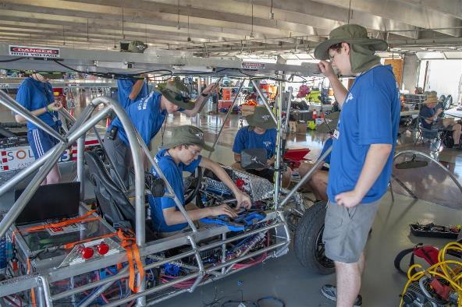
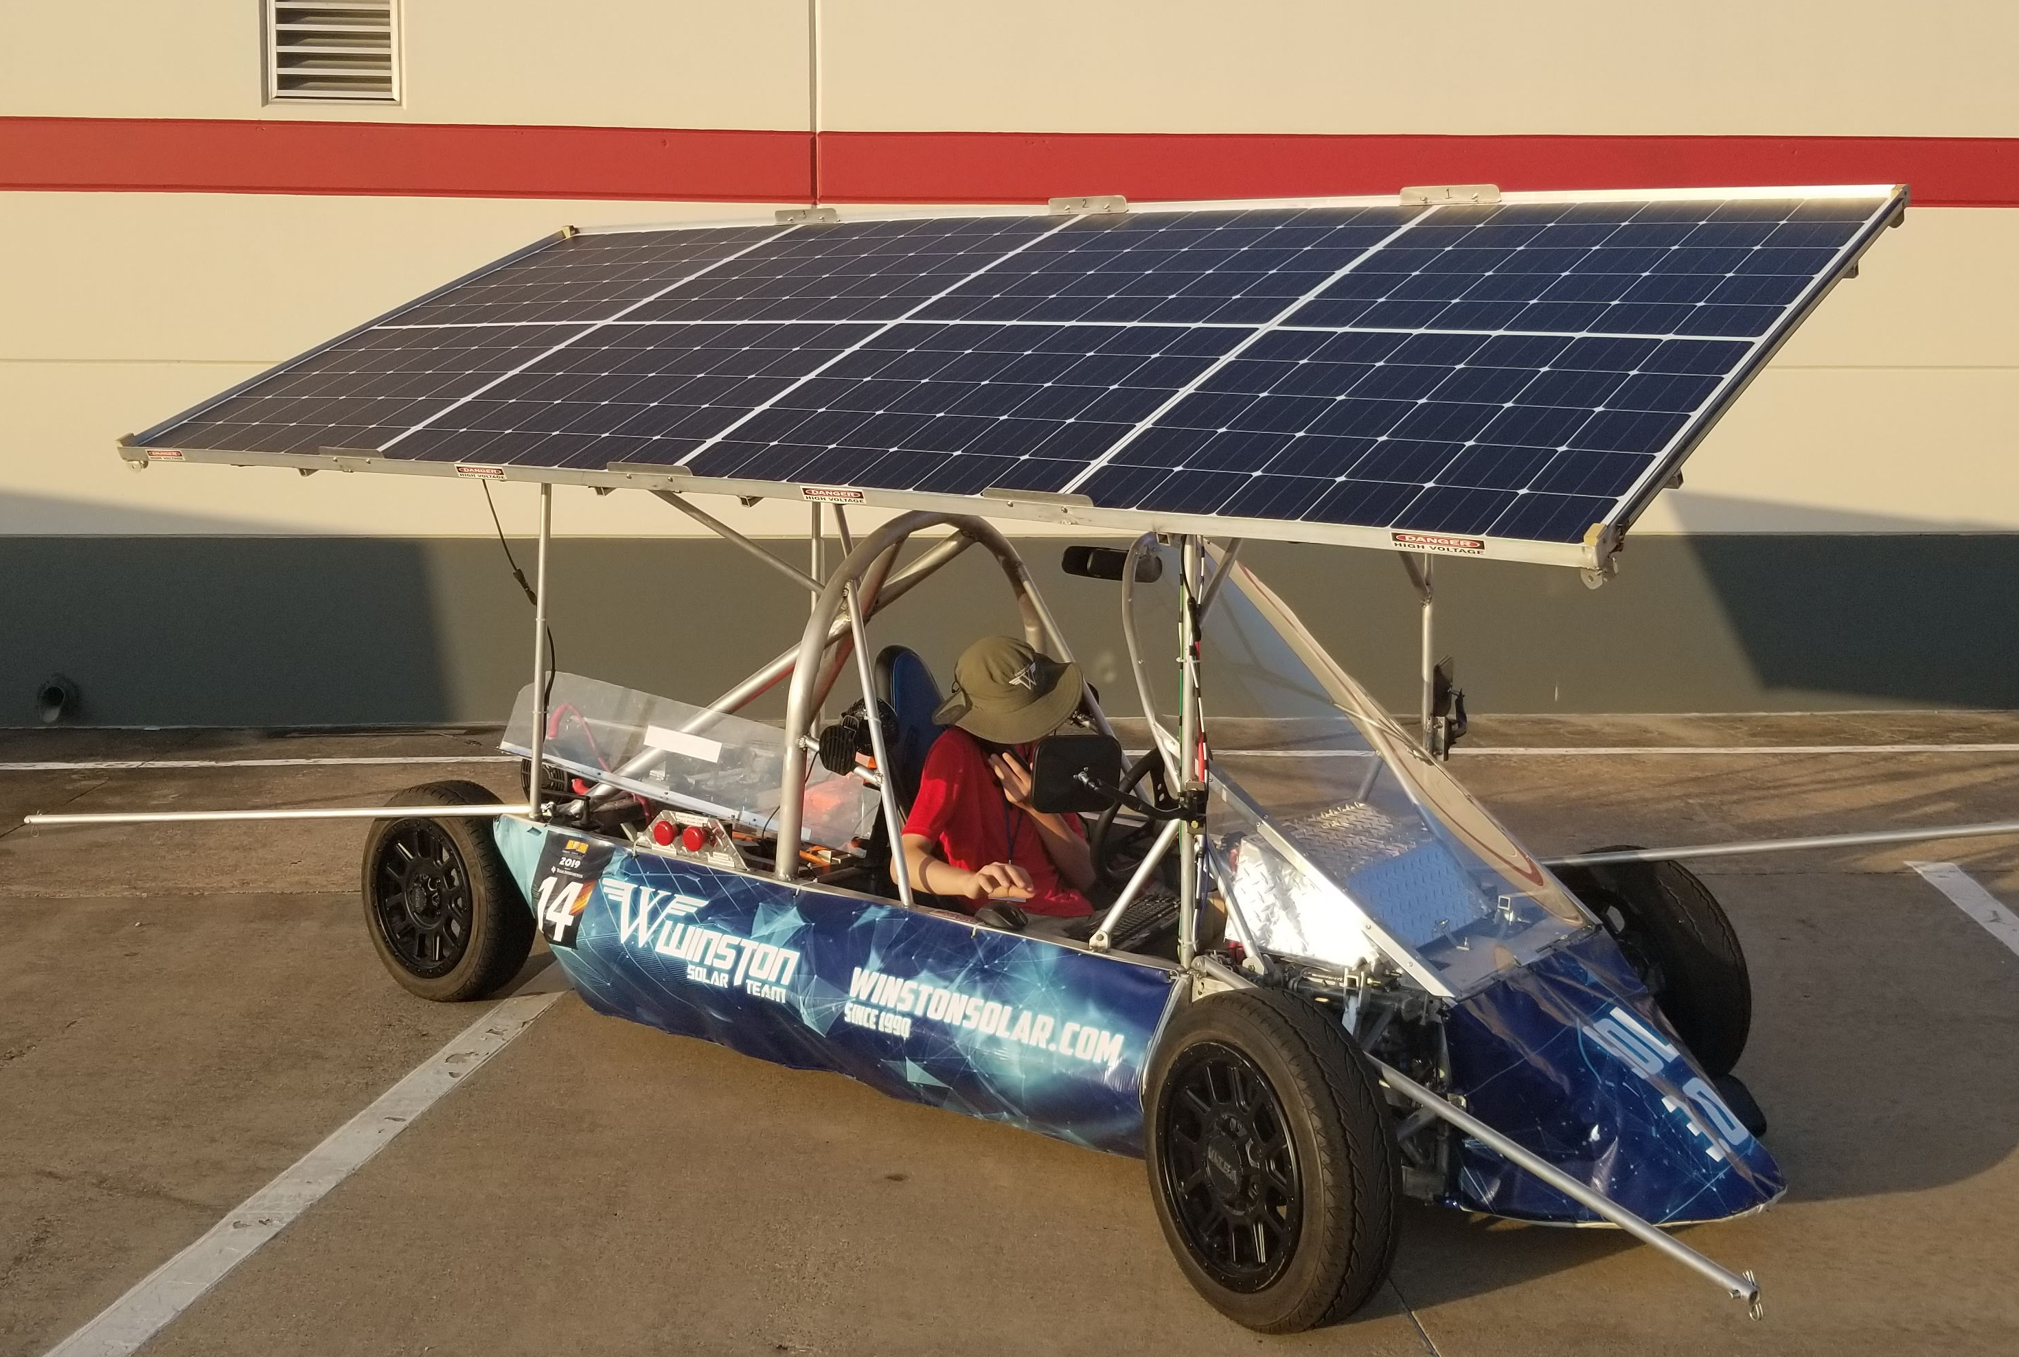
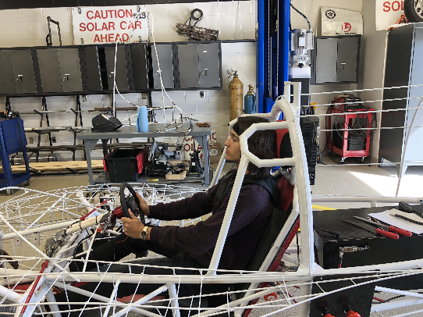
Safety Cell, Crush Zone, Roll Bar
Safety Cell – rigid protection encompassing the entire driver
  minimum OD of 1.9cm
  Padding in areas of contact with the driver
  minimum 5cm clearance to all drivers
Crush Zone – structural components designed to collapse on impact
  minimum 15 cm horizontal and 30 cm vertical clearance to driver's lower torso and legs
Roll Bar – protects the driver in the event of rollover
  continuous piece of metal
  minimum 5 cm vertical clearance
  minimum OD of 5 cm
  minimum wall thickness based on material
  welded to the structural frame

Slide 11

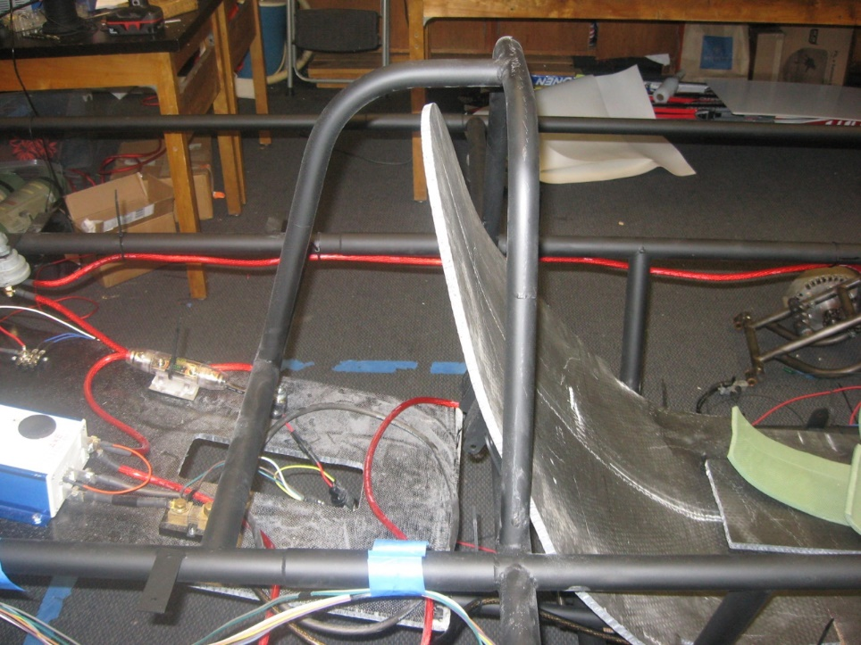
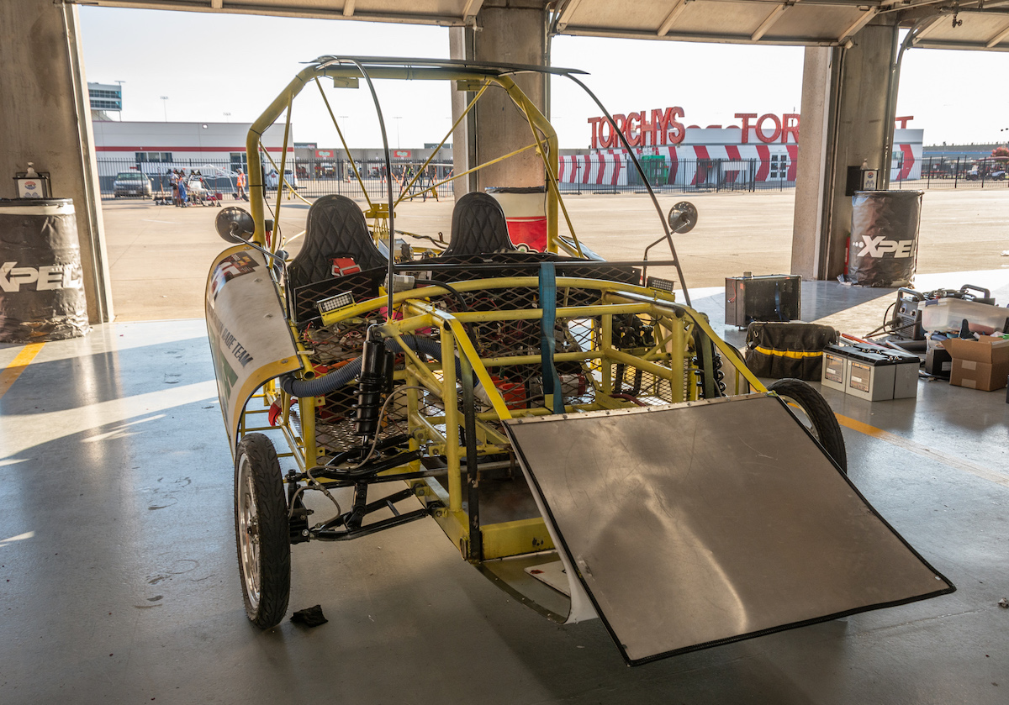
Roll Bar Example
Sufficient vertical clearance
Continuous piece of metal
Side View
Front View
Note: Cruiser Division Cars must have a roll bar per row of seats.

Slide 12
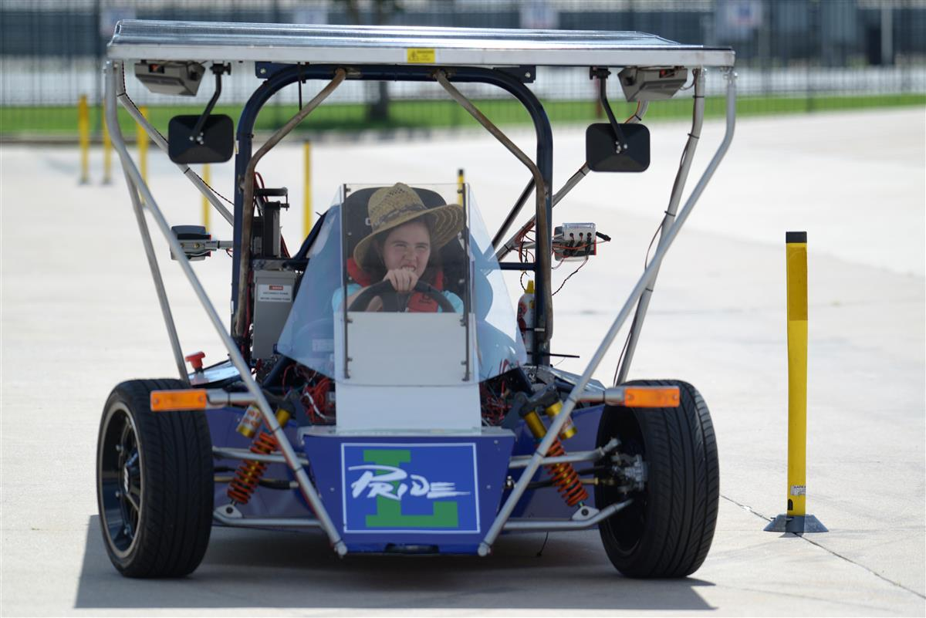
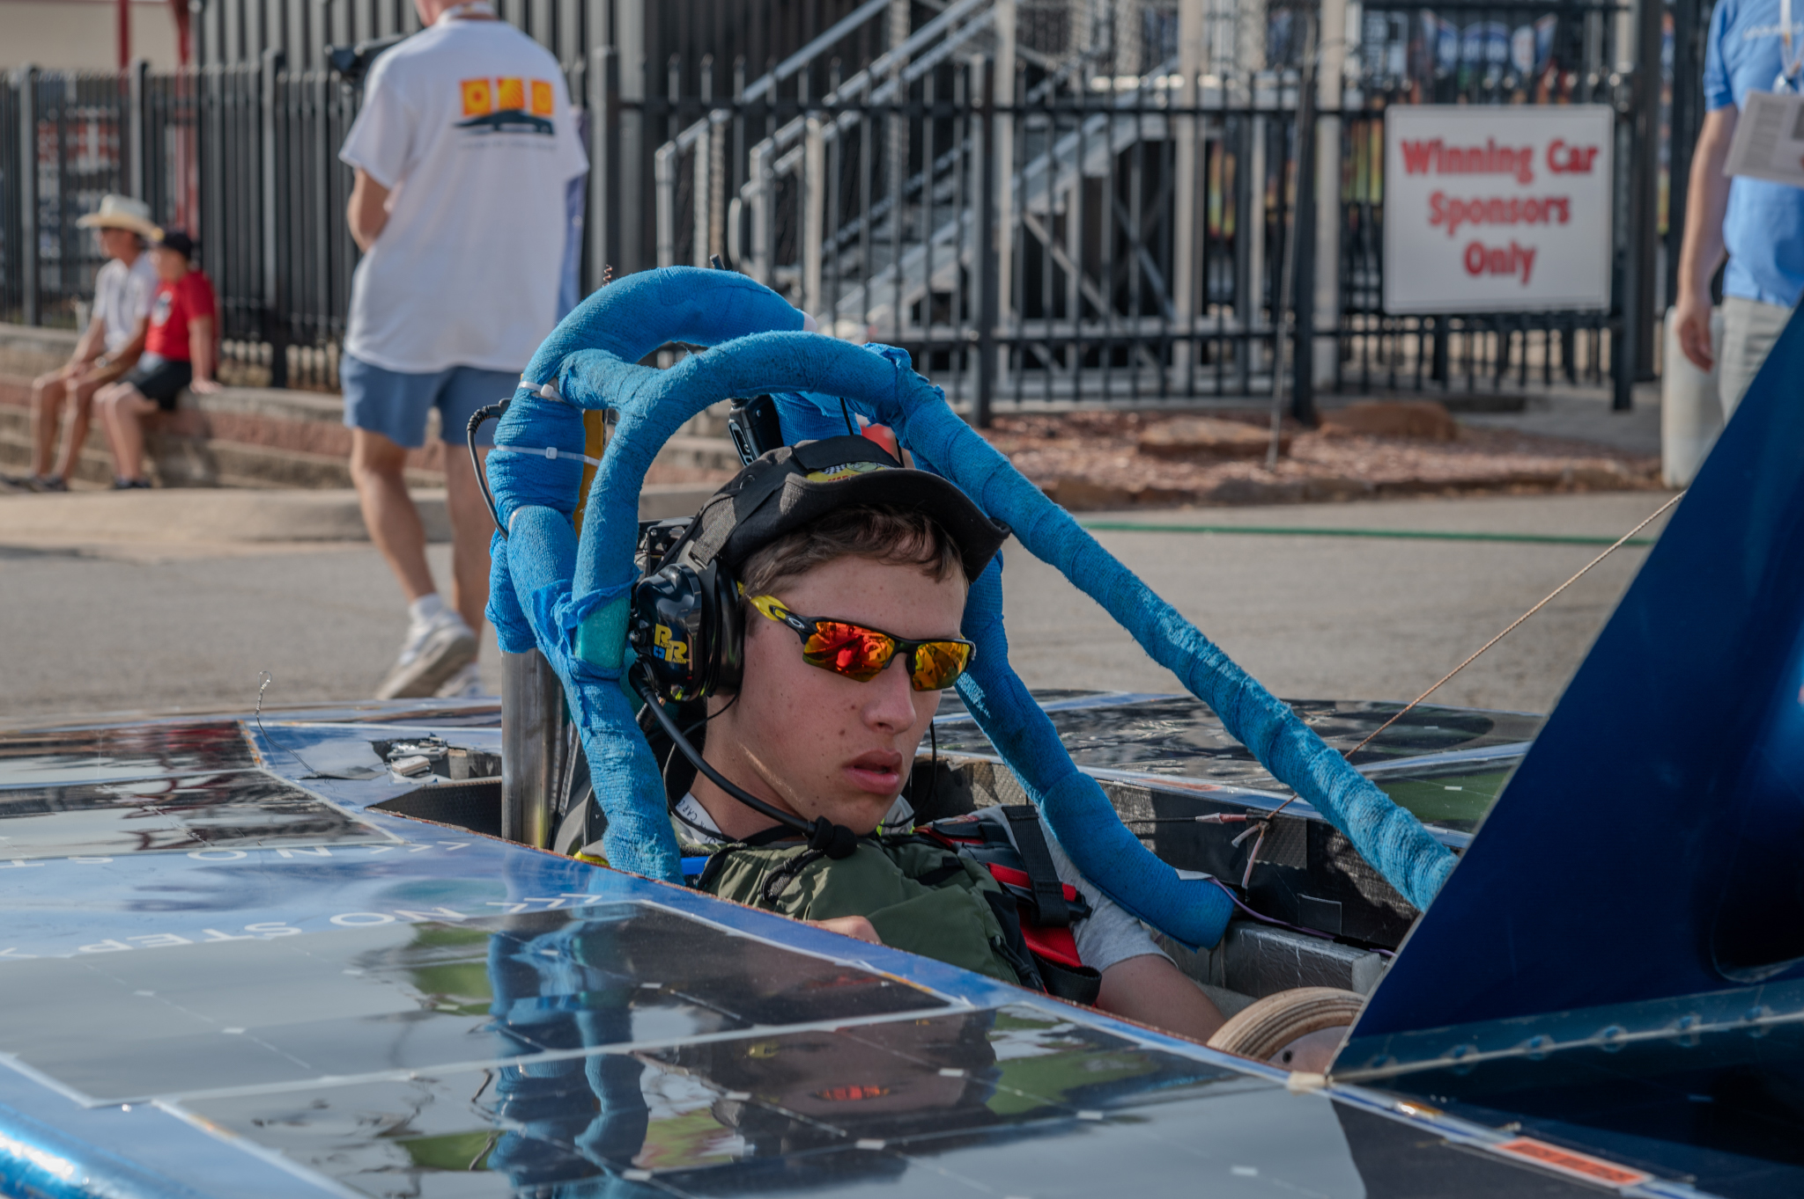
Roll bar Design styles

Slide 13
Crush Zone
Crush zone must:
  be designed to absorb impact from a collision
  protect the driver from front, side, and rear collisions
  have a minimum of 15 cm of horizontal distance from all parts of the driver’s body
  Have a minimum of 30 cm vertical distance and encompass the driver’s lower torso.
  Battery box must be protected by the crush zones, not in the crush zone.
Insufficient regard for structural safety will result in disqualification from the race.

Slide 14
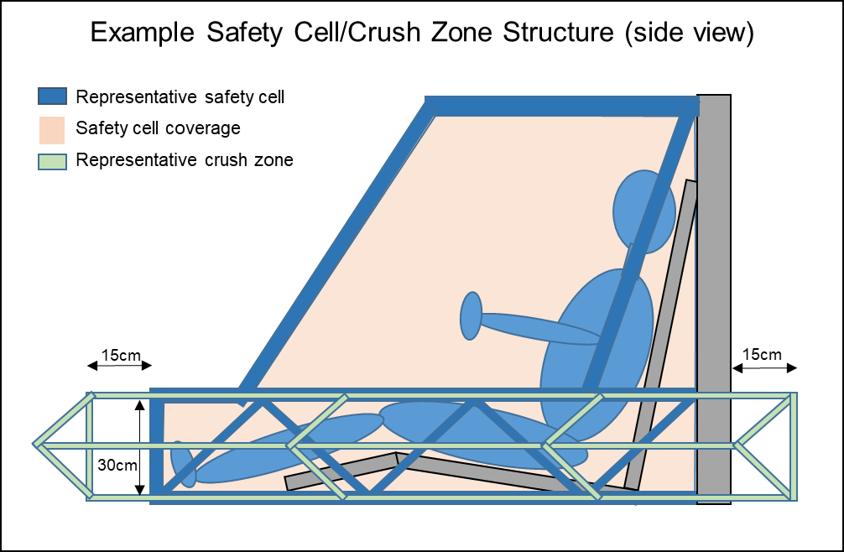
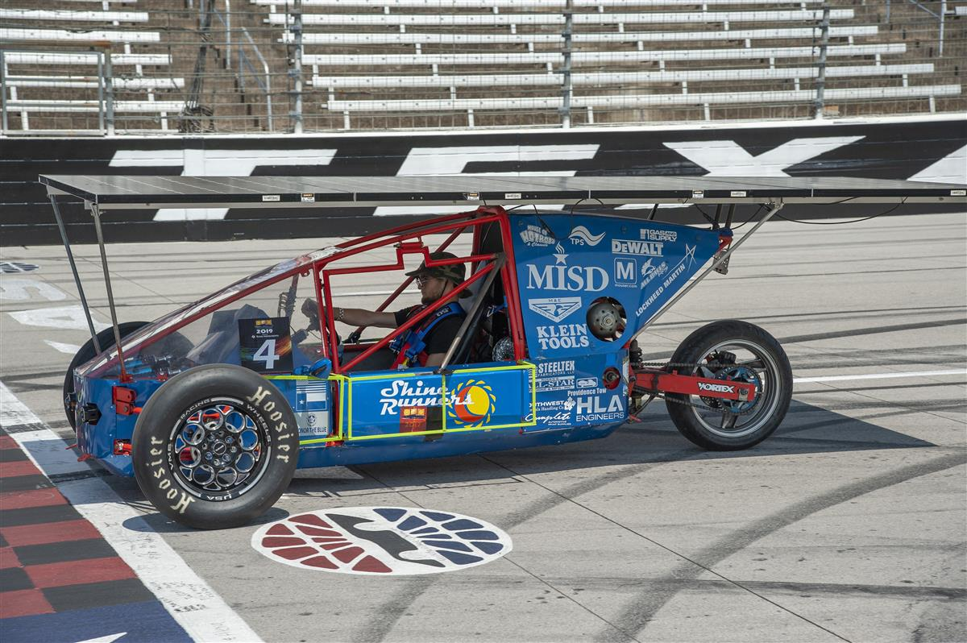
Crush Zone Structure

Slide 15
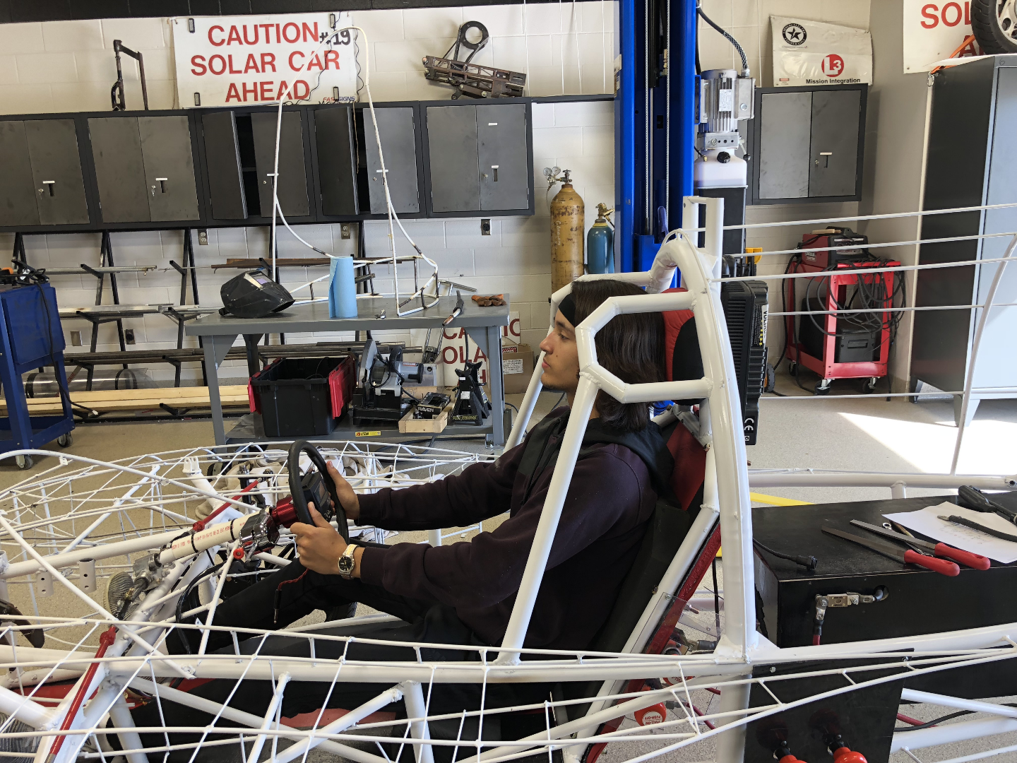
Safety Cell/ Roll Bar / Crush Zone Example
Roll Bar – continuous piece of metal; protects driver in event of rollover
Crush Zone structure – thin material designed to collapse on impact
Roll Cage – rigid protection encompassing entire driver

Slide 16
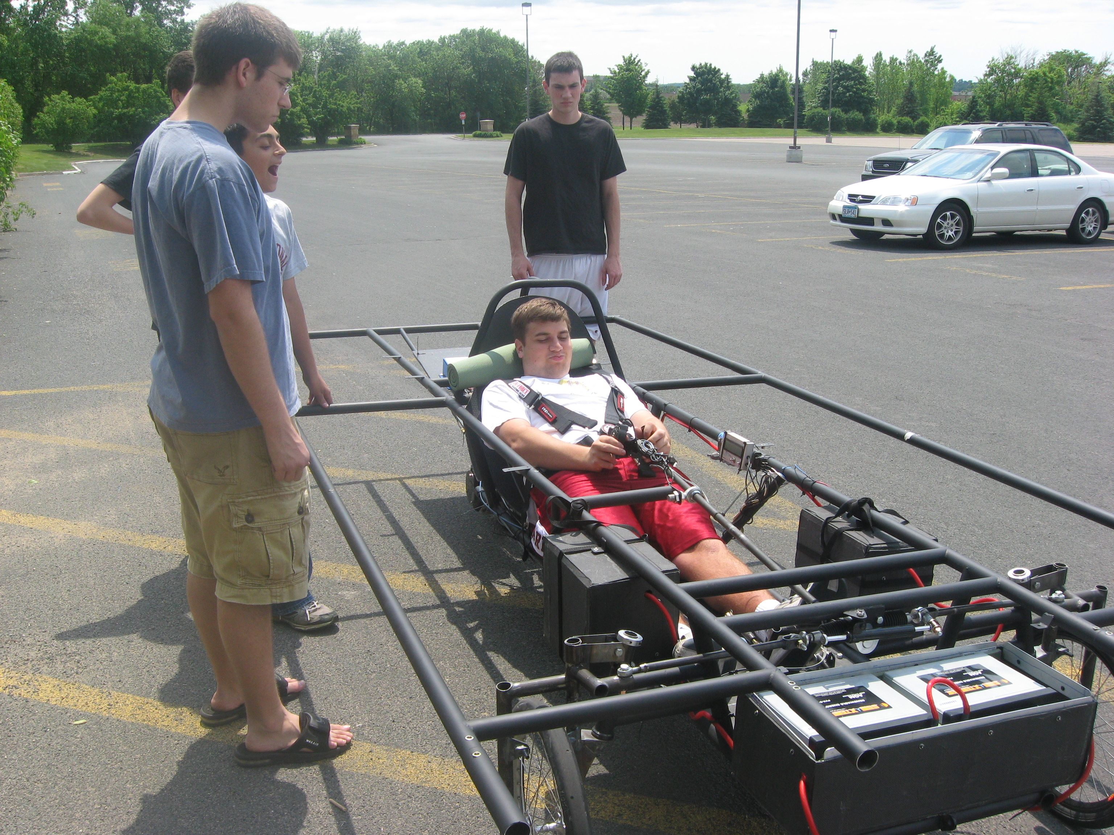
Safety Cell/ Crush Zone Example
Crush Zone – would prefer a structure less rigid and deflects away from the driver. Also violates the 30 cm of vertical distance required by new cars.
Roll Bar – Welded at more than 2 points; continuous; however, does not comply with the thickness requirement
Safety Cell– good use of strong structural components; need additional coverage for driver’s upper torso
Note: Crush zones do not need to be made of metal or welded to the frame

Slide 17
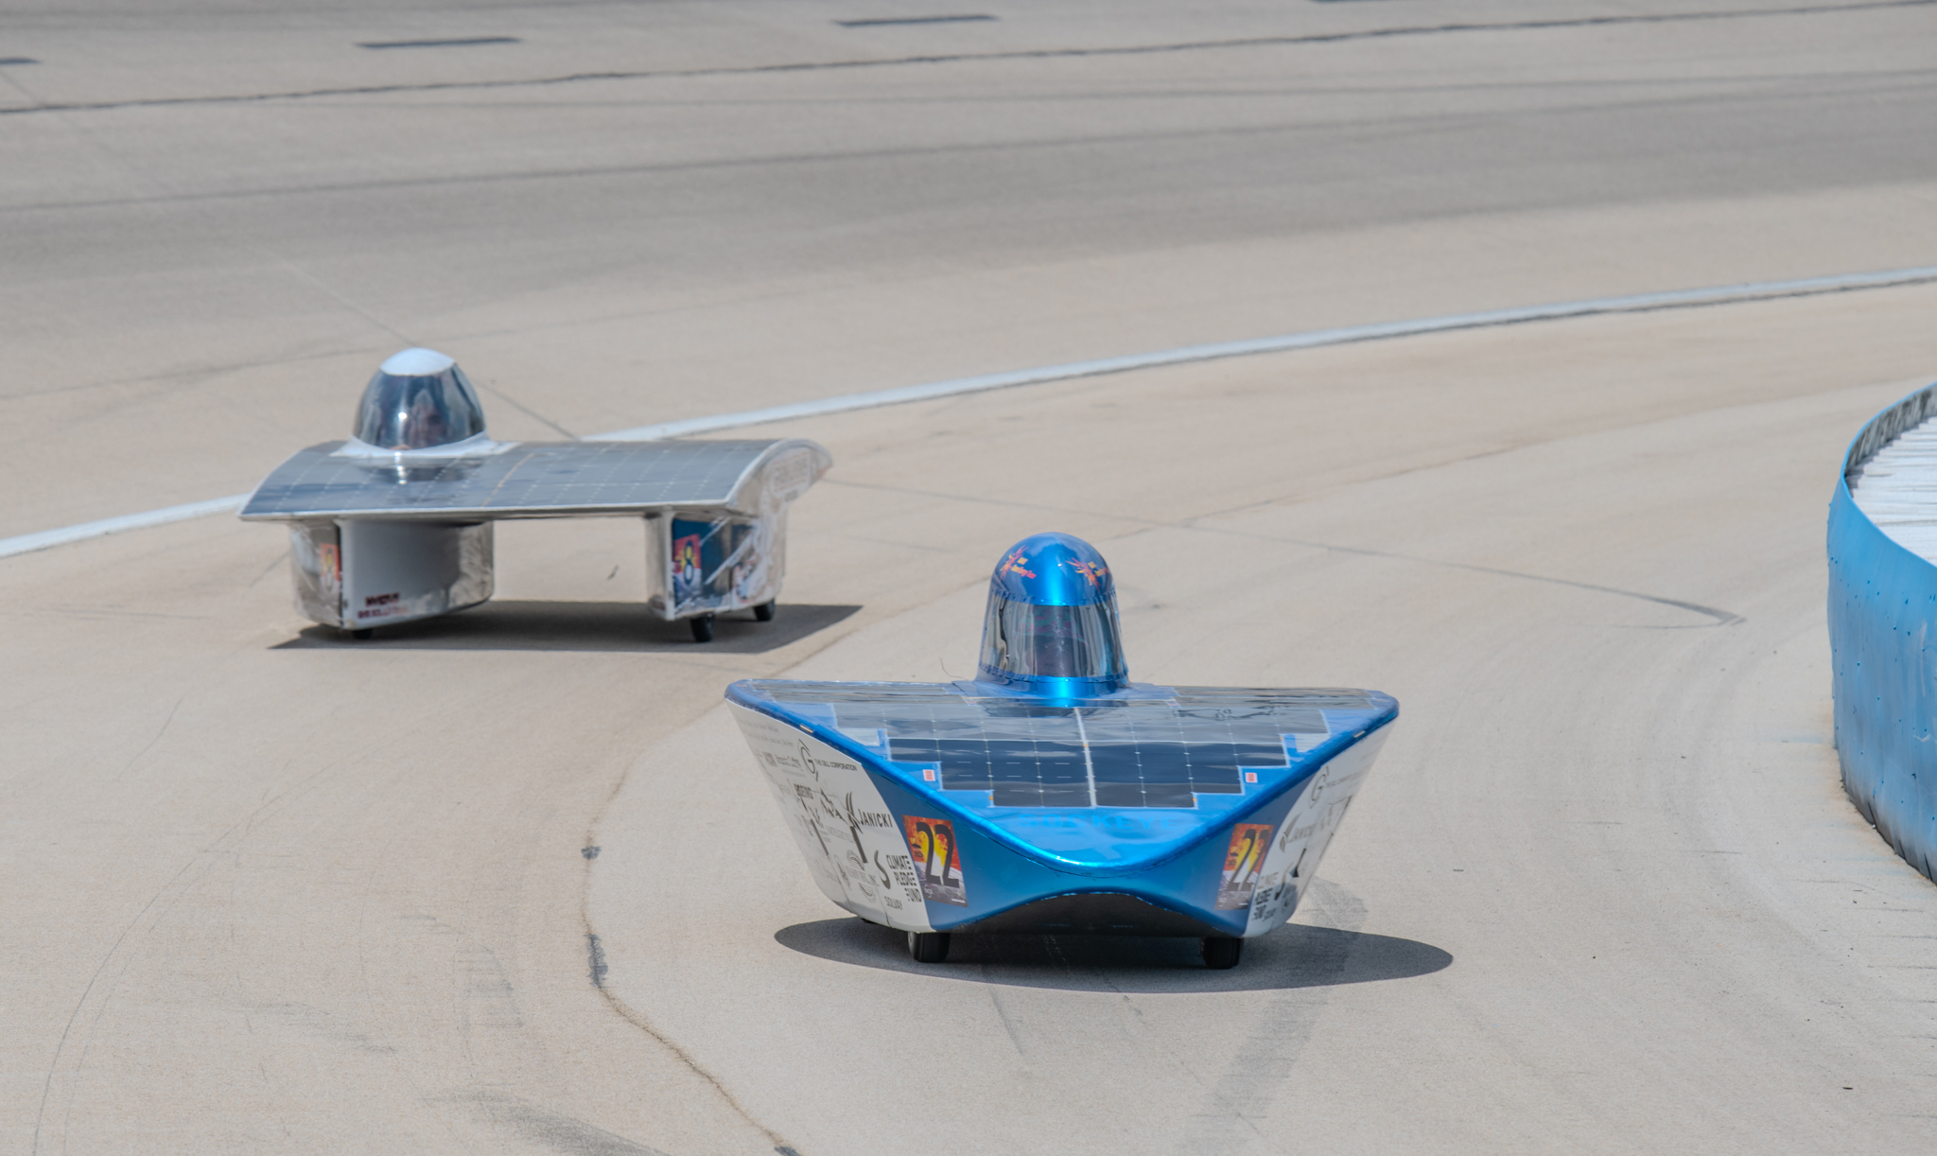
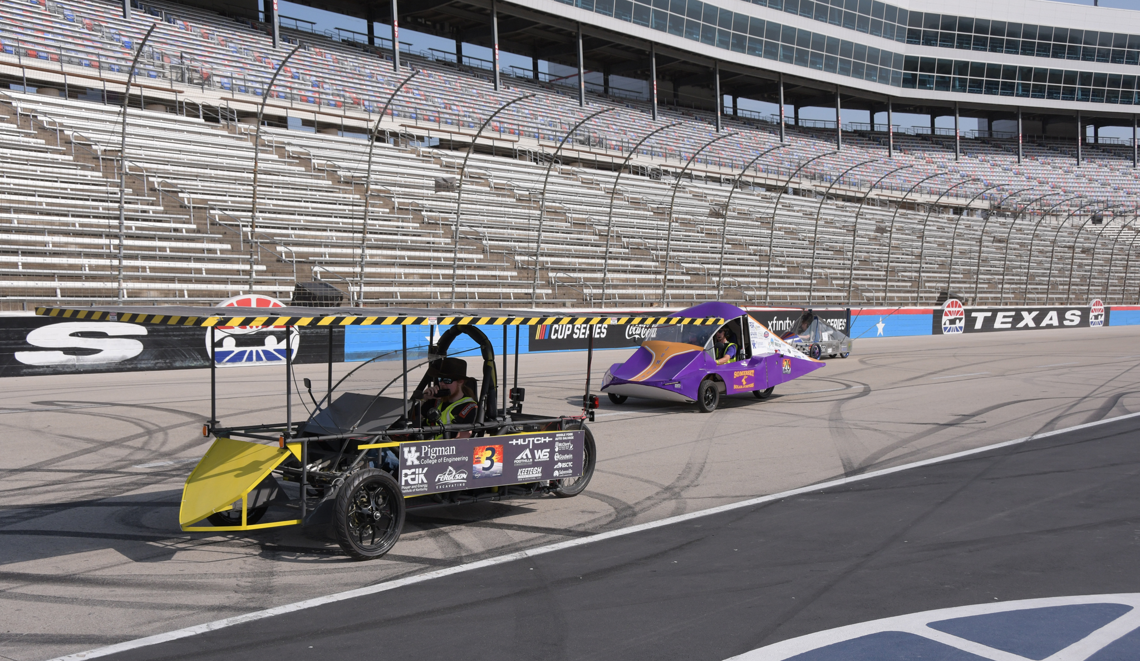
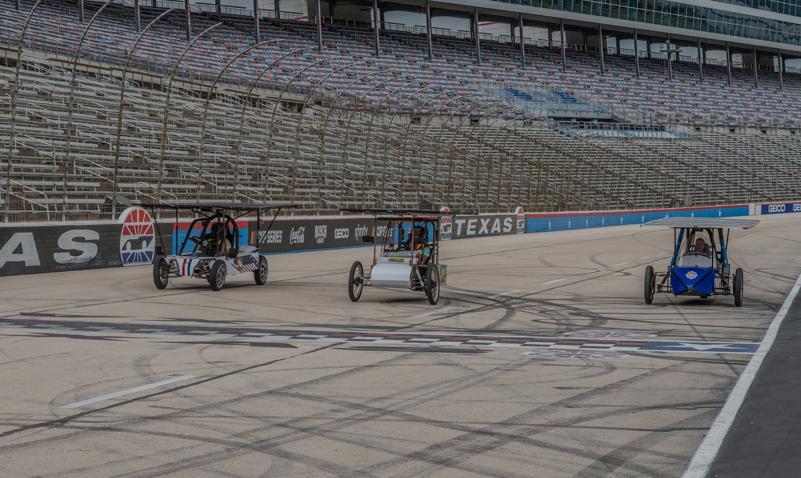
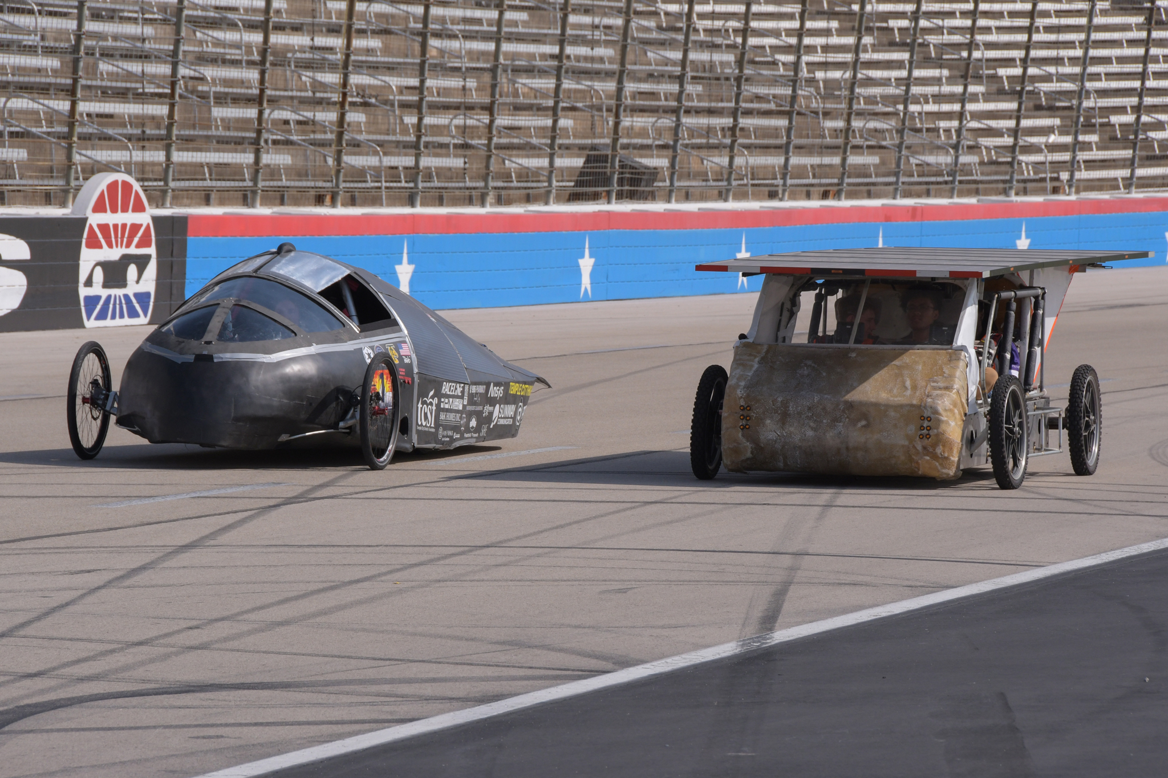
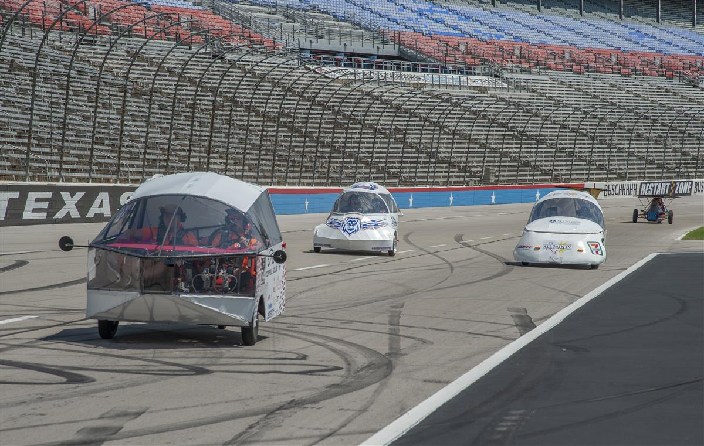
Building the Vehicle Frame
Materials
Safety Cell, Crush Zone and Roll Bar
Suspension and Steering
Wheels and Brakes

Slide 18
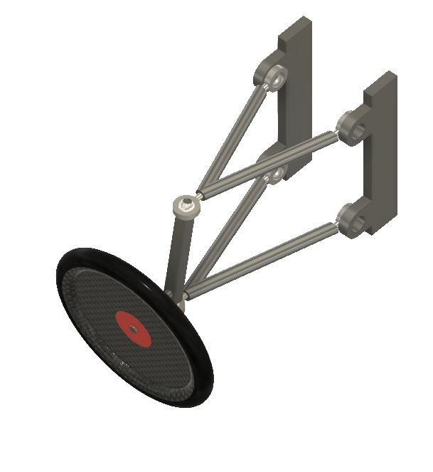
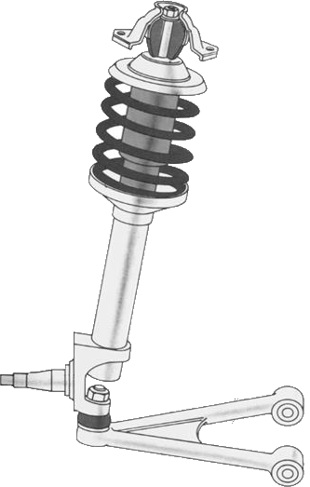

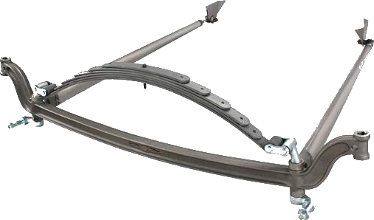
Common Front Suspension Types
MacPherson Strut
Solid Axle
Dual A Arm

Slide 19
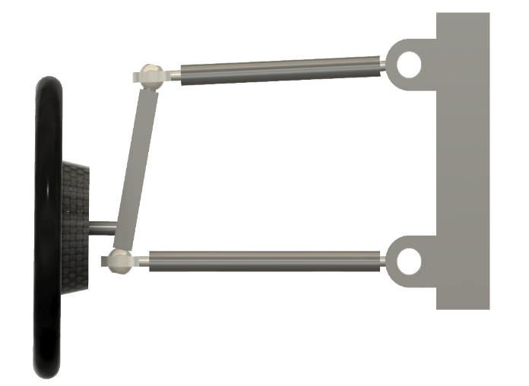
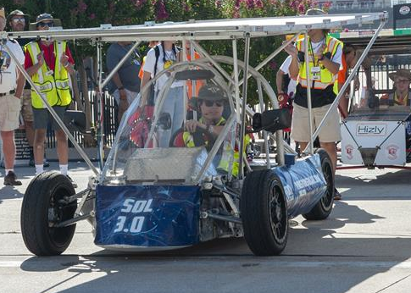
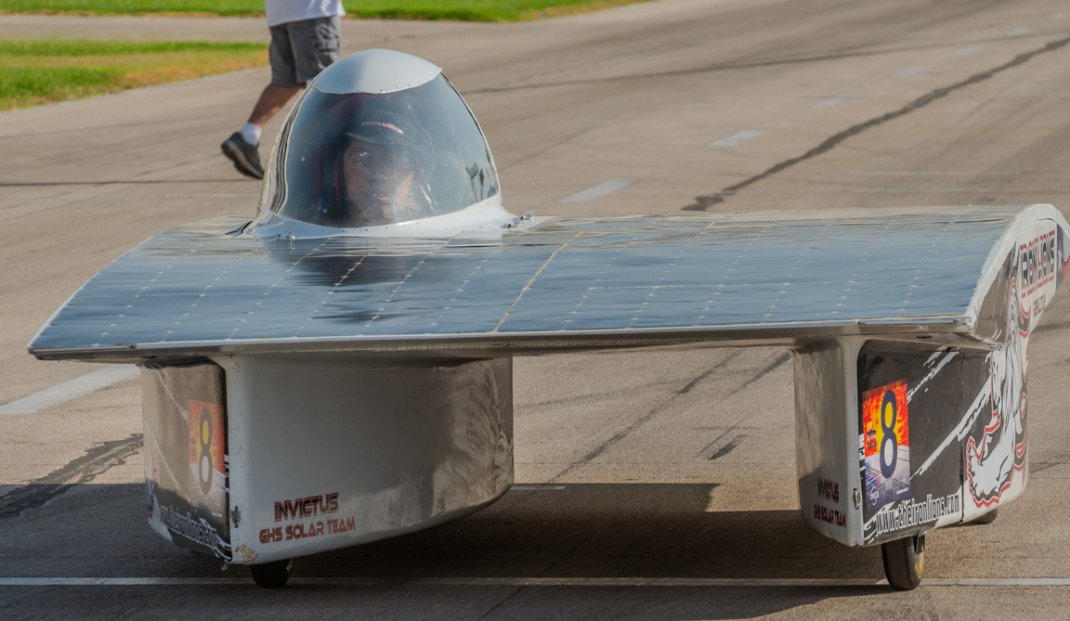
Suspension/Steering Considerations
Contact Patch
  Oval shaped area where tire contacts the road
Steering Axis
  Line between two pivot points of the wheel
Side
Top
Side
Top
Ideal
Real

Slide 20
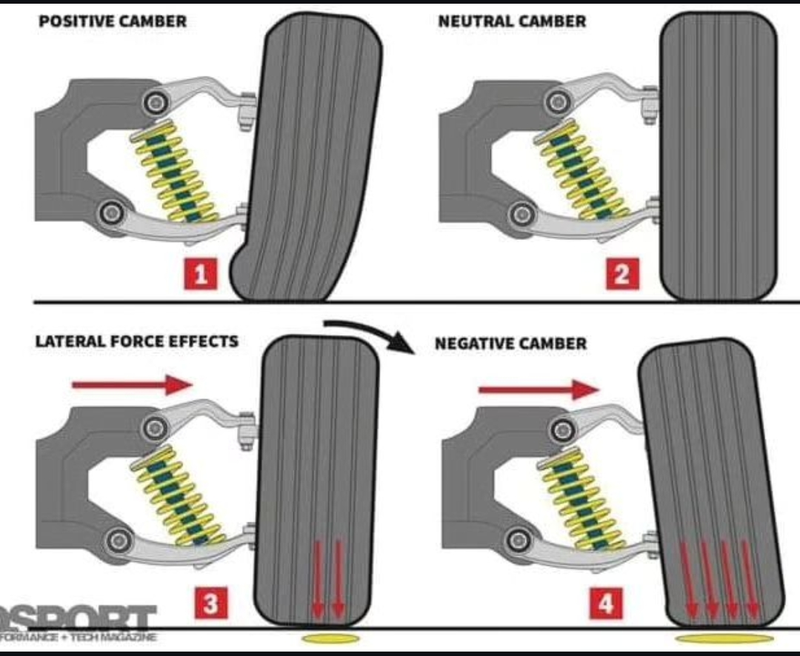
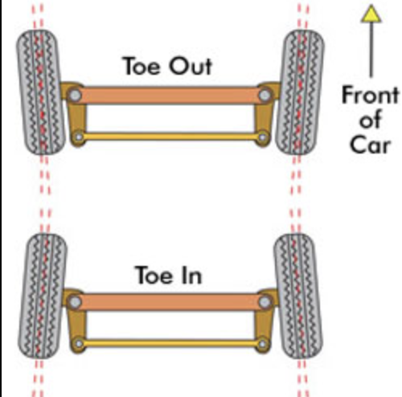
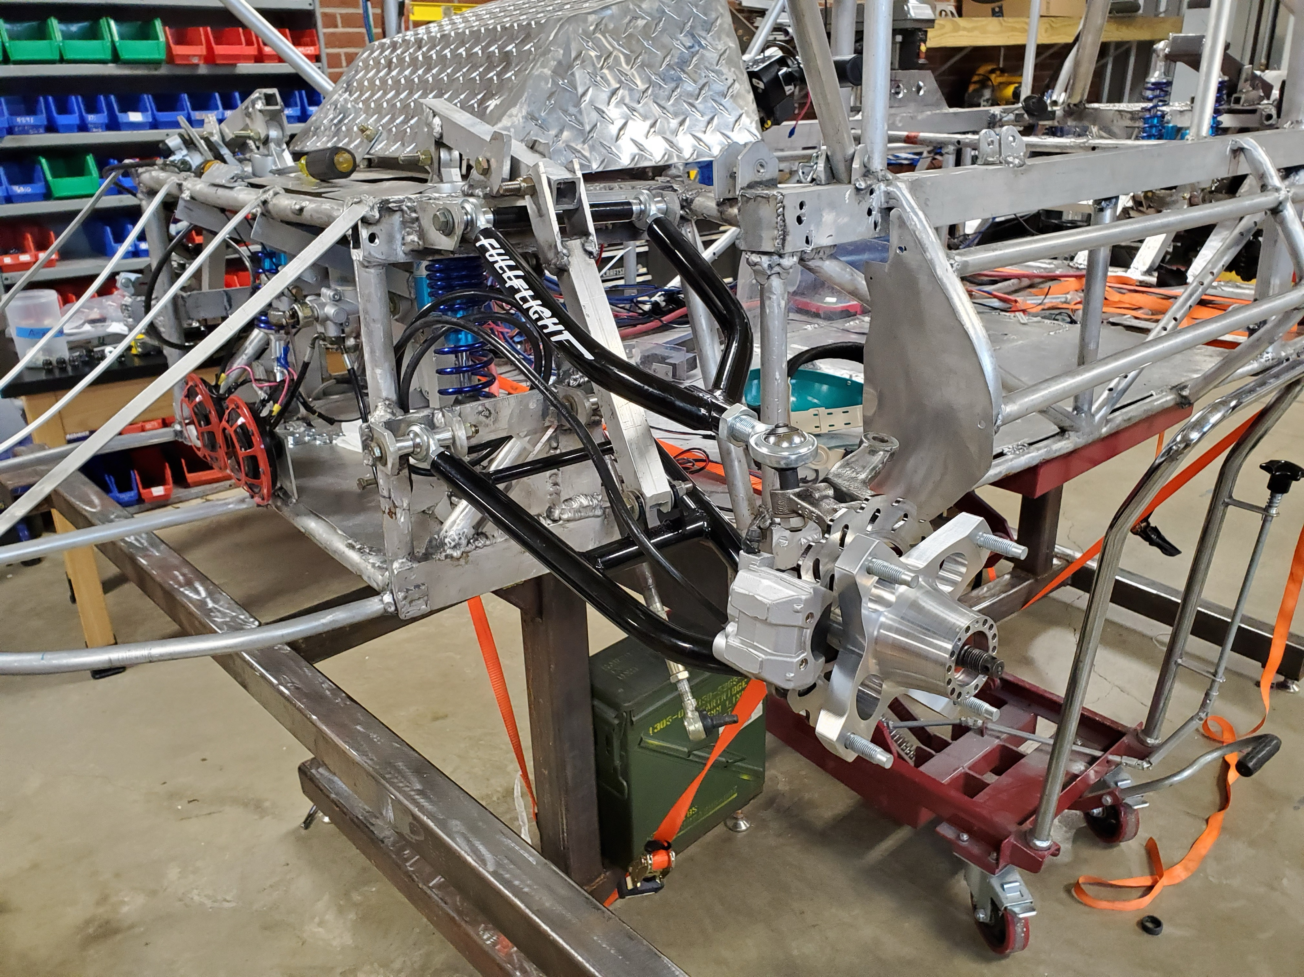
Steering Geometry
Toe
  Angle of the wheel and tire pointing away from the centerline of the vehicle
Caster
  The angular displacement of the steering angle for the vertical axis
Camber
  The angle of the wheel and tire with respect to the vertical axis
Scrub Radius
  The distance between where the steering angle intersects the ground and the contact patch of the tire
  Tip: Wheel alignment can play a major role in the efficiency of solar cars/ and wear on tires.

Slide 21
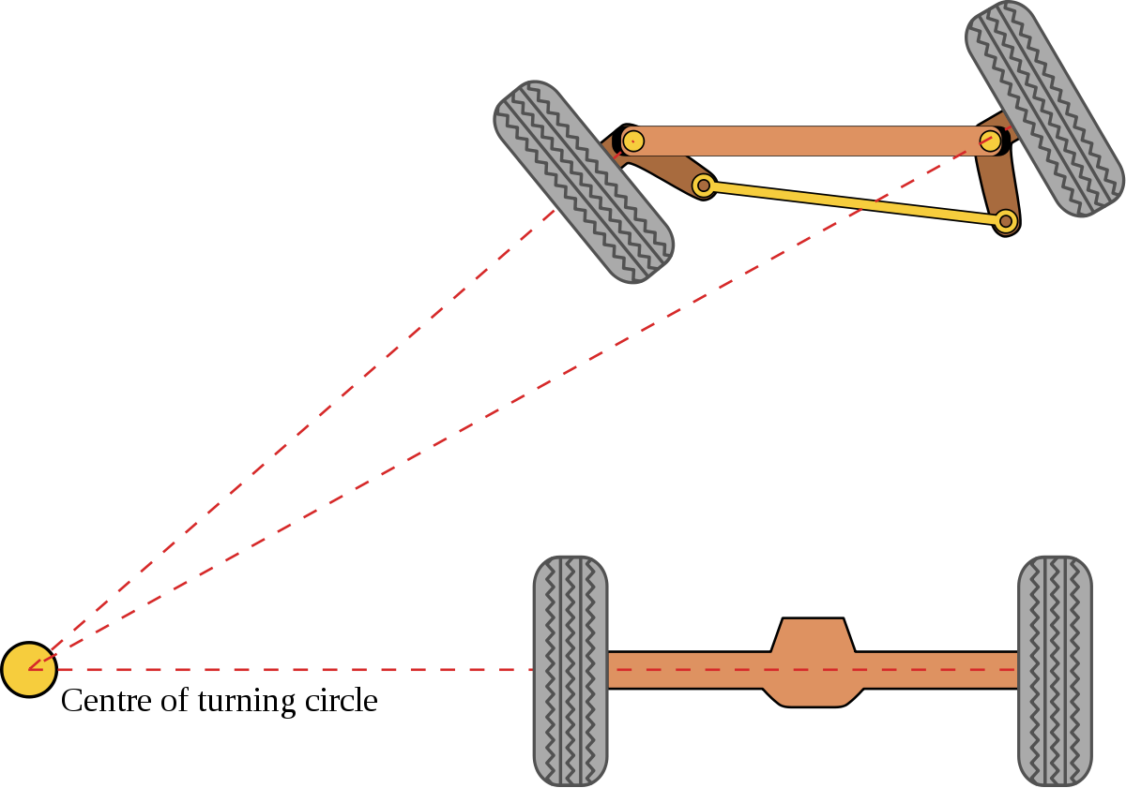
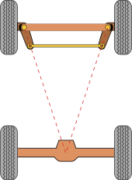
Ackerman Steering
Importance:
  Avoiding tires to slip sideways when following the path around a curve at lower speeds
Disadvantages:
  Neglects centrifugal force generated and countered by a cornering force acting on each tire. This causes the flexible tires to generate increased slip angles at higher speeds.

Slide 22
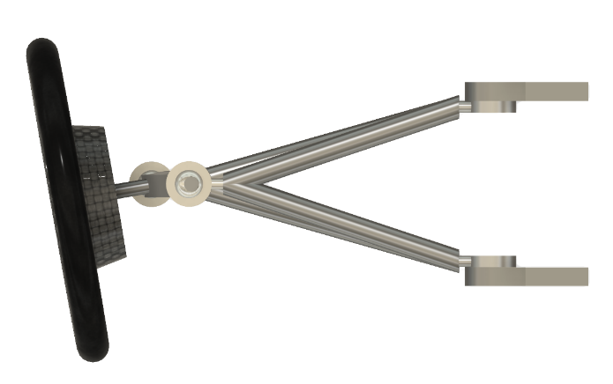

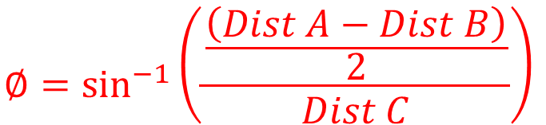
Measuring Toe
Front
$$∅=\sin^{−1}\left(\frac{\frac{\left(Dist A−Dist B\right)}{2}}{Dist C}\right)$$
Dist A
A2
A1
$$Toe=\left(Dist A−Dist B\right)$$
Dist B
C
B1
B2

Slide 23
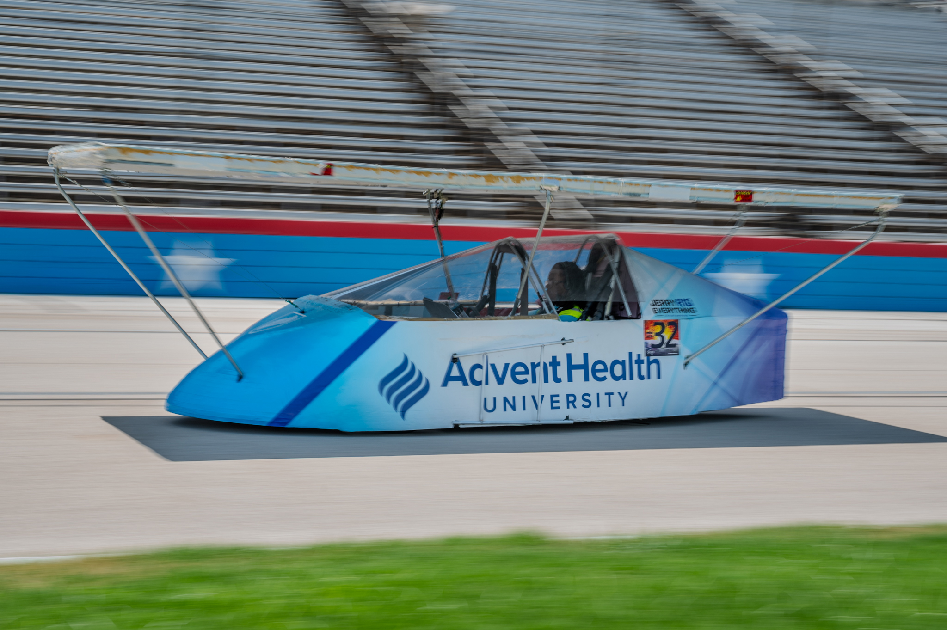
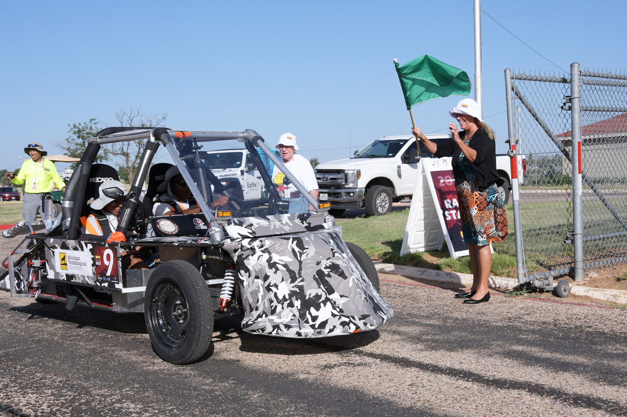
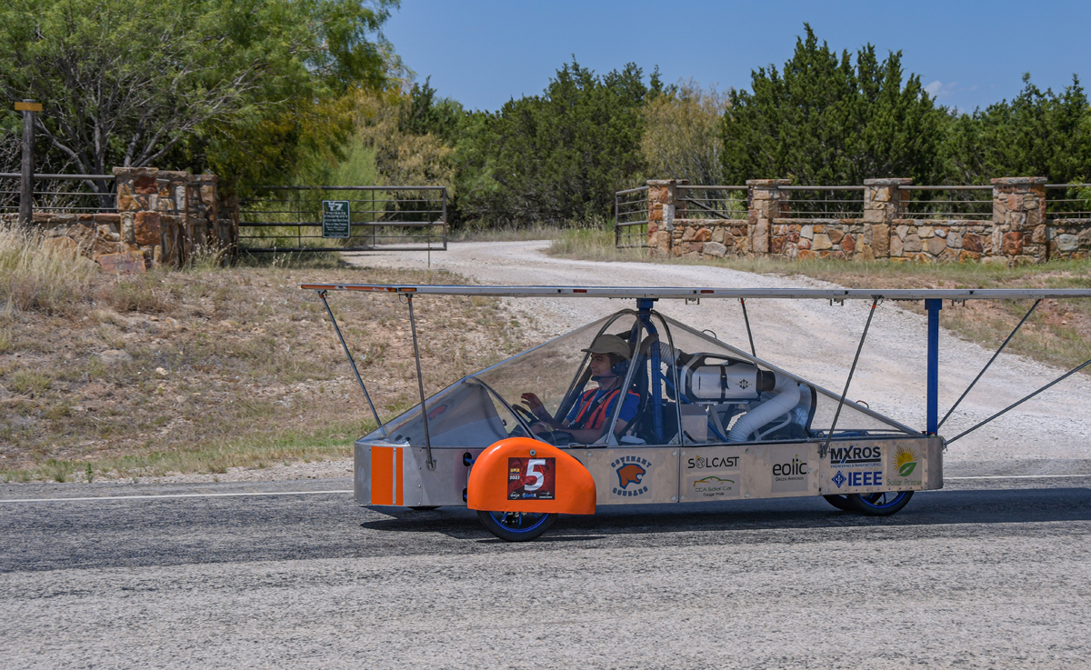
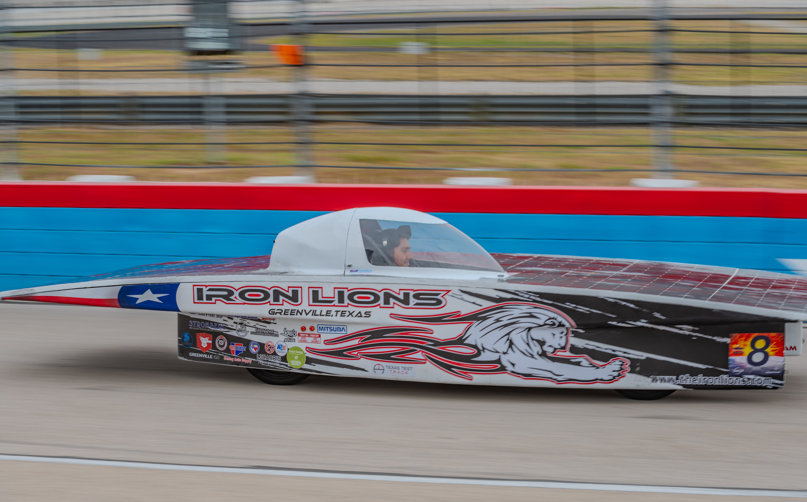
Getting your car rolling
Materials
Safety Cell, Crush Zone and Roll Bar
Suspension and Steering
Wheels and Brakes

Slide 24


Wheels
One of the most difficult parts to source
Choices need to be made very early in the design process
Three wheel designs:
  Lighter
  Easier to align
  Less expensive
  Not as safe

Slide 25



Wheels Cont.
Four wheel designs
  More parts means higher cost
  Harder to get alignment correct
  Weight distribution less critical
  Much safer in the event of a flat
  Can “straddle” dead animals on the road
Note: Required for Cruiser Division

Slide 26

Rim/Wheels
Wheel choices (must be able to handle the weight of the car and lateral forces from turning)
  NGM wheels and tires
  Motorcycle
  Junior Dragster
  Bicycle
  ATV/UTV

Slide 27



Rim/Wheel Choices

Slide 28




Brakes
Solar cars must have two independent braking systems that allow the driver to stop the vehicle safely and quickly.
Most cars use hydraulic disk brakes
ATV brakes – Cheap, fits standard atv spindles, but lots of friction of rotor
MCP brakes - great options, adjustable spacing, but can be expensive

Slide 29


Brake Pedals
Brake pedals must also be independent
  Pedals, master cylinder, etc. separate for each system
Can not “link” pedals together
Must be operated by foot (no hand brakes)
Must be automotive style pedals
Note: Brake lights must be independent from turn/ hazard lights.
X

Slide 30


Brake Testing
Brakes are tested both statically and dynamically at the event.
  Static = Test strength of brakes at rest
  Dynamic = Test how fast brakes can stop car
Many vehicles have brake problems.
Tips:
  Test before arriving at the event.
  You have access to the scrutineering booklet - simulate braking station.

Slide 31
Mini-Course in Mechanical Engineering
Construction and Materials Technology
Triton Shoup, Chief Mechanical Judge

