Slide 1
What to Expect from a Cross-Country Race
Presented by Brandon Ching

Slide 2
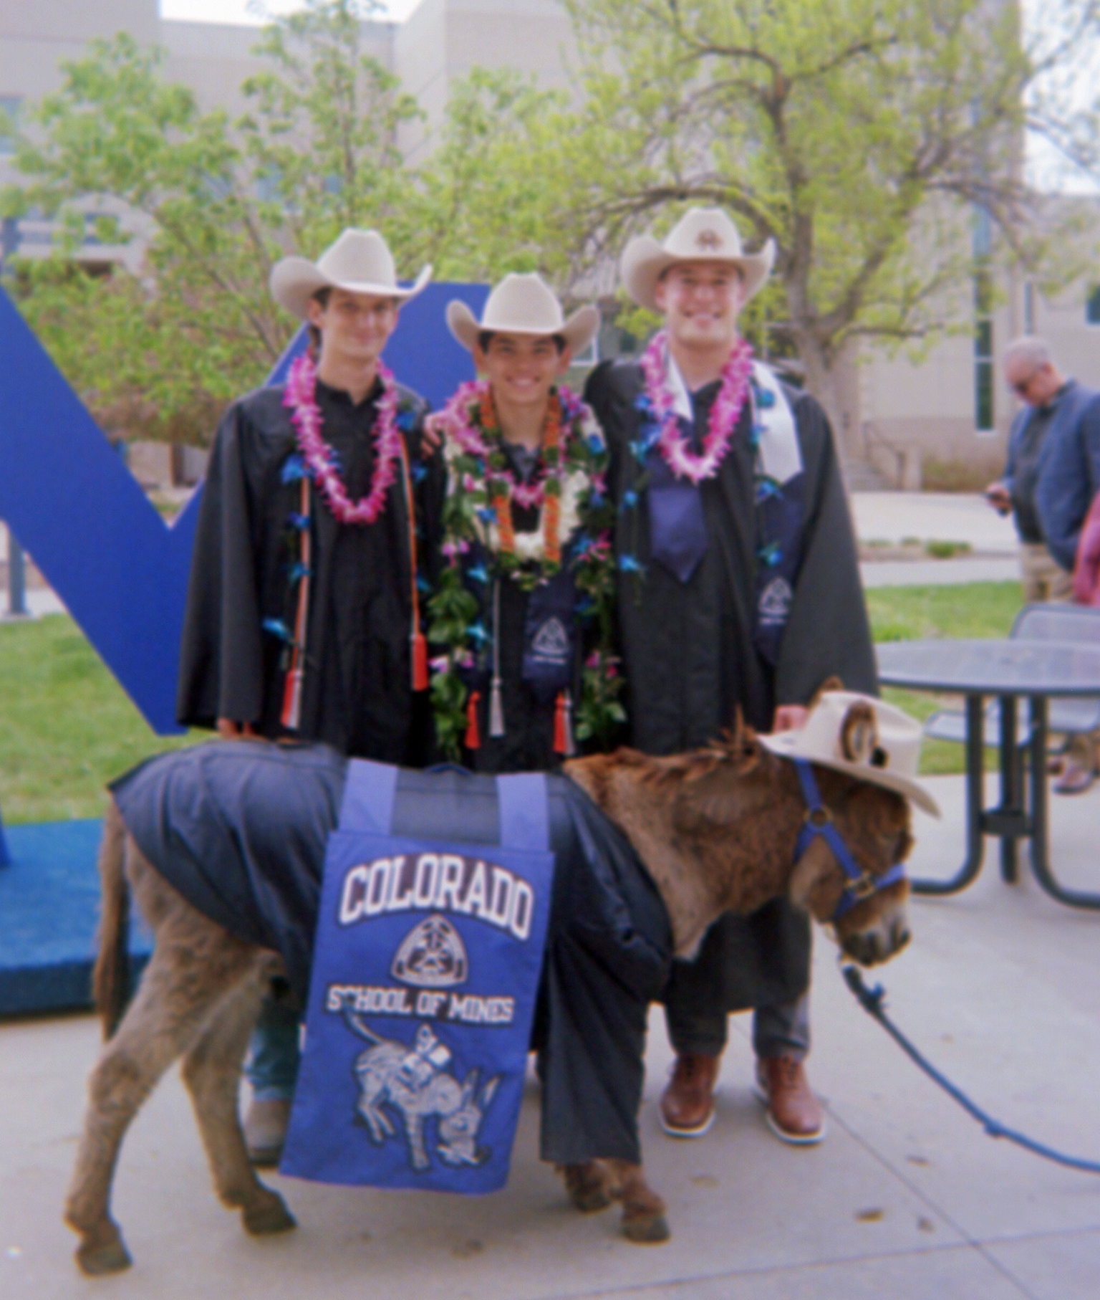
Introduction - About Me
Coppell Solar Racing Team
2018 Cross-Country Fort Worth TX -> Palmdale CA
2019 Track Race
Intern/Judge
2021-2022 Track Race
2023 Cross-Country Fort Worth TX -> Palmdale CA
2024 Track Race
Appointed to the Foundation Board of Directors during the 2024 event
Colorado School of Mines
BS in Mechanical Engineering
BS in Computer Science
Lockheed Martin
Aeronautical Engineer

Slide 3
2025 Cross-Country Race
Race Around Texas!
1,200+ Drivable Miles
Start at Texas Motor Speedway
3 Scrutineering Days
5 Racing Days

Slide 4
Scrutineering – Texas Motor Speedway
7 Stations
1 – Meeting General Requirements (Mechanical)
2 – Electrical and Battery Requirements
3 – Tilt and Turning Radius
4 – Slalom
5 – Braking
6 – Endurance
7 – Road Test (Cross-Country Only)
*8 – Electric-Solar Powered
*9 – Cruiser
*Stations 8 & 9 are only required for their respective divisions

Slide 5
Scrutineering for a Road Race
Additional Station 7 Road Test
Simulate vortices created by a passing truck
Higher Standard vs Track Races
Tips:
Don’t focus on a single station
PRACTICE!
Know what each station is checking
Be prepared for questions

Slide 6
2023 Cross Country Race
Fort Worth TX -> Palmdale CA
3 Scrutineering Days
7 Racing Days (+ 1 rest day)

Slide 7
2023 Route

Slide 8
Team Logistics
Staying in a different location each night
Transporting all of your equipment, luggage, students, and advisors
Teams are responsible for most meals, some will be provided by the race
Restrooms are few and far between

Slide 9
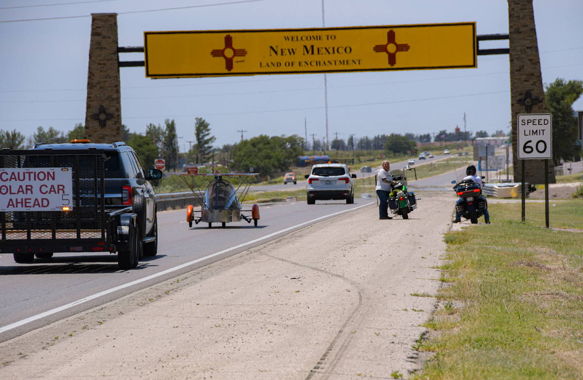
Race Convoy
Lead Car
Solar Car
Chase Vehicle 1 – Race Judge in Front Passenger
Chase Vehicle 2
Additional vehicles MUST be 1 mile or more away from their team’s convoy

Slide 10
Race Convoy
Traffic Laws Still Apply! and designated race rules
General procedures and more information will be provided closer to the event
EV Teams: The charging station MUST be secured to a trailer

Slide 11
2023 Day 1 Route – Mandatory Trailering

Slide 12
Example Race Day
06:30 AM Impound Opens
08:00 AM All Teams Meeting
09:00 AM Race Start
10:00 AM Required Rest/Trailering
12:00 PM Lunch
03:30 PM Media Stop
05:00 PM End of Race Day
09:00 PM Impound

Slide 13
06:30 AM Impound Opens
Teams gain access to Solar Cars
Pick-up race judge
Teams can:
Charge
Maintenance
Repairs/Modifications

Slide 14
8:00 AM - All Teams Meeting
Mandatory daily meeting
General announcements
Previous day Winner trophies
Begin race start lineup

Slide 15
09:00 AM Race Start
Teams released in 1-minute intervals
Day 1 Numerical Order
Following days, based on day prior results
Full convoy

Slide 16
10:00 AM Required Rest/Trailering
Typically 15 minutes

Slide 17
12:00 PM Lunch
Typically 30-minutes
Teams provide lunch for the race judge

Slide 18
03:30 PM Media Stop
Press interviews
Community Engagement
Typically 15-minute minimum stop
Highly encourage you to
Drive Solar Car in/out of the stop
Be on time

Slide 19
05:00 PM End of Race Day
Ends in delta time based on release order
Pick up car and trailer

Slide 20
09:00 PM Impound
Teams lose access to Solar Cars
Until impound, Teams can:
Charge
Maintenance
Repairs/Modifications

Slide 21
Scoring/Auditing the Race
Distance driver by Solar Car
GPS based
Only score on the race route
Daily Audit of results

Slide 22
Questions?

