Slide 1
Specialty Workshop
Solar Car Challenge

Slide 2
Levels of Participation
  Classic
  Advanced Classic
  Advanced
  Solar-Electric (New Division!)
  Cruiser

Slide 3
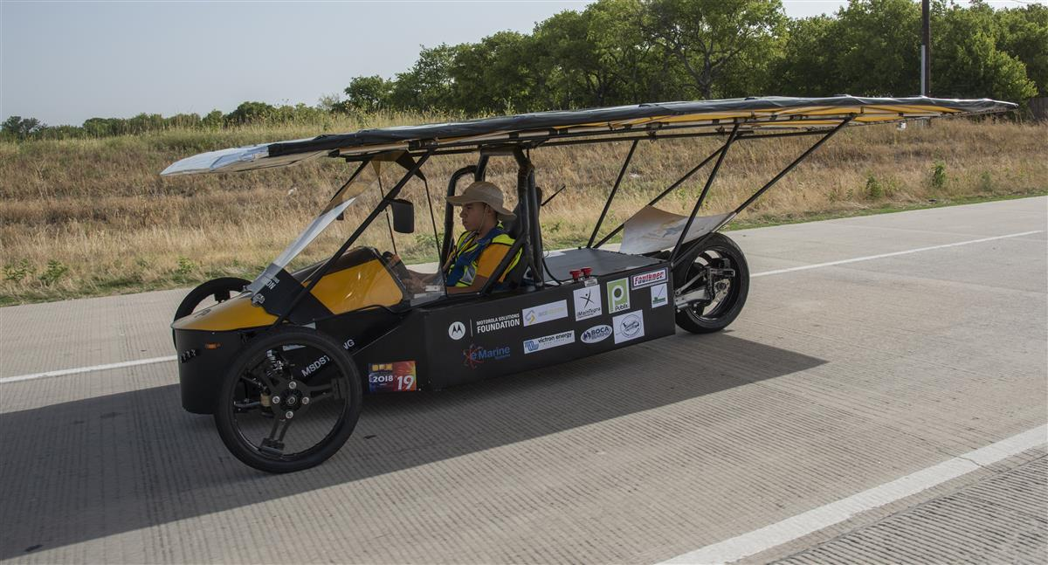
Classic Division
Solar cells less than 19% efficient
No hub motors
Lead/Acid Batteries
2018 Classic Division Champion: Solar Cats

Slide 4
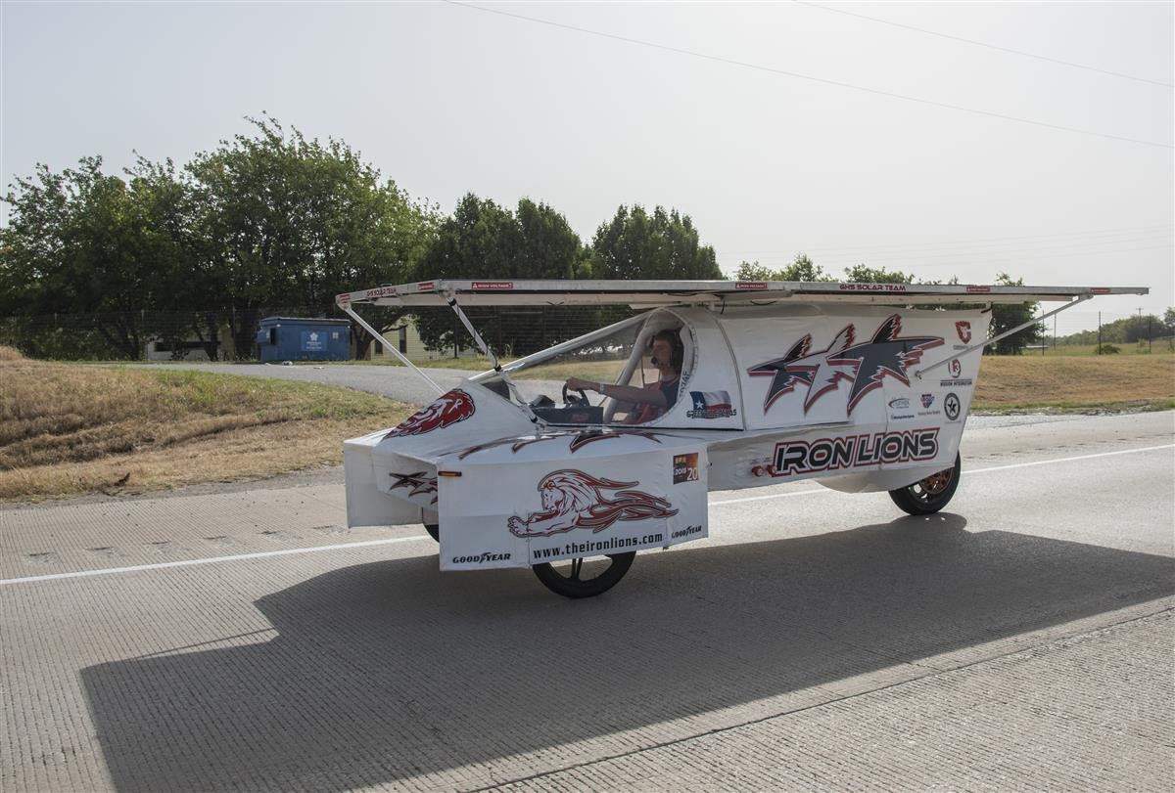
Advanced Classic Division
Same as Classic Division
*New*: Teams participating more than 2 years
2018 Advanced Classic Division Champion:
Iron Lions

Slide 5
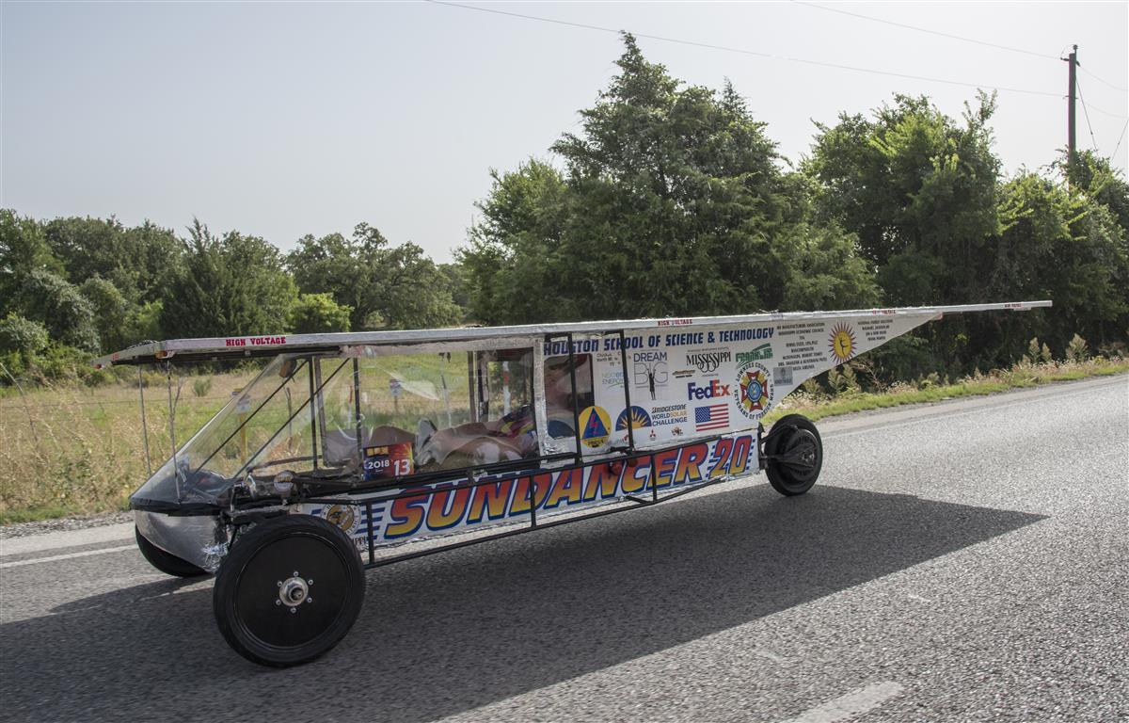
Advanced Division
Solar cells limited by cell cost
Any Motor
Any battery chemistry
Use of University body molds is allowed
2018 Advanced Division Champion: Houston Solar Race Team

Slide 6
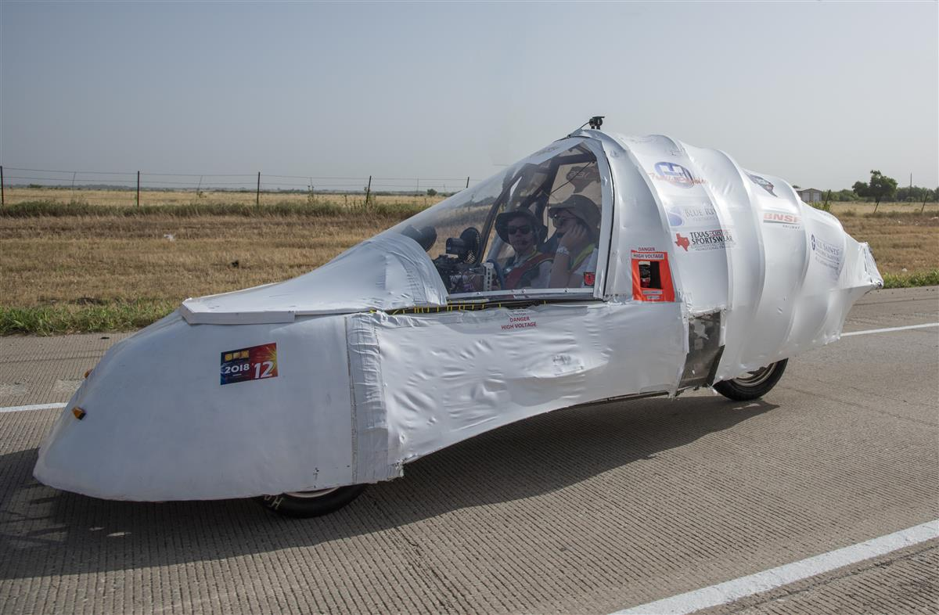
Electric-Solar Powered Division
19% Solar Cell Efficiency
No hub motors
Two-person vehicle
Pb-Acid (2 packs x 2Kw.h)
Separate Charging Station
2018 Electric-Solar Powered Division Champion: All Saints

Slide 7
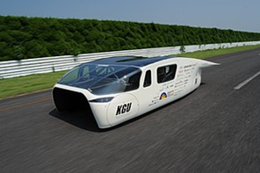
Cruiser
* New Division *
Four-seater
Solar Array attached to the body of the solar car
Body totally encloses the solar car
Advanced Division requirements

Slide 8
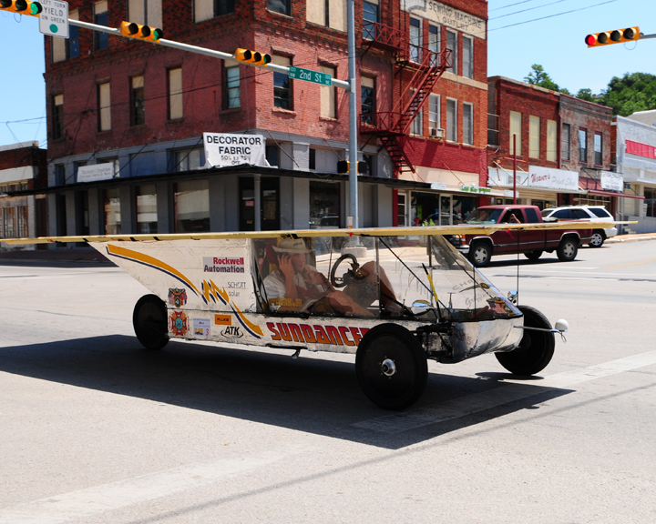
Getting your car rolling
Building the Vehicle Frame
  Materials
  Roll bar and Crush Zones
  Suspension and Steering
  Wheels and Brakes

Slide 9
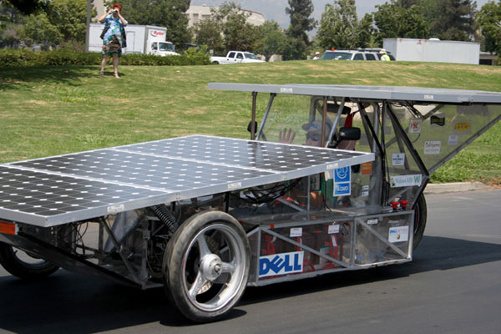
Material for the frame
Steel
  Mild/Carbon Steel
    Really easy to work with (MIG welding)
    Inexpensive (<$1/foot)
    Heavy
    Can be easily changed/modified
    Readily accessible
    Comes in a large variety of sizes and wall thicknesses

Slide 10
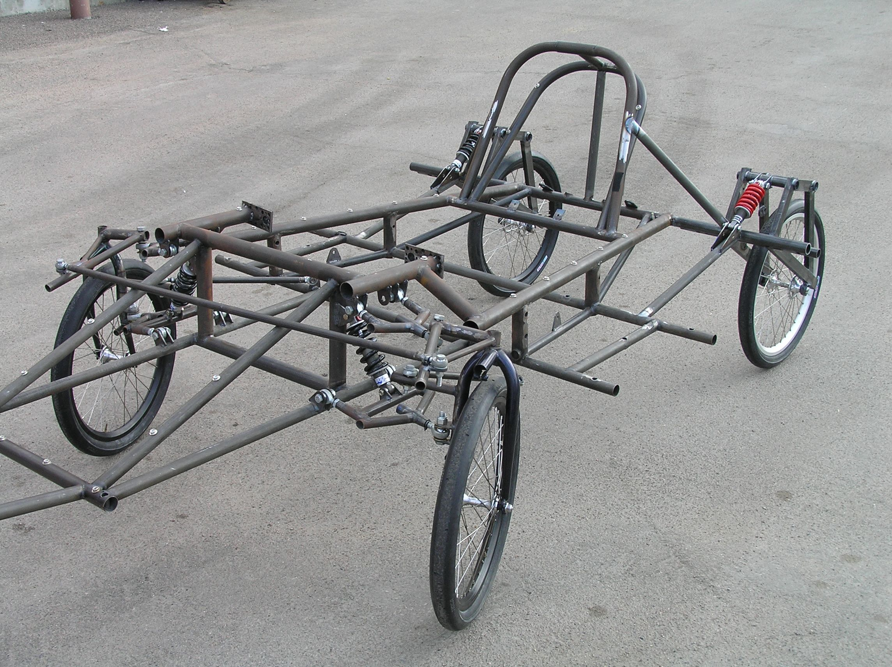
Material for the frame
Steel
  Chromoly Steel
    Harder to weld (requires TIG welding)
    More expensive ($4/foot) (+welding wire @ $15/lb)
    Light weight
    Can be easily changed/modified
    Comes in a large variety of sizes and wall thicknesses

Slide 11
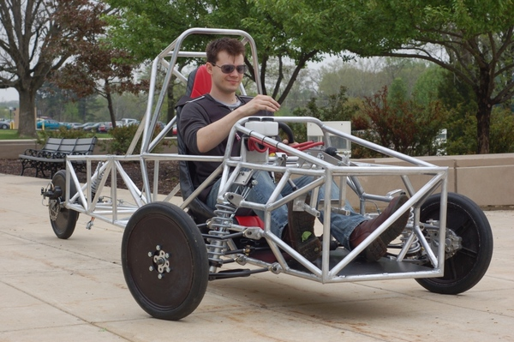
Material for the frame
Aluminum
  Very stiff for its weight
  Harder to weld
  Needs more material to resist fatigue
  Can be difficult to repair

Slide 12
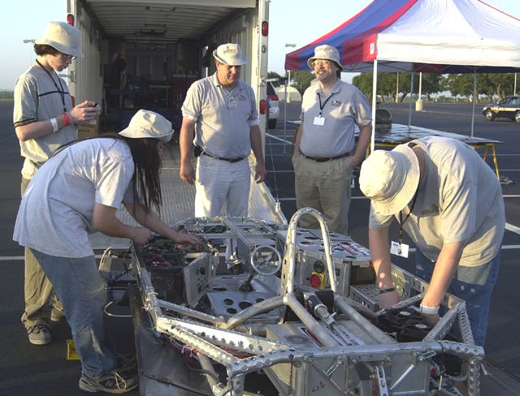
Material for the frame
Titanium
  Light
  Strong (but not stiff)
  Absorbs shock
  Hard to weld
  Expensive
  Limited sizes

Slide 13
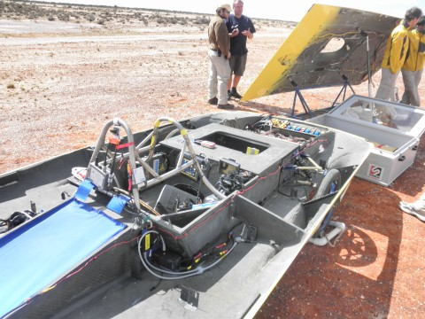
Material for the frame
Carbon Fiber (composites)
  Lightest and stiffest
  Can be formed to any shape
  Expensive
  Needs careful planning
  Learning curve is steep
  Very hard to repair on the side of the road
  Need professional engineer certification if used for roll cage, roll bar, or crush zone

Slide 14
Roll Bar and Crush Zone
Roll cage must:
  encompass the entire driver
  be integral part of the structure
  be designed to deflect body/array panels away from the driver
  allow 5 cm of clearance between the driver and the roll cage
  meet minimum diameter and wall thickness rules

Slide 15
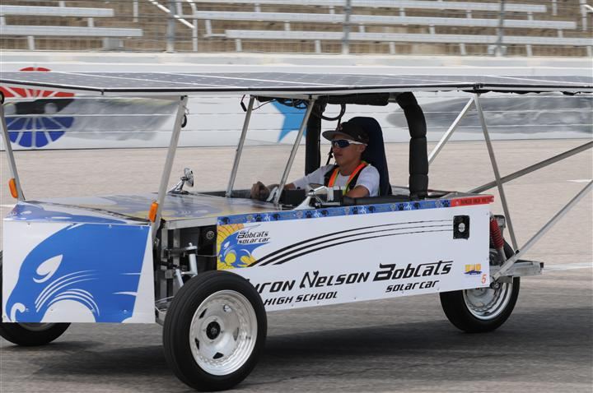
Roll Bar

Slide 16
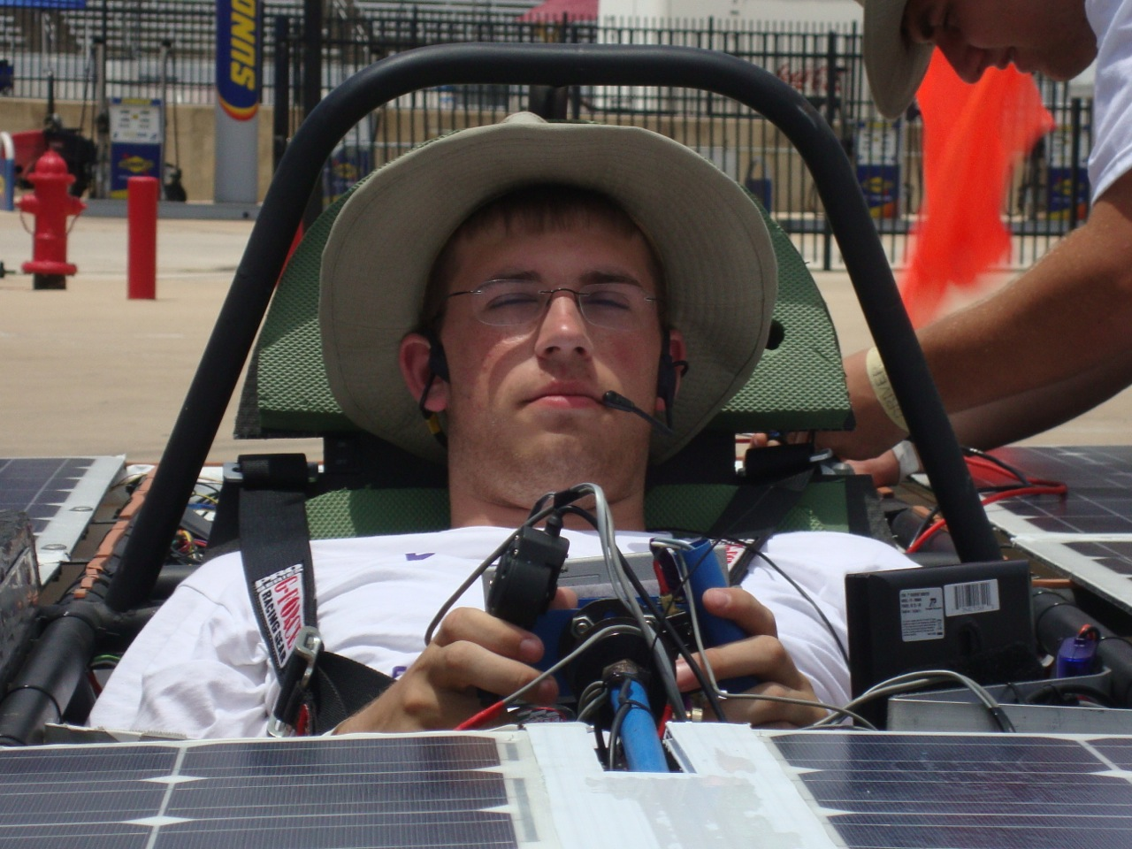
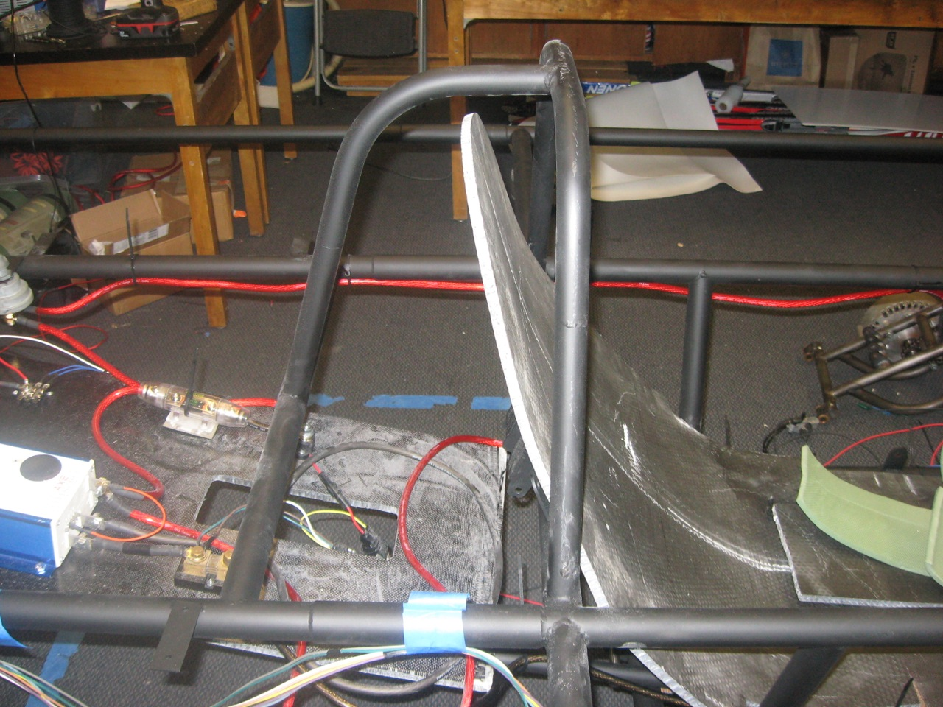
Roll Bar
Side View
Front View

Slide 17
Roll Bar and Crush Zone
Crush zone must:
  be designed to absorb impact from a collision
  protect the driver from front, side, and rear collisions
  have a minimum of 15 cm of horizontal distance from all parts of the driver’s body
  Teams must be able to demonstrate a specific, adequate crush zone in order to compete. Insufficient regard for structural safety will result in disqualification.

Slide 18
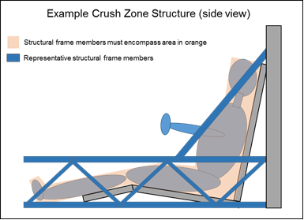
Crush Zone Structure

Slide 19
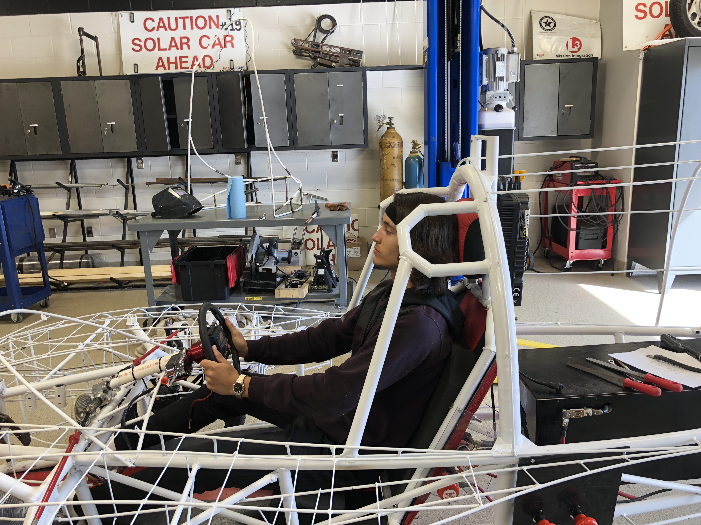
Crush Zone

Slide 20
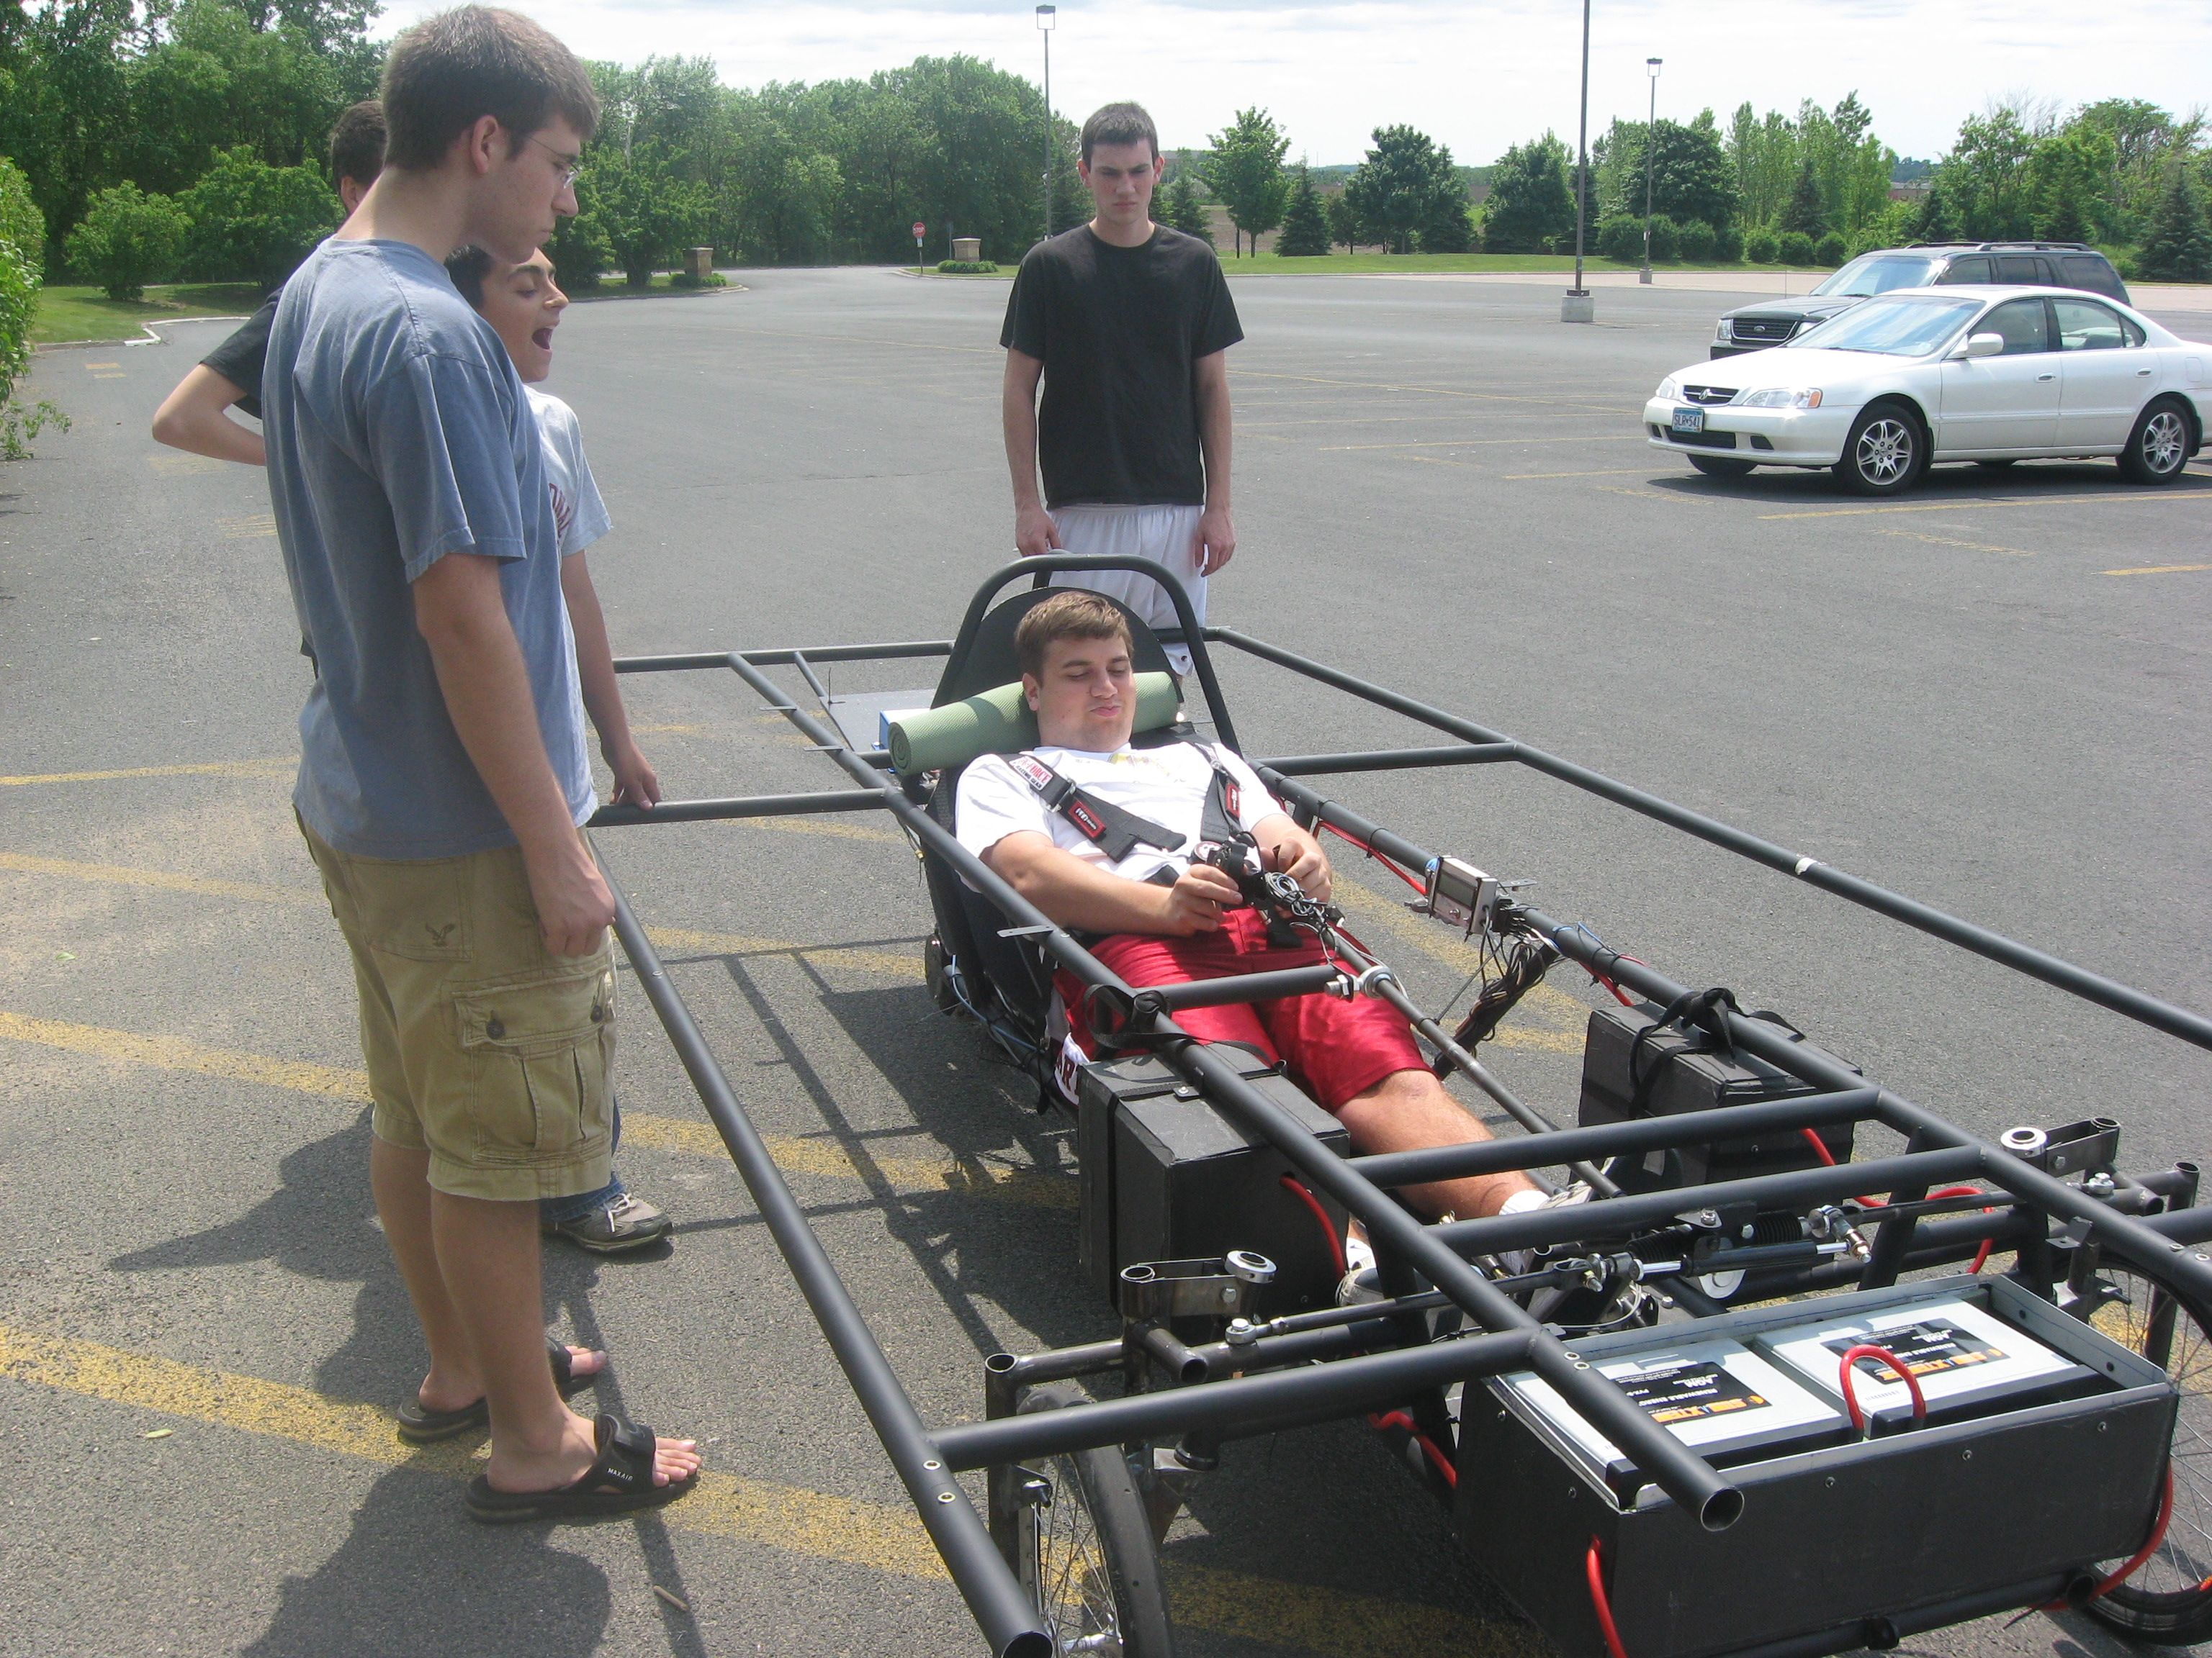
Crush Zone

Slide 21
Crush Zone

Slide 22
Specialty Workshop
Wheels, Brakes, Suspension

Slide 23
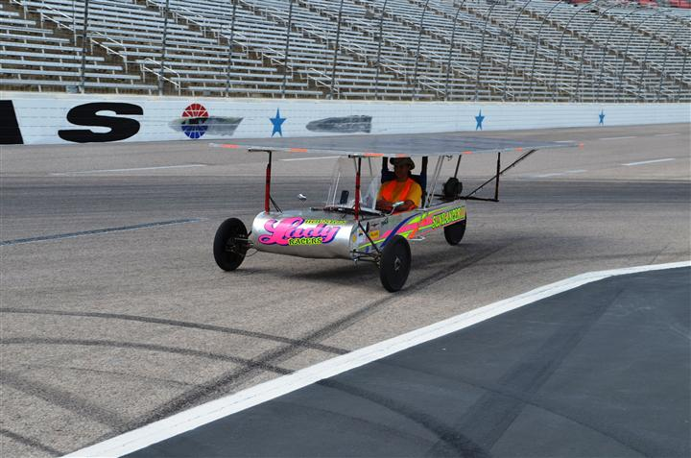
Wheels
One of the most difficult parts to source
Choices need to be made very early in the design process
Three wheel designs:
  Lighter
  Easier to align
  Less expensive
  Not as safe

Slide 24
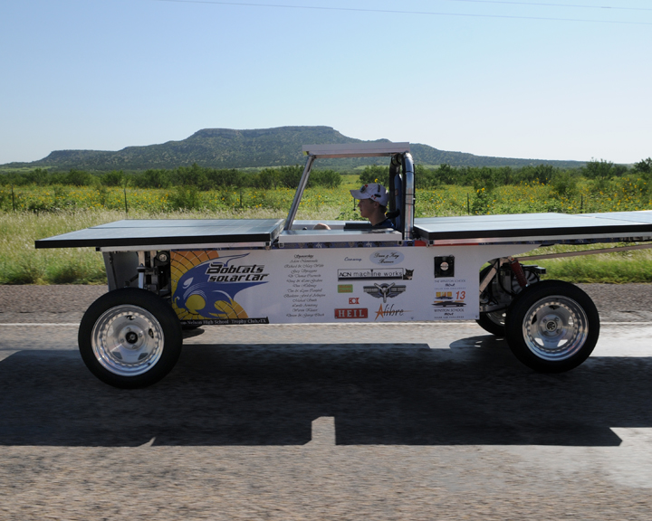
Wheels
  Four wheel designs
    More parts means higher cost
    Harder to get alignment correct
    Weight distribution less critical
    Much safer in the event of a flat
    Can “straddle” dead animals on the road

Slide 25
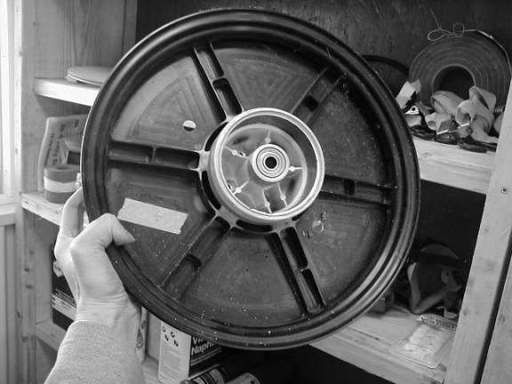
Wheels
Wheel choices (must be able to handle the weight of the car and lateral forces from turning)
  NGM wheels and tires
  Motorcycle
  Junior Dragster
  Bicycle

Slide 26
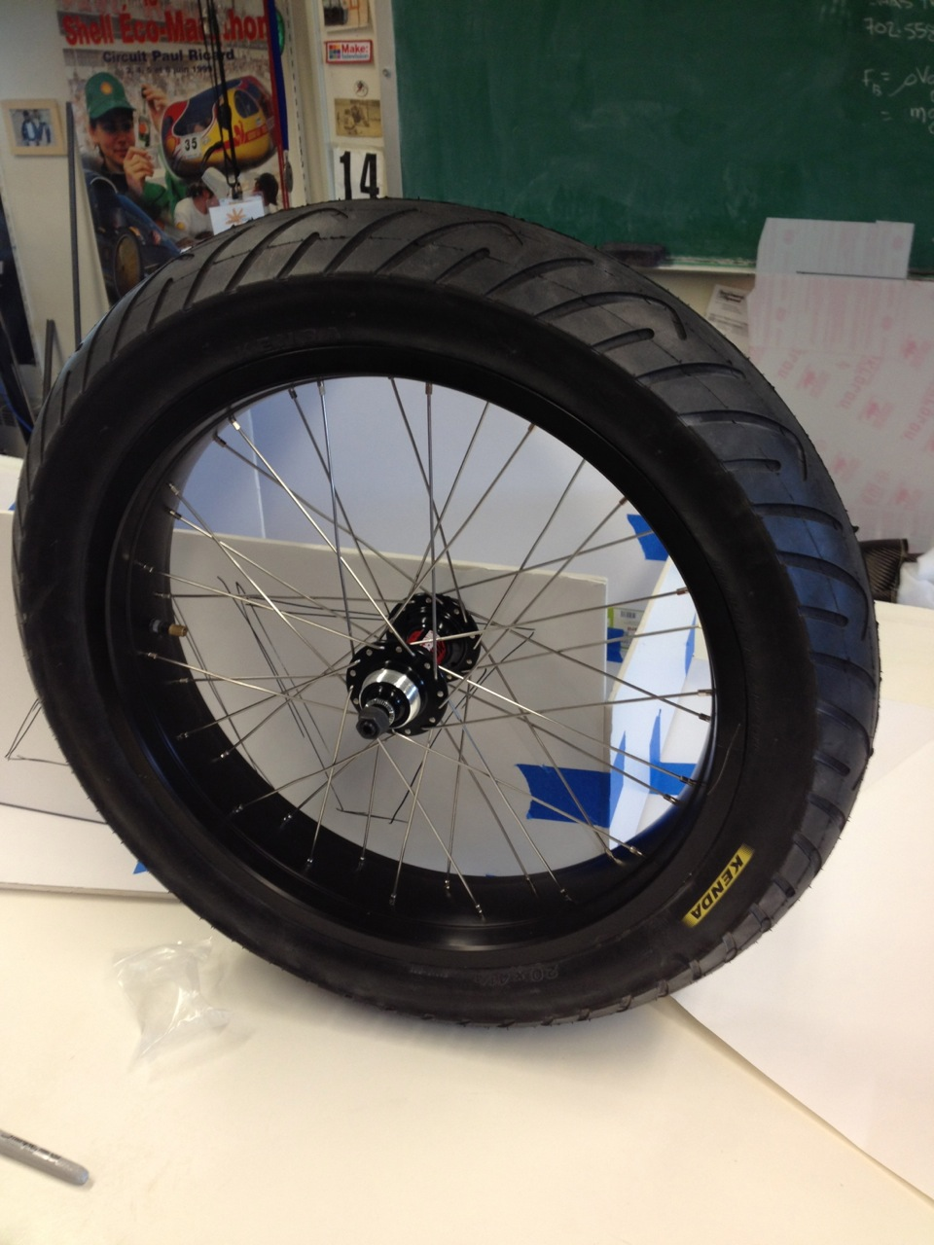
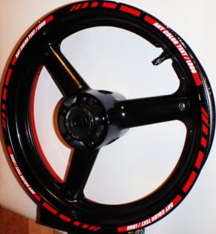
Wheels

Slide 27
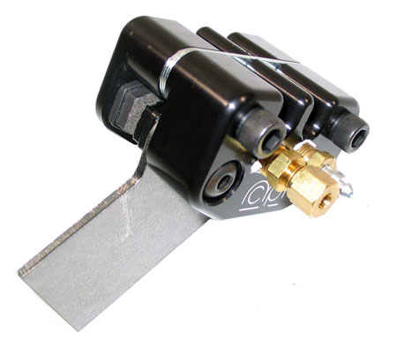
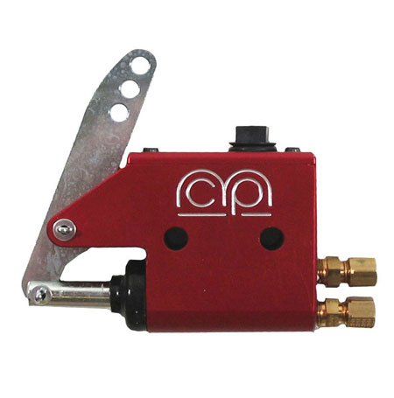
Brakes
Solar car must have two, independent, braking systems that allow the driver to stop the vehicle safely and quickly.
  Most cars use hydraulic disk brakes
    MCP single caliper brakes are easy to install and relatively inexpensive.

Slide 28
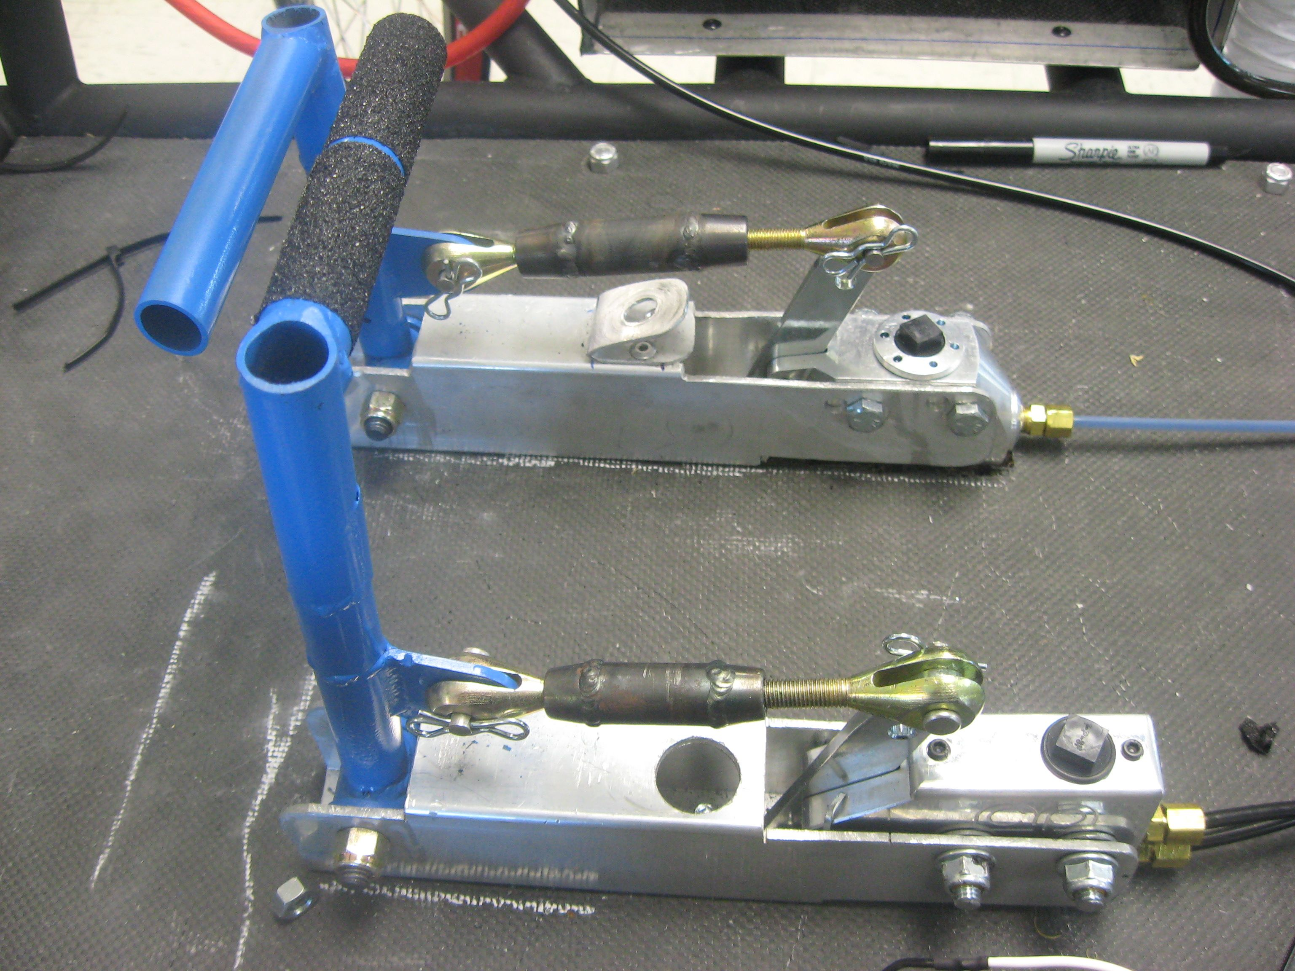
Brakes

Slide 29
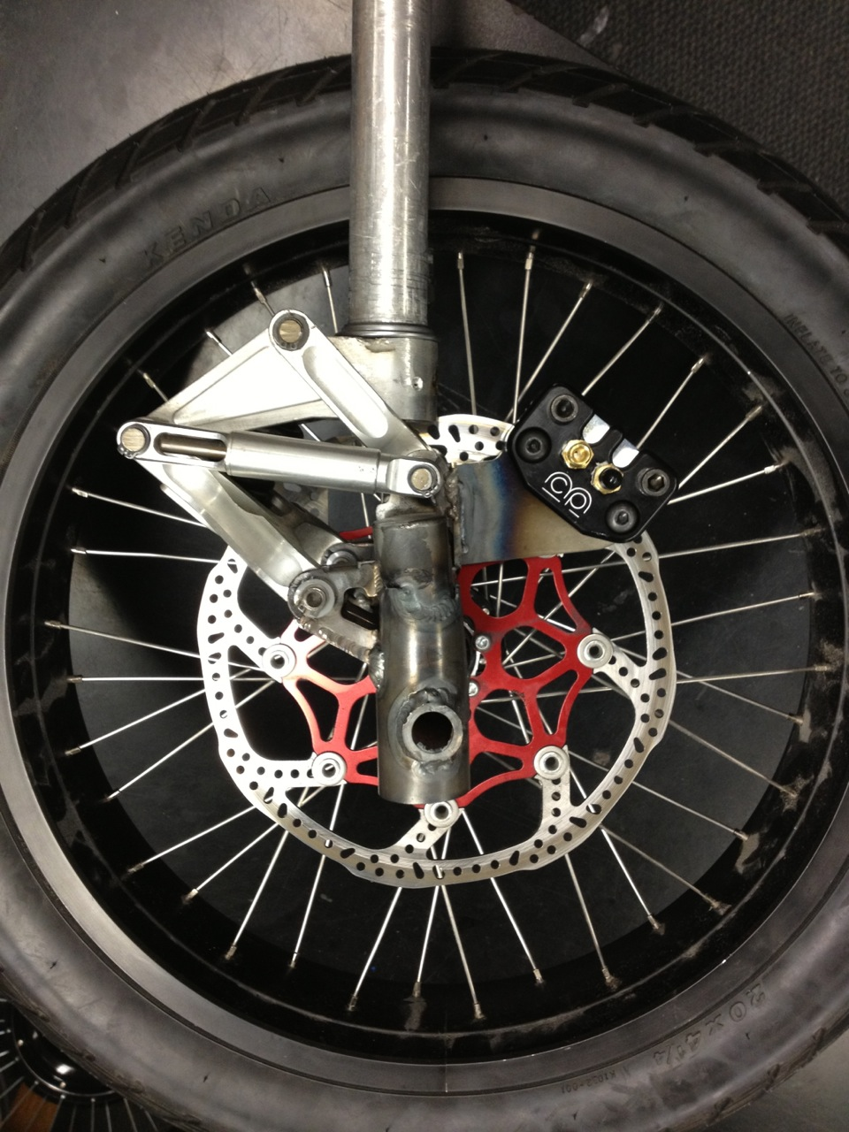
Brakes
Brakes are tested both statically and dynamically at the event.
Many vehicles have brake problems . Brakes must be tested before you arrive at the event!

Slide 30
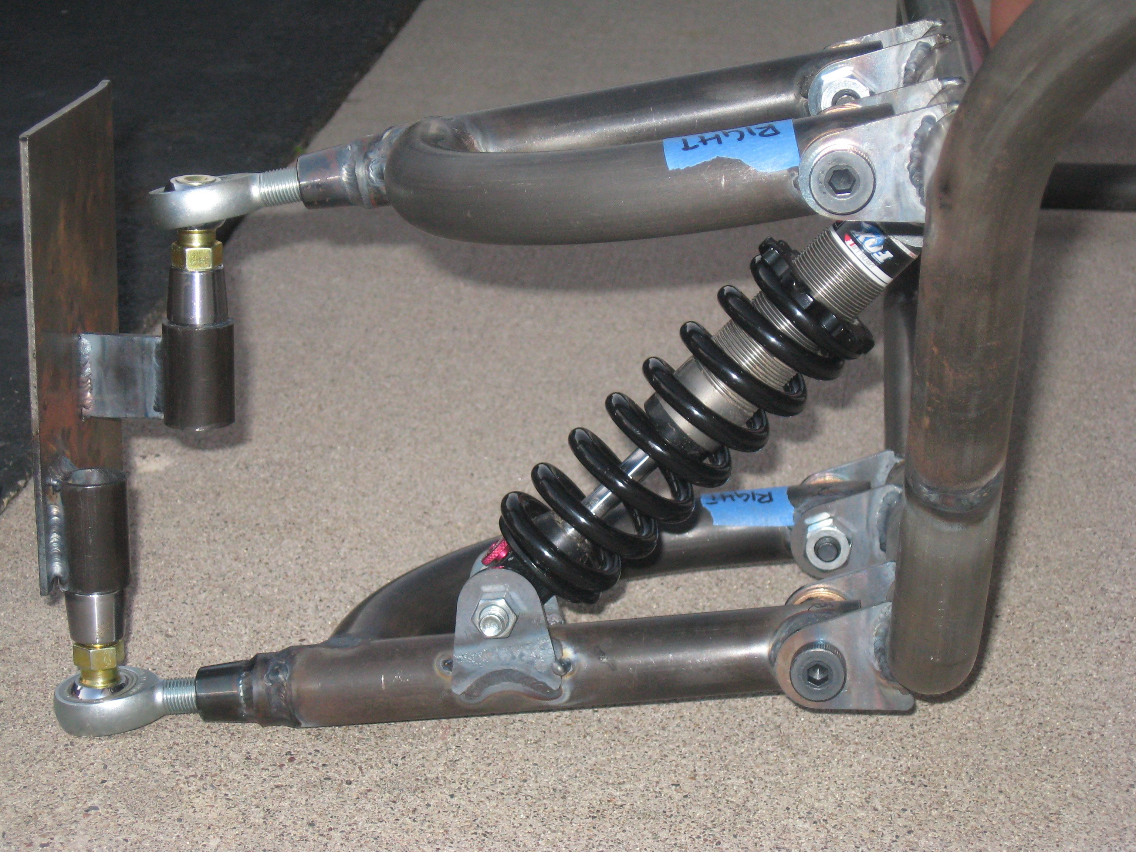
Suspension
Suspension systems
  More important on the road than on the track
  Adds weight and complexity to the vehicle
  Protects sensitive and expensive solar and electric parts
More details to come in special section

Slide 31
More Details on Suspension/Steering

Slide 32
Specialty Workshop
Powering the Solar Car

Slide 33
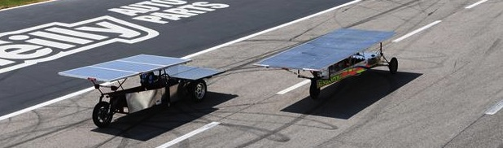
Powering the solar car
How do you get the car moving?
  Photovoltaic array choices
  Power trackers and DC-DC converters
  Electric motors and controllers

Slide 34
Shape of Array
Flat Solar Arrays
  Easier to execute
  Angle to sun less of a concern
Curved Solar Arrays
  Higher the angle the greater chance for breaks without ideal support.
  Angle to sun more of a concern

Slide 35
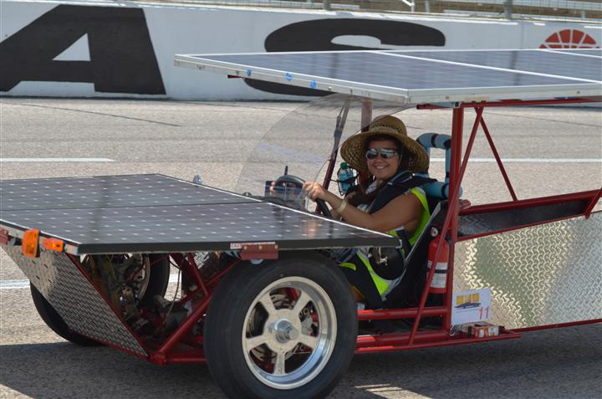
The Solar Array
Pre-made panels
    Reliable
    Easily purchased
    HEAVY (glass front adds weight)

Slide 36
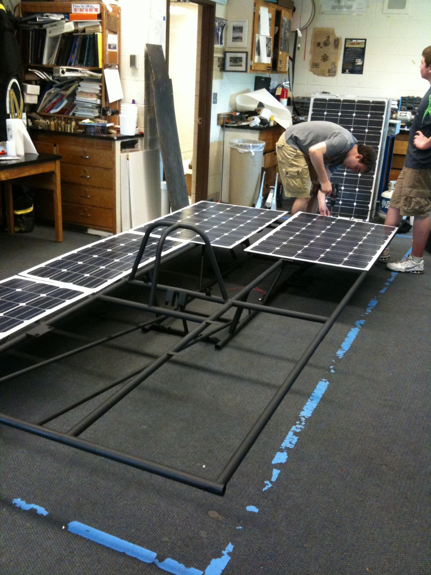

The Solar Array
Premade Lightweight Options

Slide 37
The Solar Array
Raw cells and lamination
  Planning has to start FAR in advance (you are probably too late already!)
  Process is expensive
  Panels are very light and can be built to fit your car
  Easy to maximize power and reduce aerodynamic drag

Slide 38
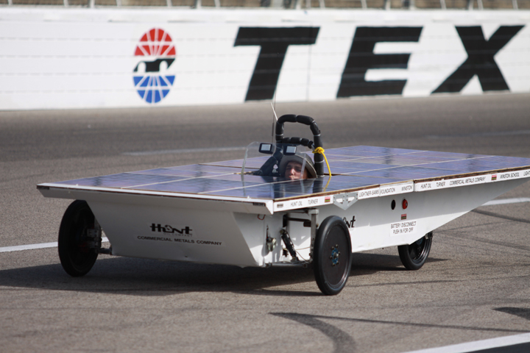
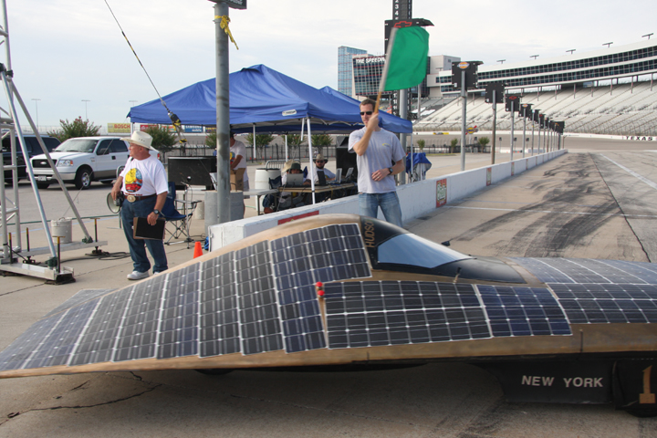
Laminated Cells

Slide 39
The Solar Array
Do-it-yourself solar array
  Amazing learning experience
  Learning curve is steep
  Hard to find raw cells
  Takes a lot of man power
  Hard to watch when cells are continually breaking
  Can fit exactly to your car

Slide 40
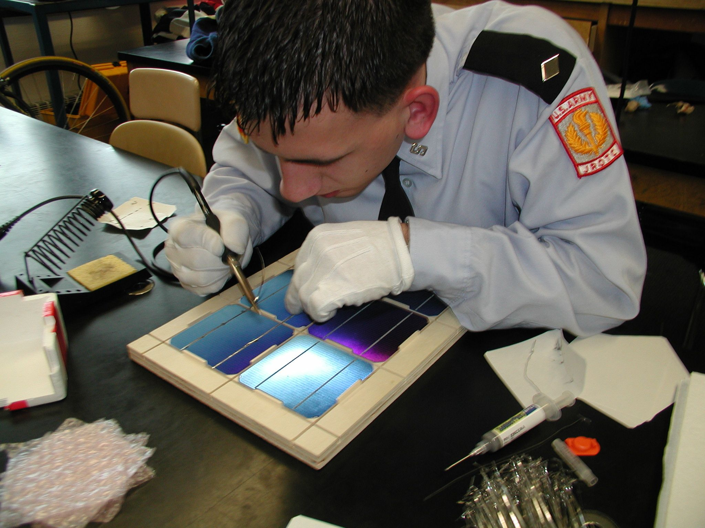
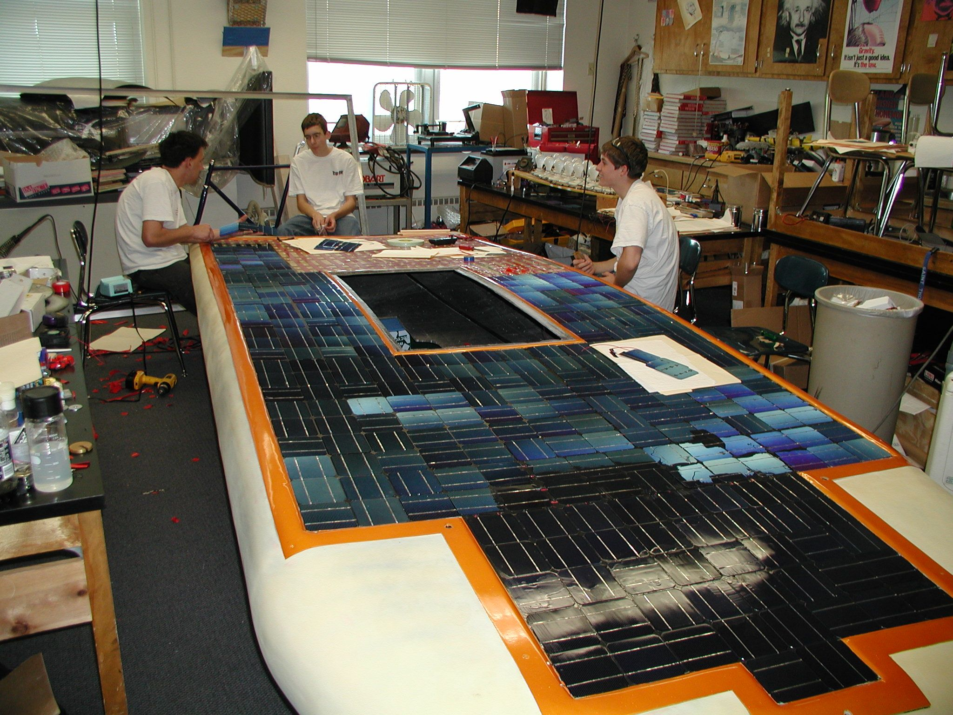
Do-it-yourself

Slide 41
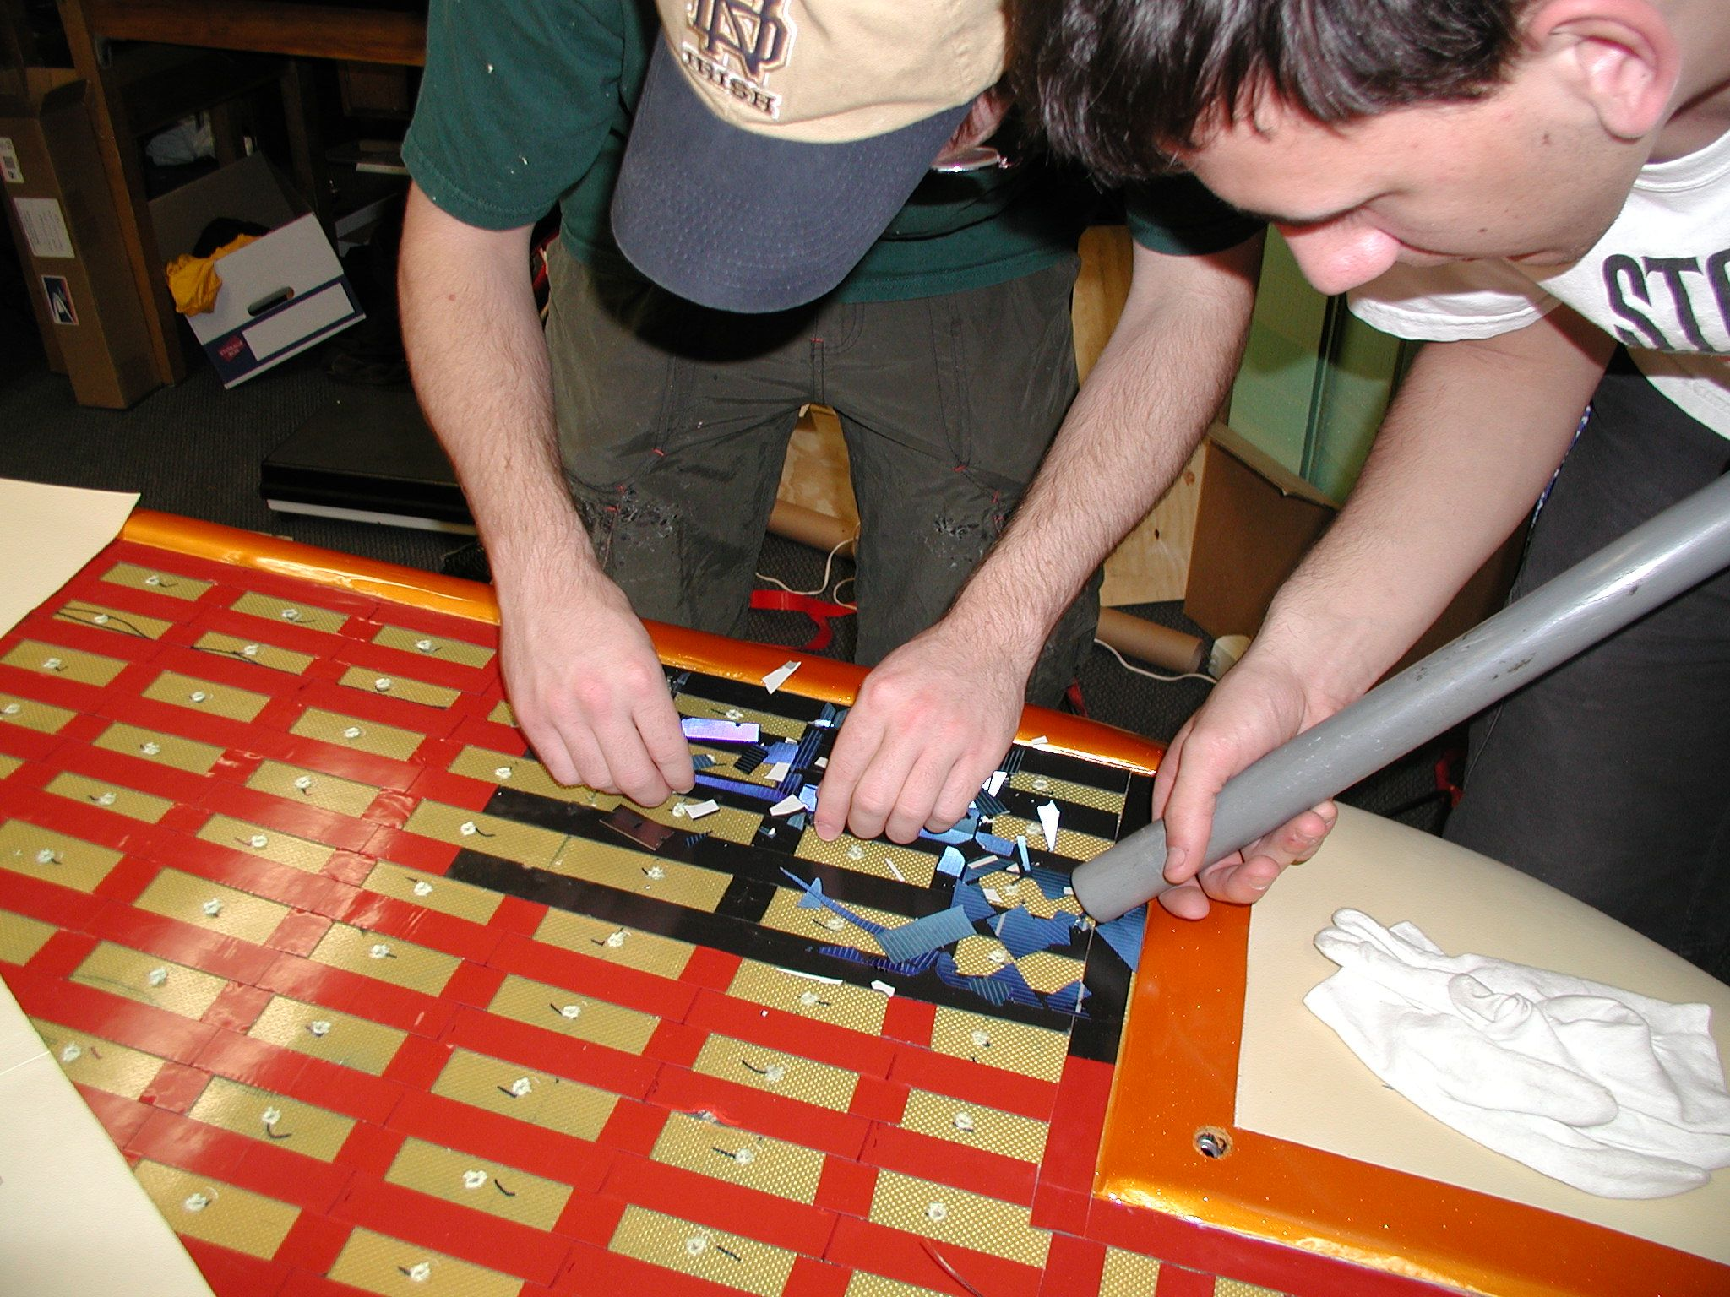
Do-it-yourself

Slide 42
MPPTs and DC-DC Converters
Moving power from the solar array to the batteries is not as easy as hooking up a couple of wires!
Voltage from your solar array needs to match the voltage of the battery pack.
Maximum Power Point Trackers adjust voltage and current from your array to give you the most possible power to your vehicle.

Slide 43
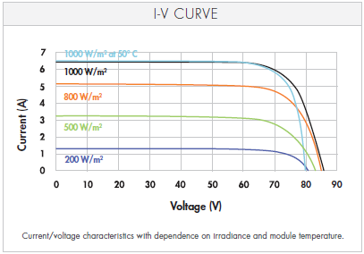
IV Curve

Slide 44
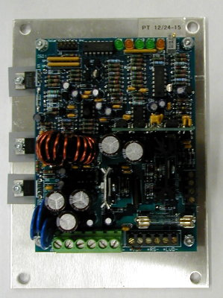
MPPT and DC-DC Choices
AERL (Australian Energy Research Laboratories)
Solar Converters Inc
Outback (and other grid type MPPTs)
Genasun
DC-DC Converters

Slide 45
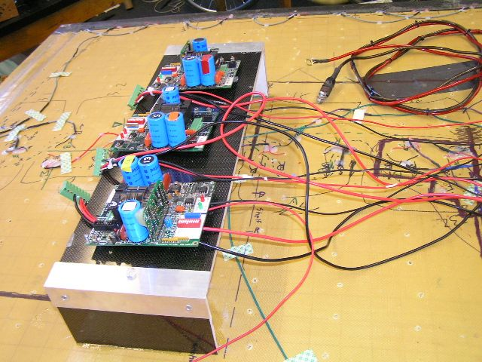
AERL MPPTs

Slide 46
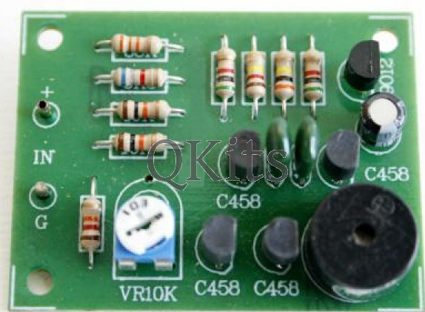
Low Voltage Indicator
Do-It-Yourself kit available at:
http://store.qkits.com/
Look for “Low Voltage Alarm”

Slide 47
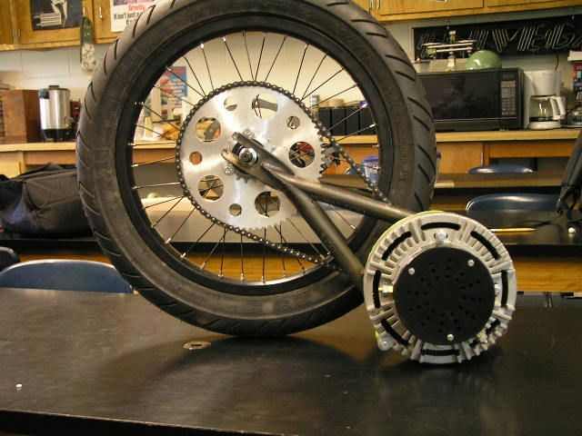
Electric Motors
Brushed Electric Motors
  Inexpensive
  Lower overall efficiency
  Controller is inexpensive and easy to wire
Brushless Electric Motors
  Very efficient
  More expensive
  Controller is more difficult to wire (typically 3 phase)

Slide 48
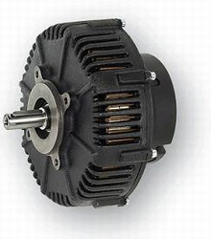
Brushed Motor Examples
Briggs and Stratton ETEK
Lynch LM200
Perm-Motor PMG-132 12-72 VDC
  90% efficient
  Wide voltage range (12-72 volts)
  Light weight (24 pounds)
  $1400

Slide 49
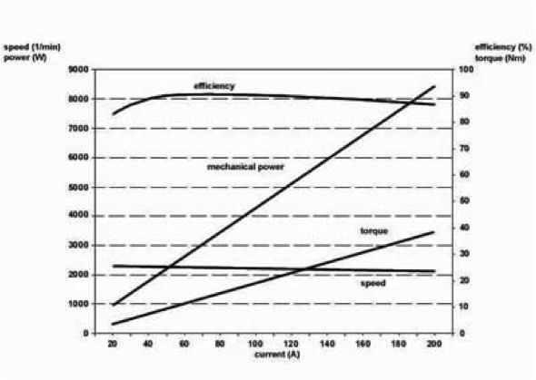
Motor Efficiency Perm PMG-132

Slide 50
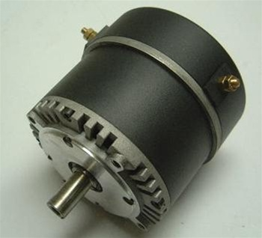
Brushed Motor Examples
Motenergy ME0909 Permanent Magnet DC
  Best replacement for original Briggs and Stratton E-tek
  12-48 volt
  Light weight (24 pounds)
  Inexpensive ($450)

Slide 51
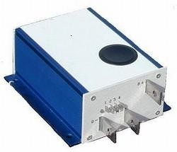
Brushed PWM Controller
Alltrax AXE
Easy to wire
0-5k Pot control
Programmable
Durable

Slide 52
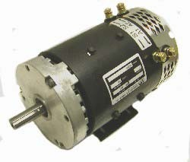
Brushed Motor Examples
Advanced DC K91-4003 motor, 48-96VDC
  Higher voltage motor (48-96 volts)
  Strong motor for heavier cars
  Low cost ($800)

Slide 53
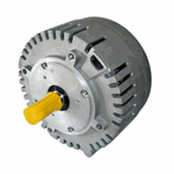
Brushless Motor Example
Motenergy ME0907 Brushless PMSM/BLDC
  No brushes=no maintenance
  24-72 volts
  Very efficient (over 90%)
  High current (up to 100 amps continuous)
  Motor is inexpensive ($460)
  Special controller needed

Slide 54
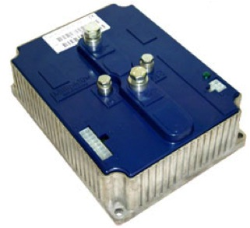
Sevcon controller (Brushless)

Slide 55
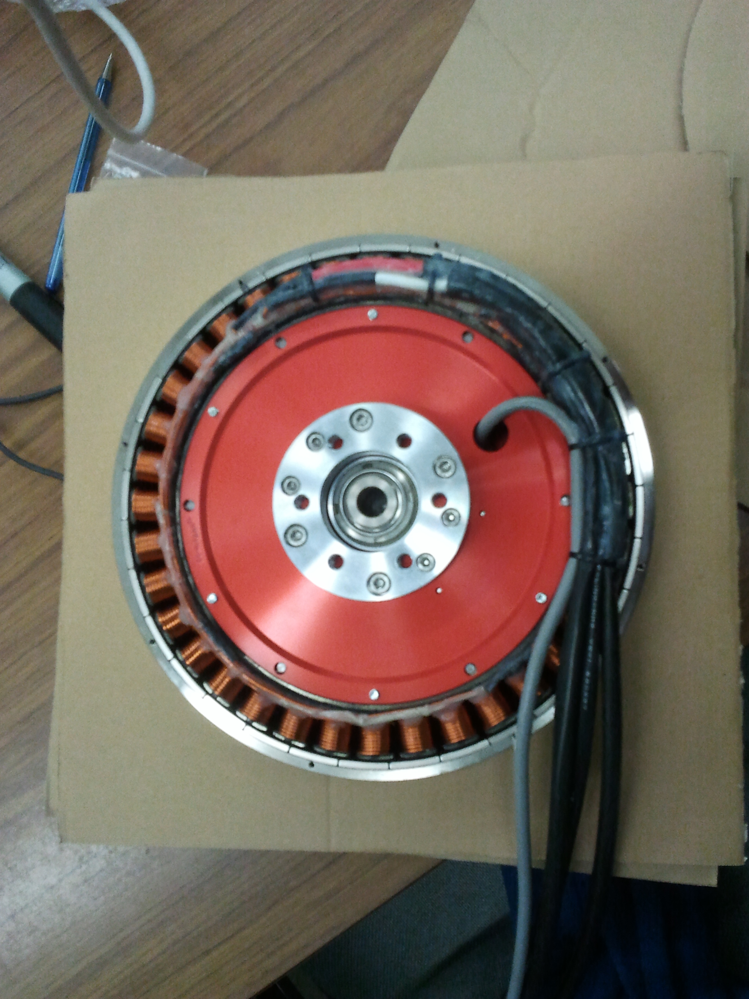
Hub Motor
NGM ‘Direct Drive’ high efficiency in-hub motor with variable air gap adjustment.
  Super efficient over a broad range of speeds
  No need for gears or chain
  Very expensive (Motor + controller > $25,000)
Mitsuba / Nomuri hub motors replacing NGM as favored motor for solar car teams
  Still ~$25,000

Slide 56
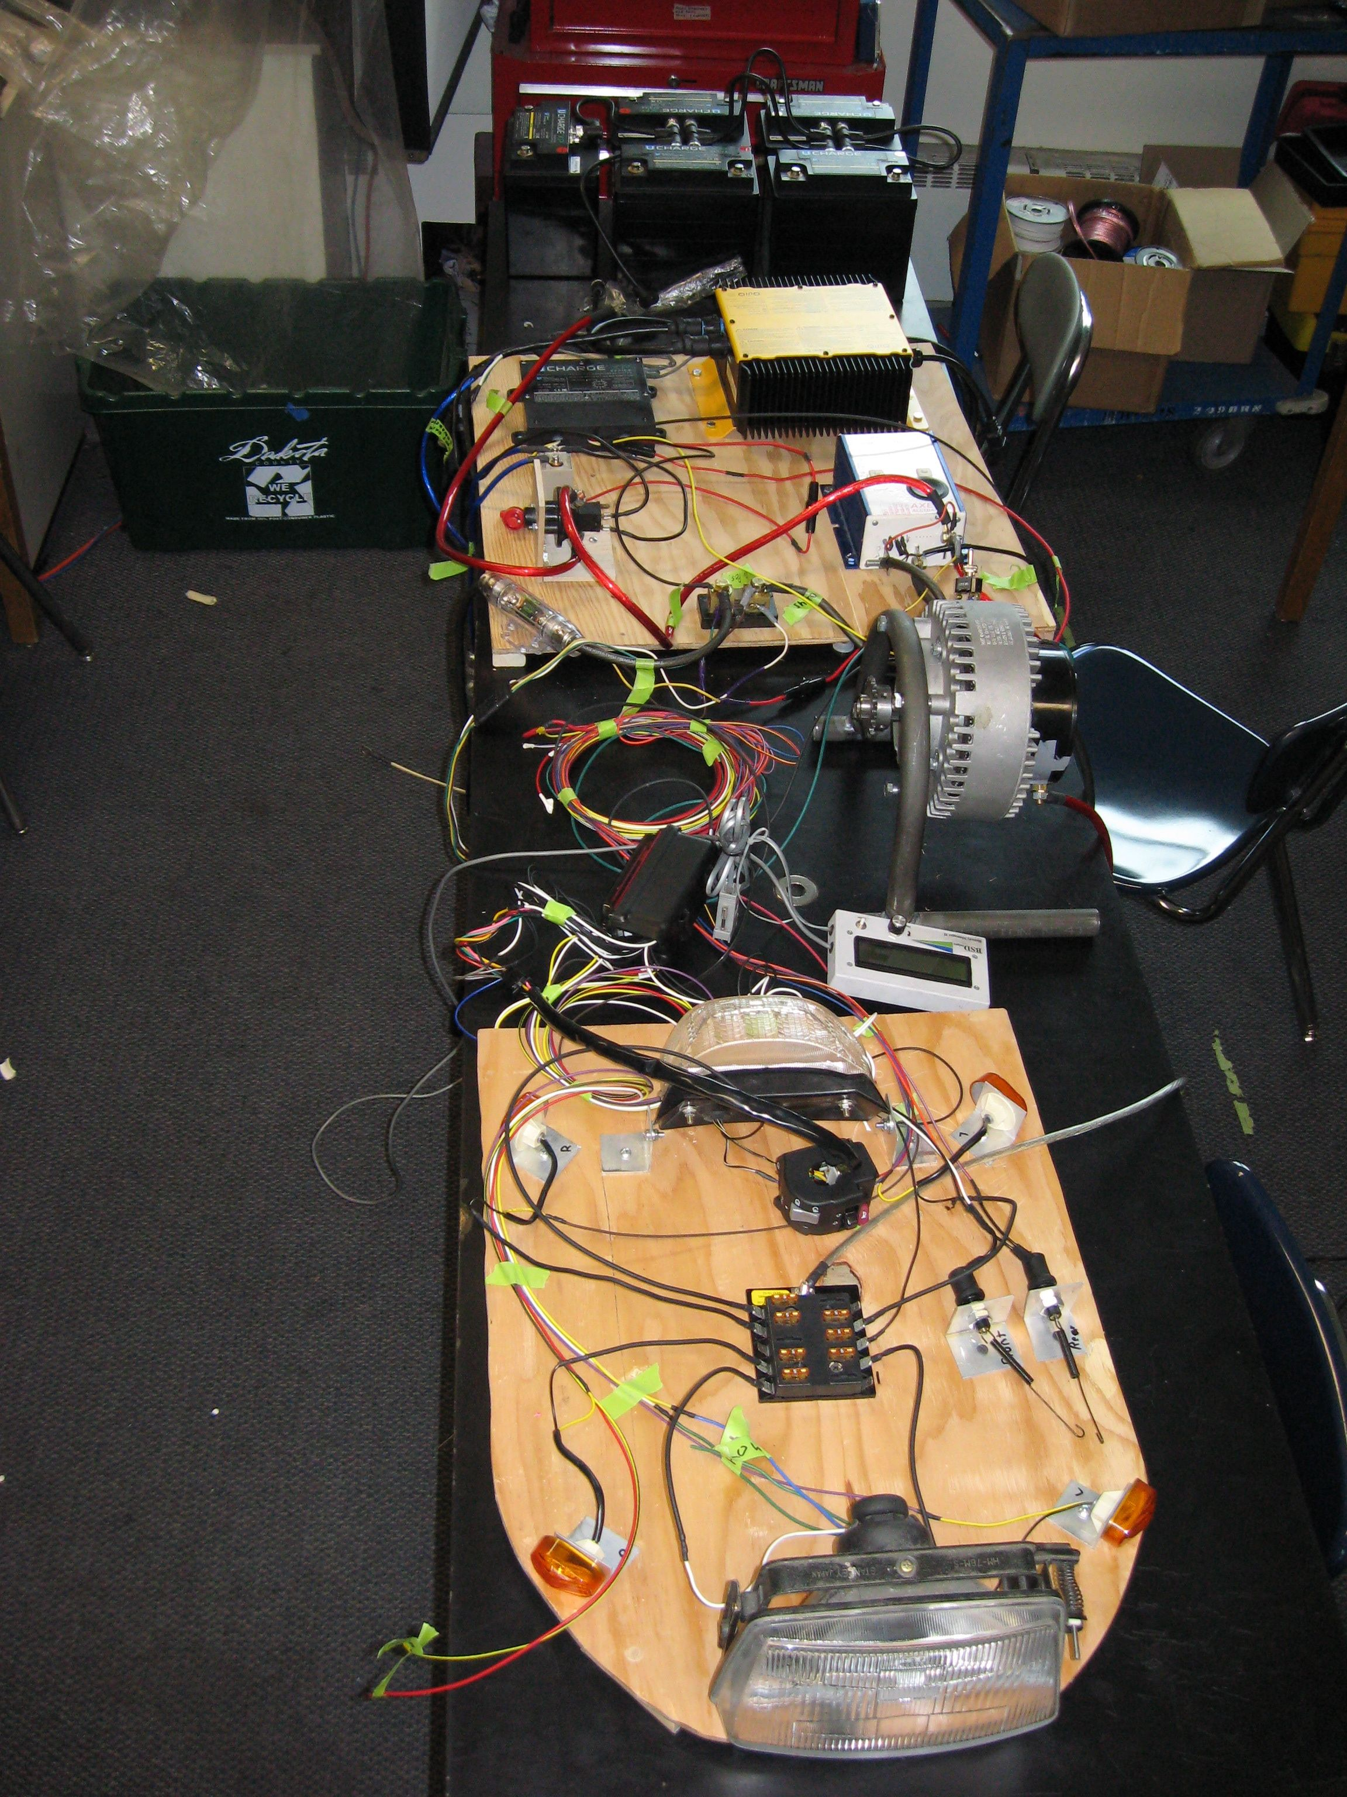
Electrical System
Main electrical system (the one that makes your car move)
  Use the correct gauge wire for the job
  Disconnect switches should be designed for DC
  Fuses
Secondary electrical system (everything else on your car)
  Lights
  Fans
  Horn

Slide 57
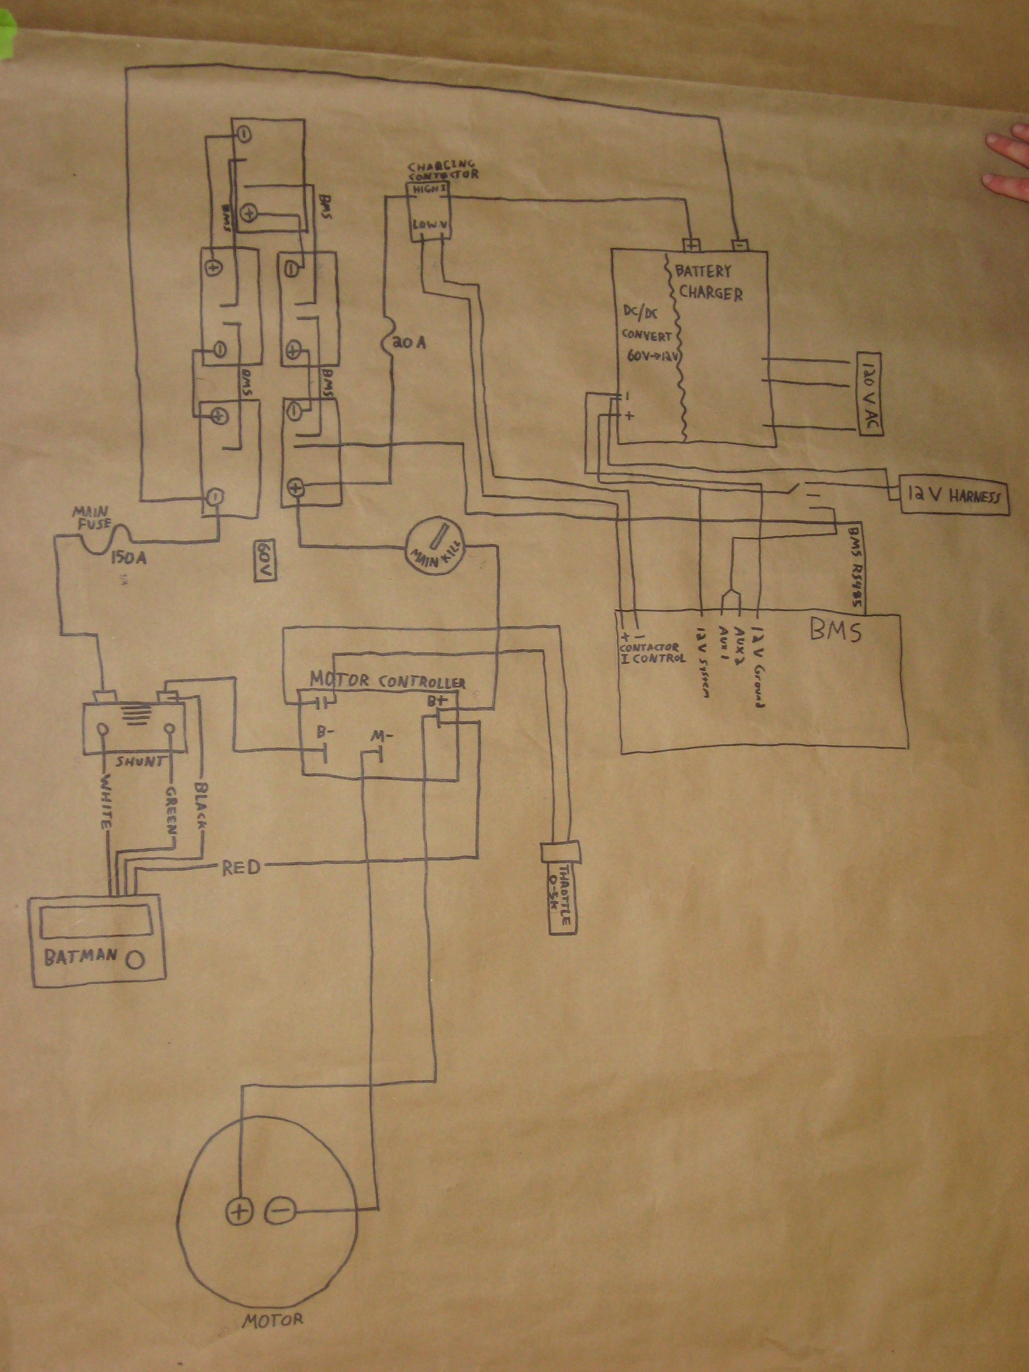

Electrical System Layout

Slide 58

Electrical System Layout
Schematic made with:
http://www.digikey.com/schemeit/
Or use Solid Edge to set schematic (can get wire lengths)

Slide 59

Electrical System

Slide 60
Batteries
Choose carefully!
Batteries are one of the areas where you get what you pay for.
  Decisions to make:
    What voltage does your car run at?
      Higher voltage means lower current .
    How much weight can you carry?
    How much energy can you get at that weight?
    Can your solar panels recharge the battery pack?
    Is it a road race or a track race?

Slide 61

Batteries
The 5 kilowatt-hour rule
  kw-h = Amp-hours x Voltage
  (at the 20 hour discharge rate)
  Example:
  Four, 12 volt, 84 amp-hour batteries in series
  84ah x 48 v = 4032 watt-hours or 4.032 kilowatt-hours
  (this battery pack would weigh around 230 pounds)

Slide 62

Batteries
Choosing batteries based on the Peukert number:
  A typical sealed lead acid battery has a Peukert number between 1.1 and 1.3. (The closer to 1.0 the better!)

Slide 63

Batteries
Testing batteries:
  Understanding how your batteries perform is one of the most important things you can know BEFORE the race starts.
  Carefully recording voltage, current, and amp-hours will help your team make good decisions during the race

Slide 64


Batteries
Some of our favorites:
  Concorde Sun Xtender series
    84 Ah $245/battery
  EnerSys Odyssey Marine series
    68 Ah $250/battery

Slide 65


Switches/Fuses
    There are a lot of resources for switches and fuses. Be sure they meet the race requirements before ordering!
    Be sure they are rated for your DC system. (AC rating will not qualify!)
    (Bussmann FWH Fuses are rated at 500V DC)
    *New for 2020* - Relays are allowed!
    Electric Motorsport www.electricmotorsport.com
    Tecknowledgey
    http://www.tecknowledgey.com
Single Pole On/Off
Rated load: 400 A
Break Current: 1200 A @ 48 V DC (600 A @ 96 V DC)
500V DC @90 amp fuse is about $50

Slide 66
Specialty Workshop
Power Management

Slide 67

Power Management
How much power does it take to make your car go down the road?
  The amount you will use depends on:
      Aerodynamic drag
      Rolling friction
      Weight
      Electrical system resistance

Slide 68
Power Management
A typical Solar Car Challenge vehicle array produces 800-1000 watts of power.
There is approximately 12 hours of usable sunlight during a race day.
800 watts x 12 hours = 9600 watt-hours of energy/day. (Assuming clear skies and good sun.)
A full-size, fully-charged battery pack has approximately 4000 watt-hours of energy.
It will take approximately 5000 watt-hours of energy to completely recharge the battery pack.

Slide 69
Power Management
Dead Batteries are dead weight
  A 48 volt battery pack is “dead” at 42 volts.
It will take (at least) 5 hours of full sun to completely recharge a dead battery pack.
Hills, clouds, trees, wind, and children with sticky fingers all reduce your array efficiency.
The only way you will know how much energy your car will use is to test it.
Keep a record of current draw vs. mph (It is not linear!)

Slide 70
Strategic Decisions
First step in power management is deciding your high-level strategy (without looking at numbers)
  Do you empty your battery pack each day and recharge as much as possible during off-hours?
  Do you end the day with as much energy as you can recover during off-hours?
  Do you run down a certain capacity each day so you end up with no energy left on the last day (e.g. run down ¼ of pack each day for 4 day event)?
Do you run based on net draw (motor – solar) or motor draw?
No right answers; just decisions the team must make

Slide 71
Set Targets Based on Strategy
If strategy is to empty battery pack each day, and you have a 100 Ah battery pack, how fast should the driver drive?
  Trick question: Driver does not drive based on speed, but current draw.
OK, how much current should driver be taking from the battery?
  100 Ah / 6 hours of racing (Classic Division) = 16.7 A, right?
Classic Division runs 9am-12pm, 2-5pm, with 2 hours lunchtime in between. How much charge will I get back during the two hours?
  Assume 1000W panel, 48 V system = ~20 A → 40 Ah
  After 3 hours of racing at 16.7A, would have (100Ah – 16.7A x 3 hrs = 49.9Ah)
  After 2 hours of charge time, 49.9 Ah + 40 Ah = 89.9 Ah left
  Rest of racing period = 89.9 Ah / 3 hrs = 30 A
To get the same current draw throughout the day, what should the current draw be?
  100 Ah + 40 Ah = 140 Ah / 6 hours = 23.3 A

Slide 72

Collecting Data
How to measure what your car is doing:
  Voltmeter and/or ammeter
  Batman measurement system (Bruce Sherry Design)
  Link (e-meter)

Slide 73
What Data is Important?
Different teams have different answers to this!
Typical measurements include:
  Battery Voltage (measured under load)
  Motor current draw (the rate that you are taking energy out)
  Array current (the rate that you are putting energy back in)
  Amp-hours or Watt-hours (how much total energy you have taken out or put back in)

Slide 74

What’s Interesting About This Data?

Slide 75
Charging Characteristics
Power stays fairly constant throughout racing period (~1000 W)
Power input drops near end of charging period (takes more power to fill pack)
Battery voltage remains fairly stable, even when current changes (because of MPPT)

Slide 76

What’s Interesting About This Data?

Slide 77
Discharge Characteristics
Current draw is not directly correlated to speed; associated with acceleration
Wide range of current draw for specific speed, including outliers

Slide 78
How Do I Get The Right Data
Test! Test! Test!
Multiple runs at different speeds
Test both uphill and downhill (at different grades)
Simulated race days

Slide 79

Making Decisions

Slide 80
Getting Data to the Right People
Driver should not need to make decisions other than driving.
Pit crew should inform driver about “speeding up” or “slowing down”.
One person should be responsible for communicating with the driver.
Telemetry systems

Slide 81

Choose the Correct Gears
Don’t gear a car for 50 mph if you are going to drive it at 25 mph. Be realistic about your cars speed!
Chain drive systems can be very efficient if gears are aligned and lubricated.
Pictured: 48V system, 15 tooth front, 70 tooth rear. Max speed = 36 mph

Slide 82

Choose the Correct Gears
Custom Sprockets:
Rocket Sprockets www.rocketsprocket.net
PMP Sprockets www.pmpsprocket.com

Slide 83
Other Power Management Considerations to Research & Test
How does weather affect charging?
How much power do you get at different angles of sun?
How does different array shapes/angles affect charging?
How does the route topology (or track layout) affect power usage?
Other Considerations?

Slide 84
Specialty Workshop
Aerodynamics, Weight, & Friction

Slide 85
Aerodynamics vs. Weight
If I were to choose one thing, what would I focus on?
  Dependent on speed
  Track vs. road race
    “Uphills/Downhills” on turns

Slide 86

Aerodynamic Drag
Reducing drag is the least expensive way to improve your solar car.

Slide 87

Aerodynamic Drag

Slide 88

Aerodynamic Drag
Drag starts at the back of the vehicle, not the front. Hence the name “drag”.
Choose shapes that release airflow smoothly.
Fairings can be made from many common and light weight materials.

Slide 89

Aerodynamic Drag
This is the enemy number one to a solar car’s efficiency.

Slide 90

Inexpensive Wheel Fairing
Things you need:
  Foam core board
  Razor Blade
  Hot glue
  Carbon fiber or Fiberglass reinforcement
  Epoxy resin
  Creativity
  Body filler

Slide 91


Wheel Fairings
Cut foam core board to shape
Score with a razor blade
Bend to shape
Glue

Slide 92

Adding Reinforcement
One or two layers of Carbon or Fiberglass cloth is enough.
Epoxy resin won’t eat through the foam core.
Squeege excess resin from fabric.

Slide 93

Adding Reinforcement
Add some carbon fiber squares on the inside at attachment points to strengthen foam core board.
Trim with a common jigsaw to fit.

Slide 94

Finishing
Reinforcement is covered with a light-weight body filler and sanded smooth.
Prime and paint
(A good painter can cover a lot of flaws!)

Slide 95

Final product

Slide 96

Weight
Heavier cars have more rolling resistance and take more energy to accelerate. (Much bigger problem in a road race.)
Do not reduce weight at the cost of safety.
Making things too light will force you to find an expert welder because things WILL break.

Slide 97
Rolling Resistance
Bearings can be opened, cleaned, and filled with a light oil.
Tall, skinny, high pressure tires reduce rolling resistance but sacrifice handling.
Tire Proper pressure
If it rotates: lubricate!
Wheel alignment is critical to reducing rolling resistance.

Slide 98
Specialty Workshop
Solar Car Challenge

