Slide 1
Specialty Workshop
Solar Car Challenge

Slide 2
Levels of Participation
Classic
Veteran Classic
Advanced
Solar-Electric

Slide 3
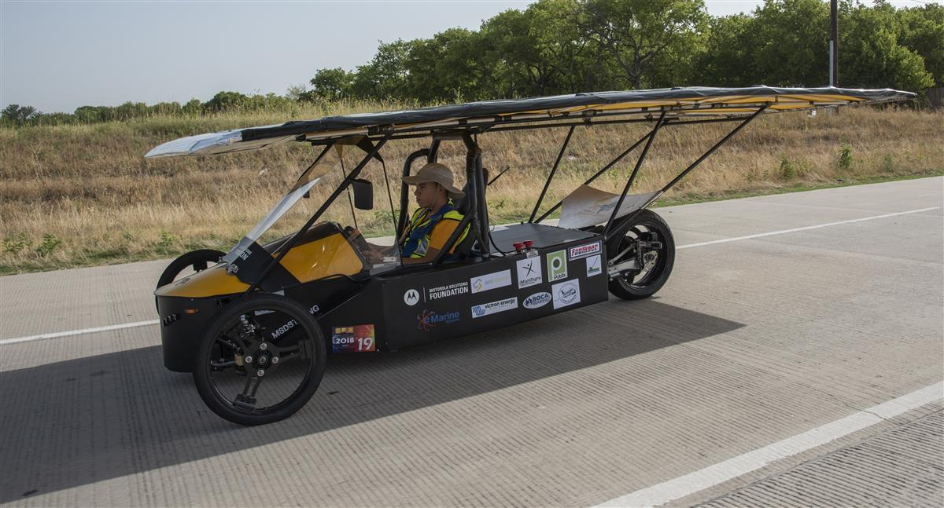
Classic Division
Solar cells less than 19% efficient
No hub motors
Lead/Acid Batteries
2018 Classic Division Champion: Solar Cats

Slide 4
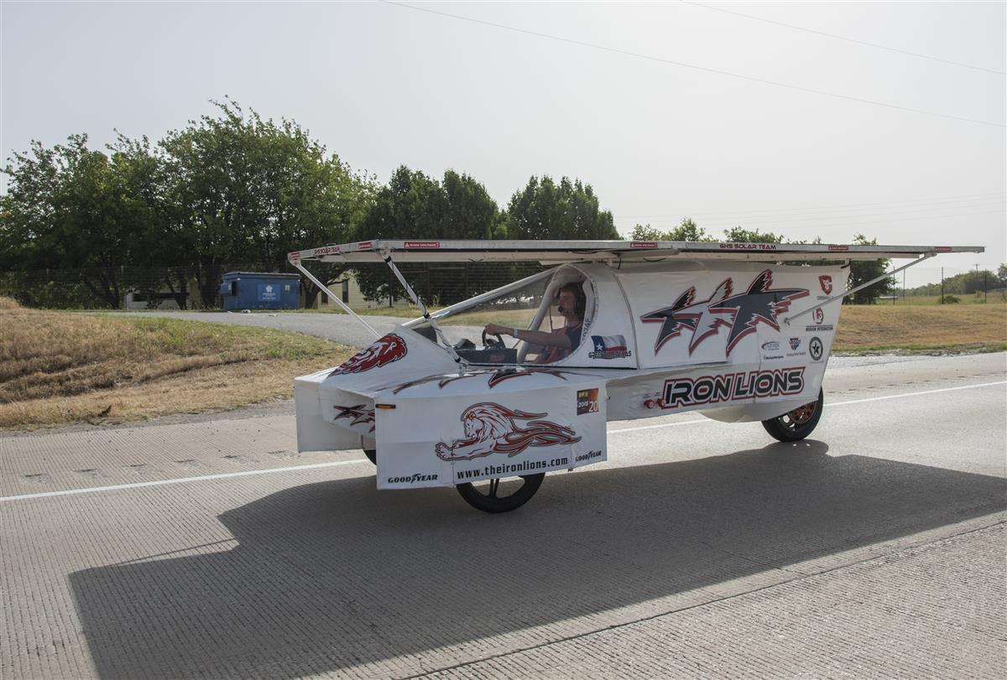
Advanced Classic Division
Same as Classic Division
*New*: Teams participating more than 2 years
2018 Advanced Classic Division Champion: Iron Lions

Slide 5
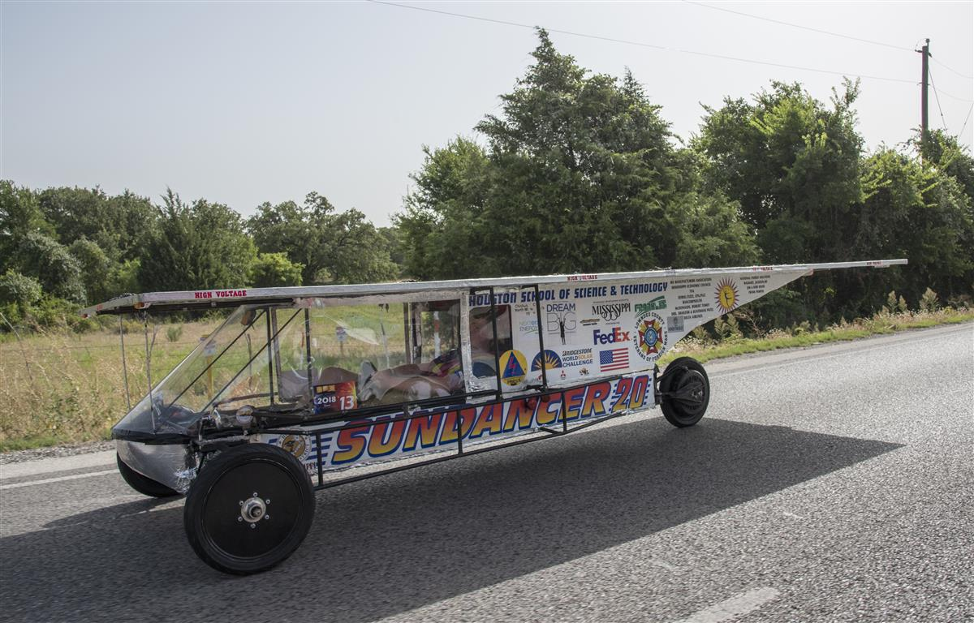
Advanced Division
Solar cells limited by cell cost
Any Motor
Any battery chemistry
Use of University body molds is allowed
2018 Advanced Division Champion: Houston Solar Race Team

Slide 6
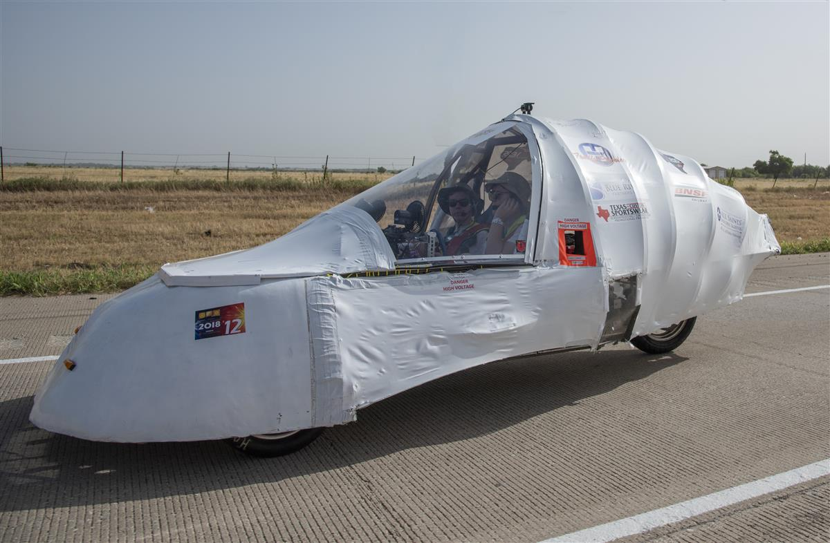
Electric-Solar Powered Division
19% Solar Cell Efficiency
No hub motors
Two-person vehicle
Pb-Acid (2 packs x 2Kw.h)
Separate Charging Station
2018 Electric-Solar Powered Division Champion: All Saints

Slide 7
Specialty Workshop
Building the Vehicle Frame

Slide 8
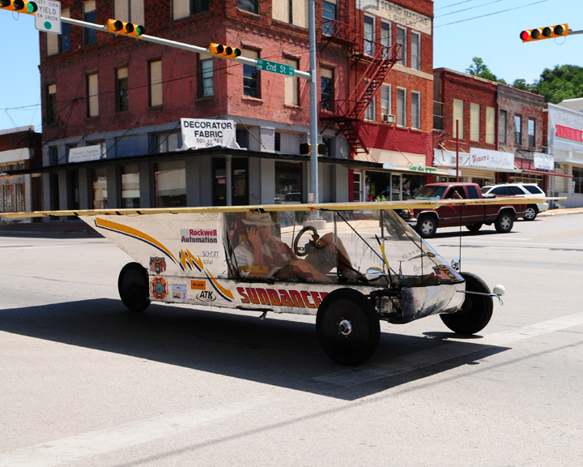
Getting your car rolling
Building the Vehicle Frame
Materials
Roll bar and Crush Zones
Suspension and Steering
Wheels and Brakes

Slide 9
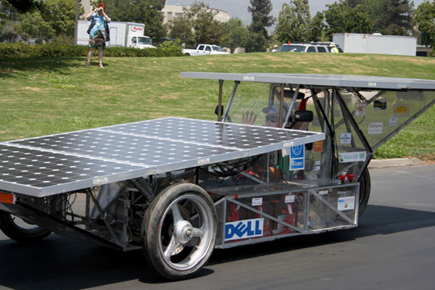
Material for the frame
Steel
Mild/Carbon Steel
Really easy to work with (MIG welding)
Inexpensive (<$1/foot)
Heavy
Can be easily changed/modified
Readily accessible
Comes in a large variety of sizes and wall thicknesses

Slide 10
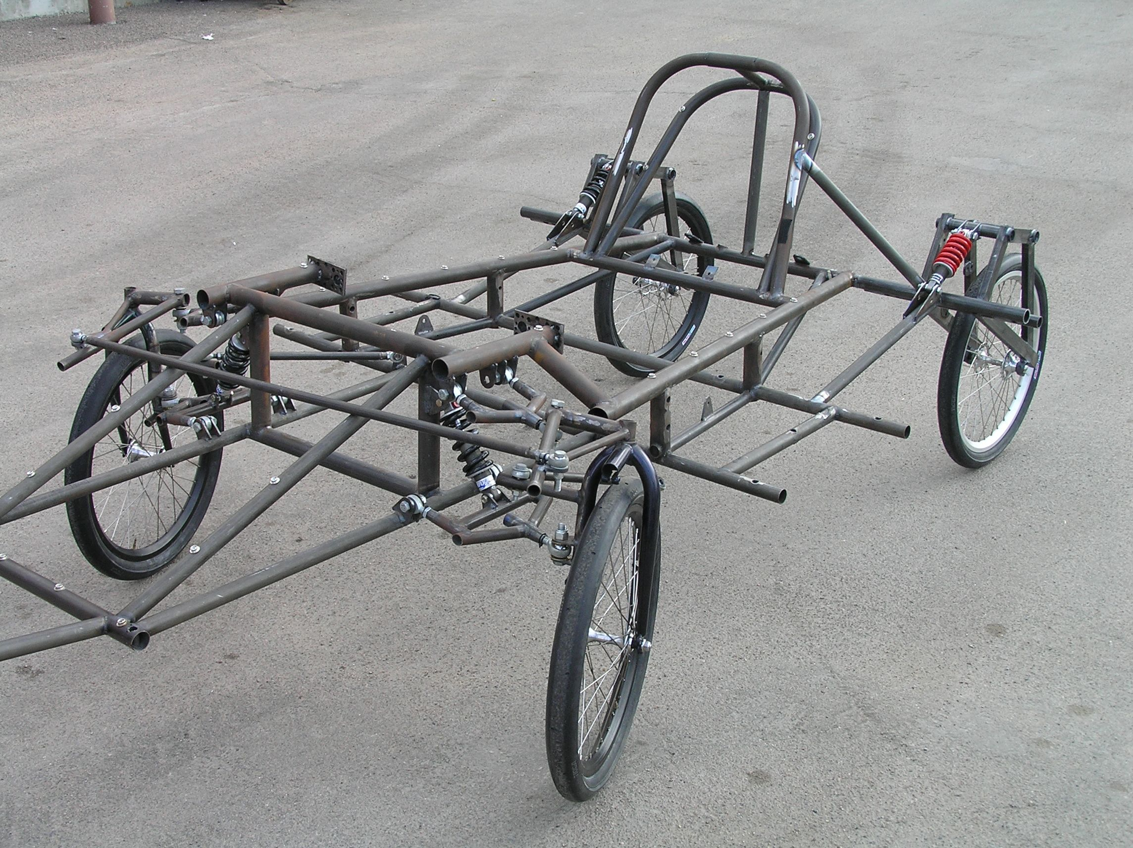
Material for the frame
Steel
Chromoly Steel
Harder to weld (requires TIG welding)
More expensive ($4/foot) (+welding wire @ $15/lb)
Light weight
Can be easily changed/modified
Comes in a large variety of sizes and wall thicknesses

Slide 11
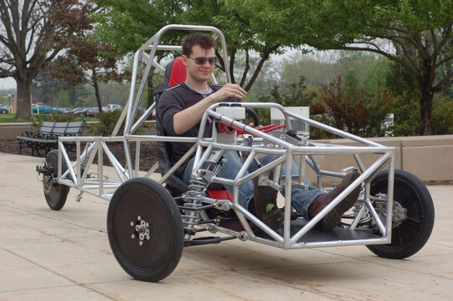
Material for the frame
Aluminum
Very stiff for its weight
Harder to weld (requires TIG welding)
Needs more material to resist fatigue

Slide 12
Material for the frame
Wicks Aircraft www.wicksaircraft.com
Aluminum and 4130 Chromoly in a lot of size choices
Online Metals www.onlinemetals.com
Titanium and a variety of plastics and metals

Slide 13
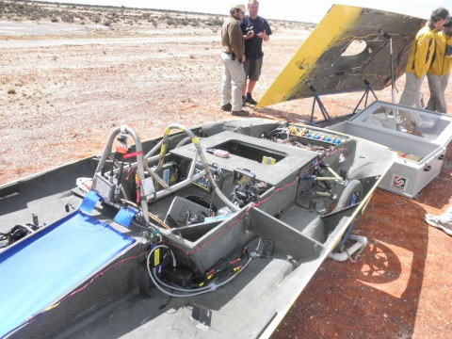
Material for the frame
Carbon Fiber (composites)
Lightest and stiffest
Can be formed to any shape
Expensive
Needs careful planning
Learning curve is steep
Very hard to repair on the side of the road
Need professional engineer certification if used for roll cage, roll bar, or crush zone

Slide 14
Material for the frame
Composites: Carbon fiber, resins, vacuum bag materials, and core materials

Slide 15
Roll Bar and Crush Zone
Roll cage must:
encompass the entire driver
be integral part of the structure
be designed to deflect body/array panels away from the driver
allow 5 cm of clearance between the driver and the roll cage
meet minimum diameter and wall thickness rules

Slide 16
Roll Bar and Crush Zone

Slide 17
Roll Bar

Slide 18
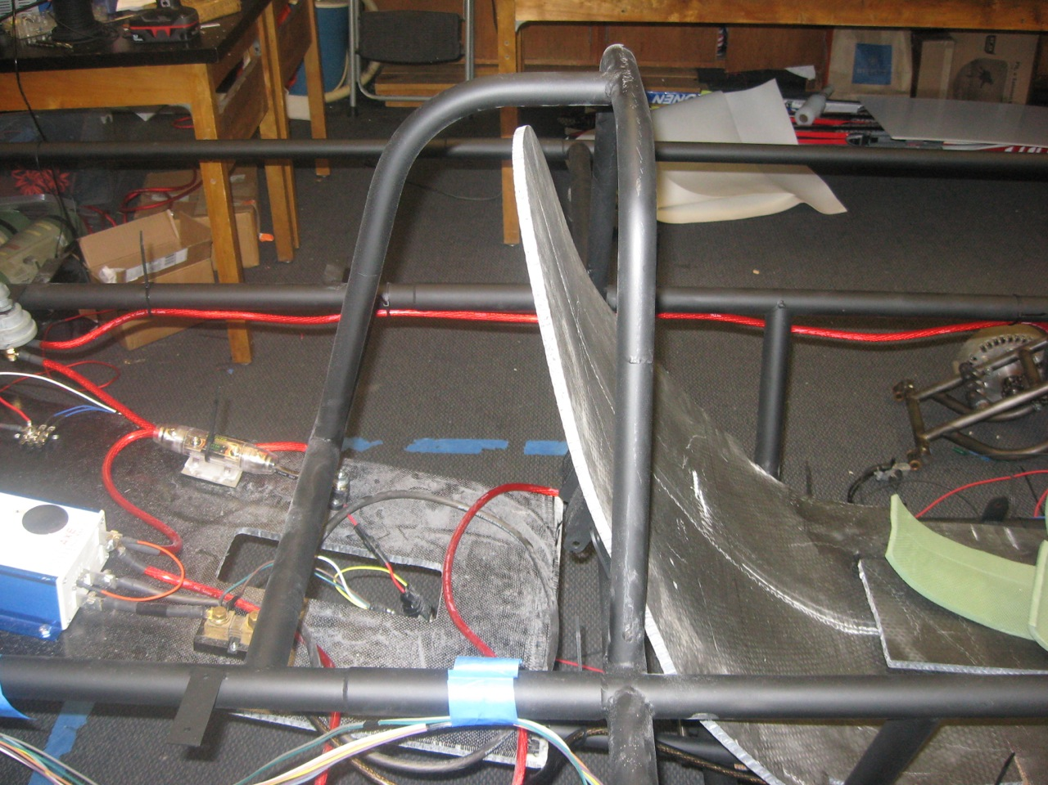
Roll Bar
Side View
Front View

Slide 19
Roll Bar and Crush Zone
Crush zone must:
be designed to absorb impact from a collision
protect the driver from front, side, and rear collisions
have a minimum of 15 cm of horizontal distance from all parts of the driver’s body
Teams must be able to demonstrate a specific, adequate crush zone in order to compete. Insufficient regard for structural safety will result in disqualification.

Slide 20
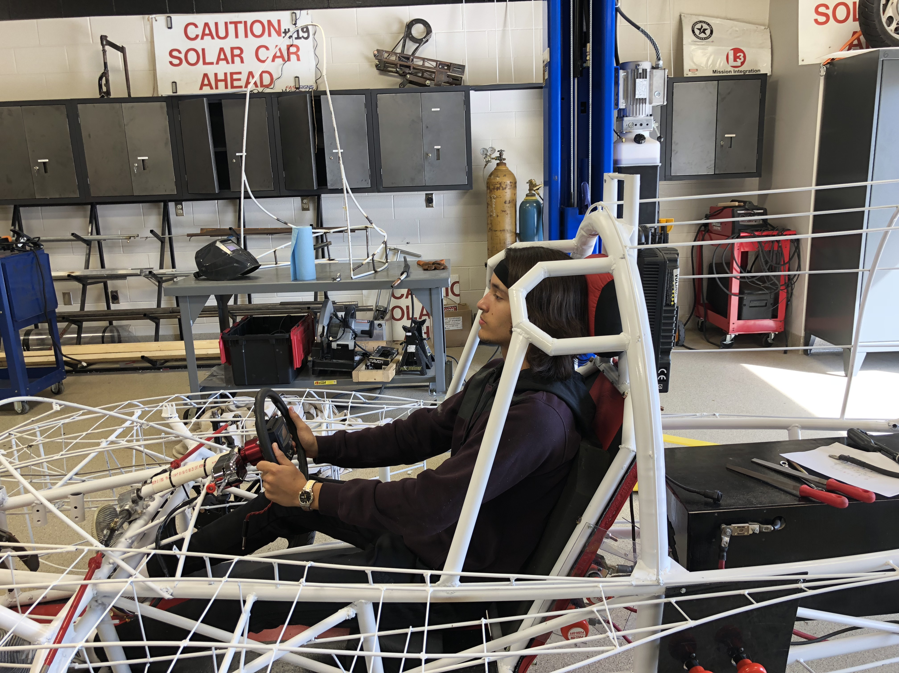
Crush Zone

Slide 21
Crush Zone

Slide 22
Specialty Workshop
Wheels, Brakes, Suspension

Slide 23
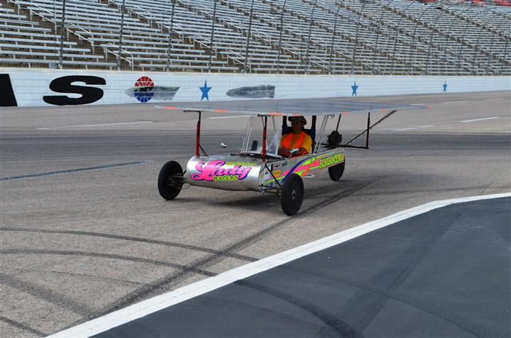
Wheels
One of the most difficult parts to source
Choices need to be made very early in the design process

Slide 24
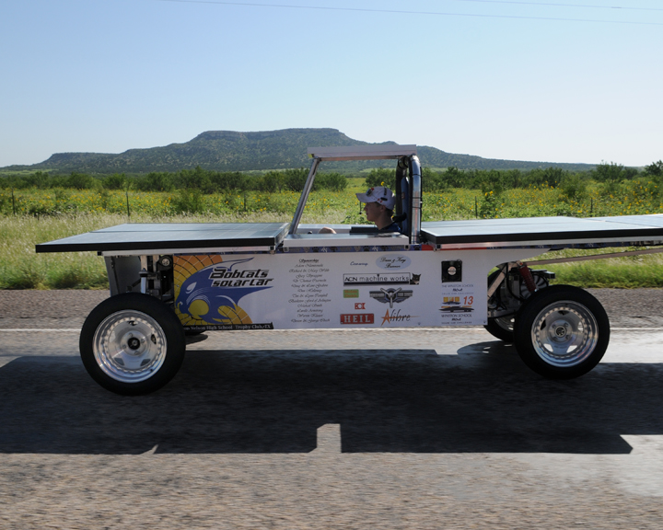
Wheels
Four wheel designs
More parts means higher cost
Harder to get alignment correct
Weight distribution less critical
Much safer in the event of a flat
Can “straddle” dead animals on the road

Slide 25
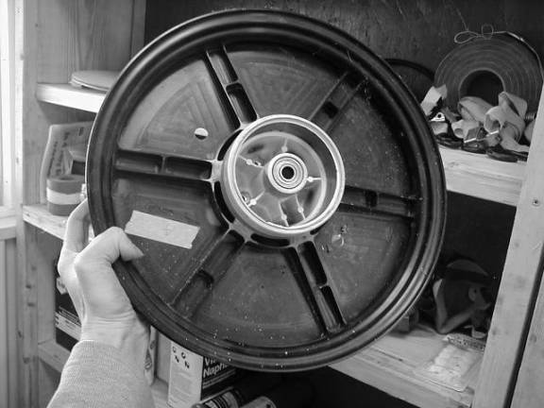
Wheels
Wheel choices (must be able to handle the weight of the car and lateral forces from turning)
NGM wheels and tires
Motorcycle
Junior Dragster
Bicycle

Slide 26
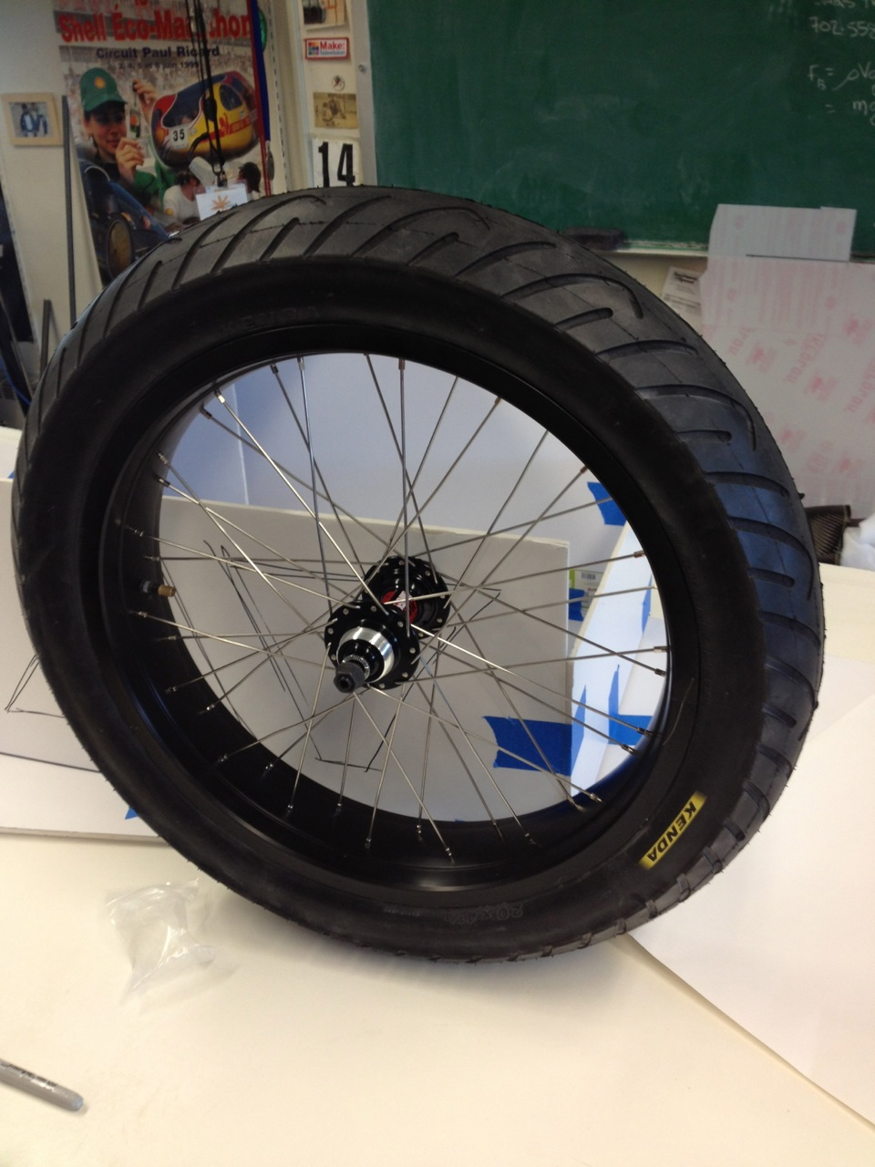
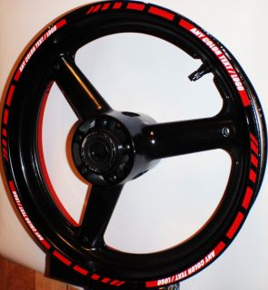
Wheels

Slide 27
Wheels
Summit Racing www.summitracing.com
Universal Cycles www.universalcycles.com
Local motorcycle boneyard or ebay.com

Slide 28
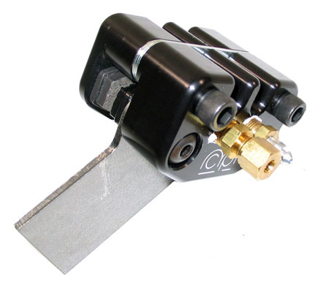
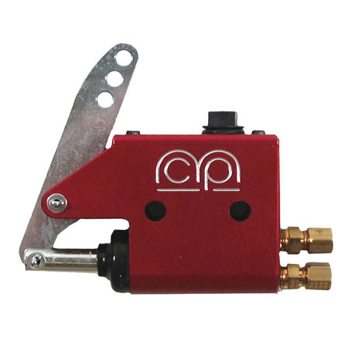
Brakes
Solar car must have two, independent, braking systems that allow the driver to stop the vehicle safely and quickly.
Most cars use hydraulic disk brakes
MCP single caliper brakes are easy to install and relatively inexpensive.
BMI Karts www.bmikarts.com

Slide 29
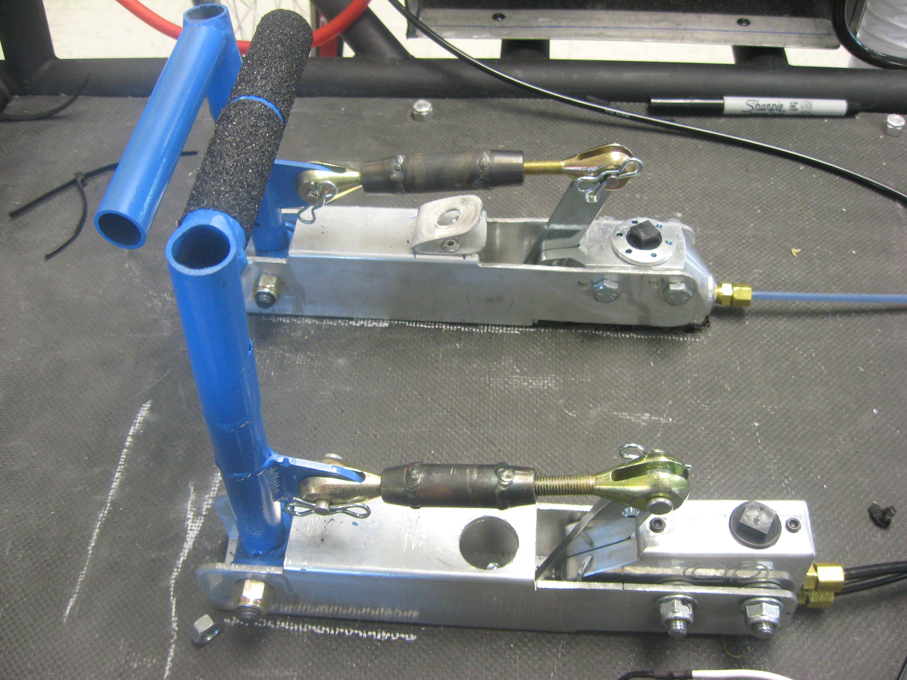
Brakes

Slide 30
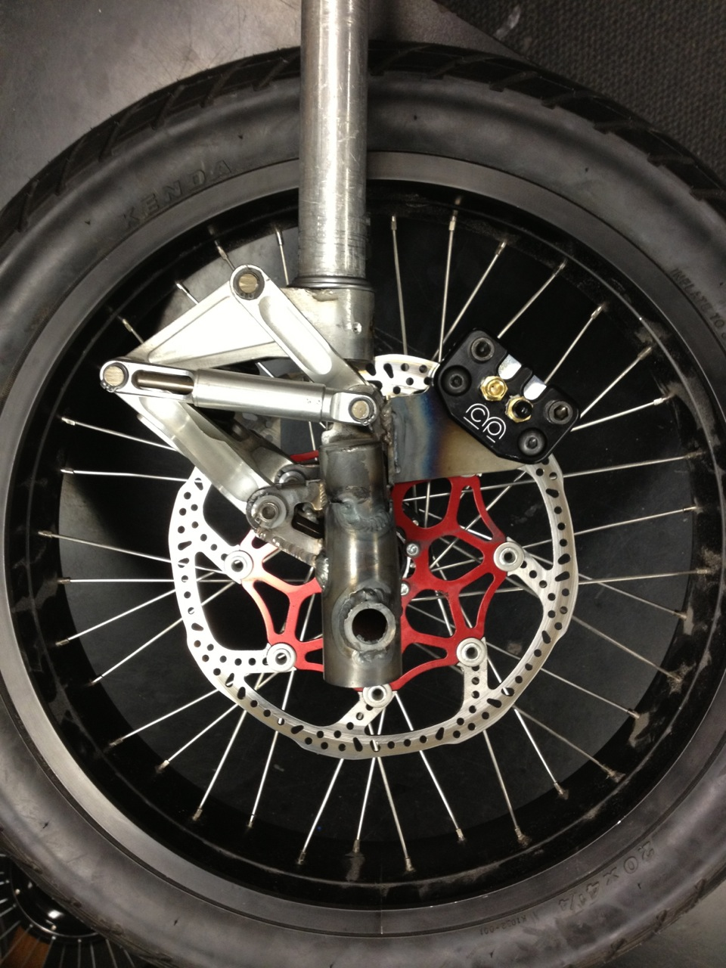
Brakes
Brakes are tested both statically and dynamically at the event.
Many vehicles have brake problems . Brakes must be tested before you arrive at the event!

Slide 31
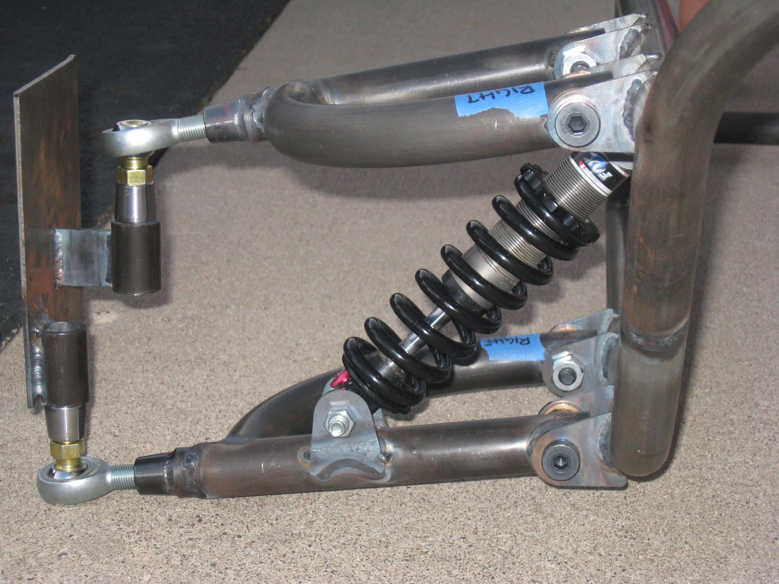
Suspension
Suspension systems
More important on the road than on the track
Adds weight and complexity to the vehicle
Protects sensitive and expensive solar and electric parts

Slide 32
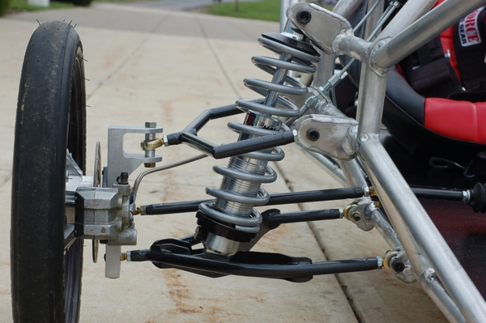
Suspension

Slide 33
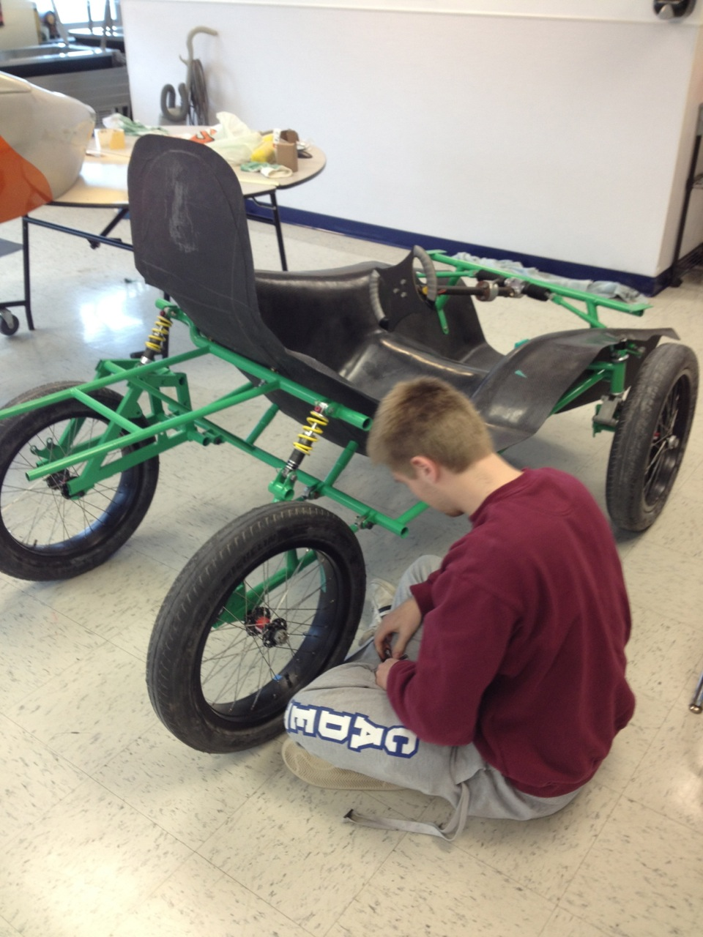
Alignment
Suspension design and alignment have a huge effect on vehicle performance and handling.
Adding adjustability is worth the added weight.
Alignment should be checked everyday!

Slide 34
Alignment
ATV A-Arm Suspension
www.ebay.com
Chassis Shop
www.chassisshop.com
FOX
www.ridefox.com

Slide 35
More Details on Suspension/Steering

Slide 36
Specialty Workshop
Powering the Solar Car

Slide 37
Powering the solar car
How do you get the car moving?
Photovoltaic array choices
Power trackers and DC-DC converters
Electric motors and controllers

Slide 38
Shape of Array
Flat Solar Arrays
Easier to execute
Angle to sun less of a concern
Curved Solar Arrays
Higher the angle the greater chance for breaks without ideal support.
Angle to sun more of a concern

Slide 39
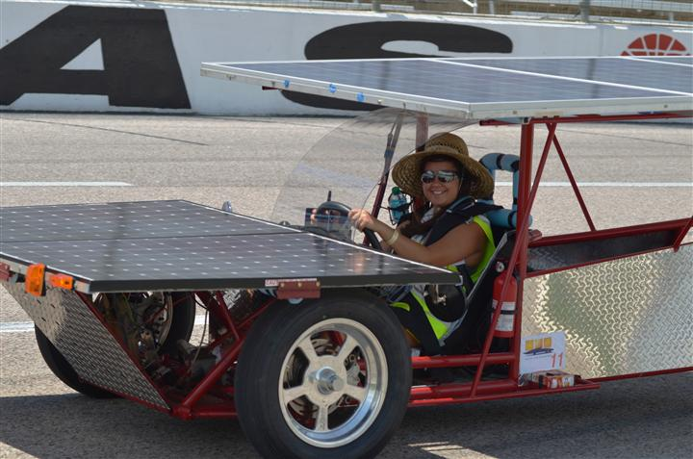
The Solar Array
Pre-made panels
Reliable
Easily purchased
HEAVY (glass front adds weight)
www.wholesalesolar.com
www.civicsolar.com

Slide 40
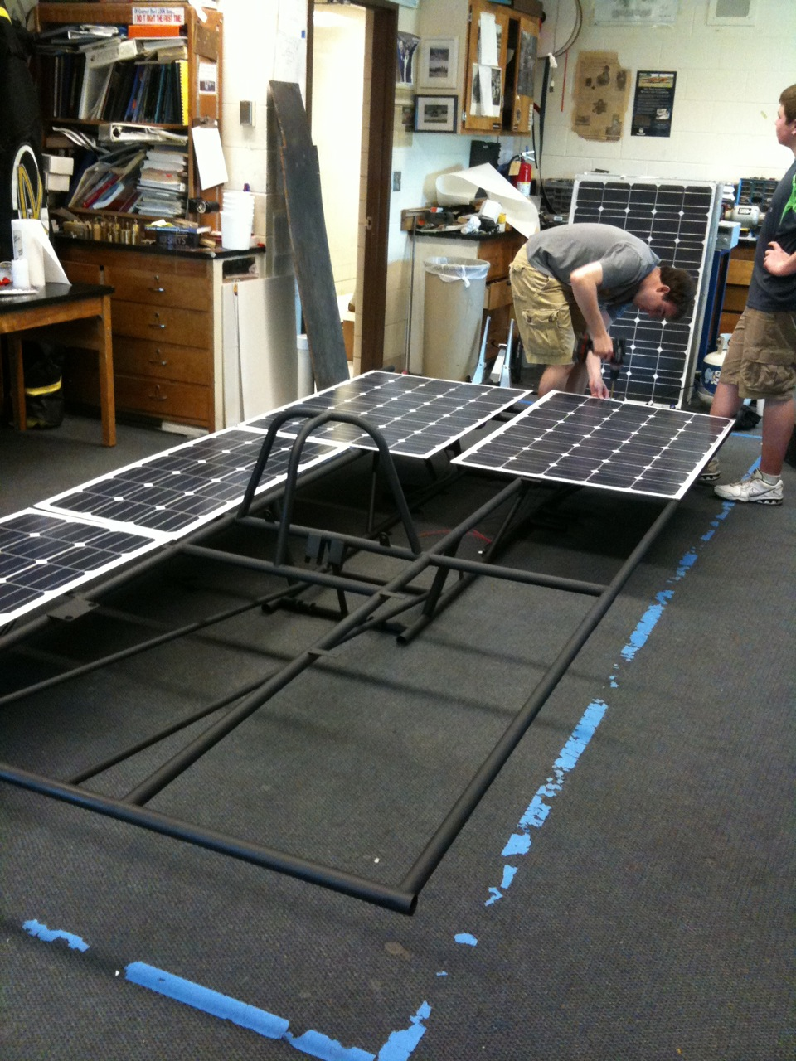
The Solar Array
Premade or Custom Lightweight Options
SBMSolar.com

Slide 41
The Solar Array
Raw cells and lamination
Planning has to start FAR in advance (you are probably too late already!)
Process is expensive
Panels are very light and can be built to fit your car
Easy to maximize power and reduce aerodynamic drag
Sun Cat Solar Allen Chuzel Elgin, Arizonia
(602) 710-0477

Slide 42
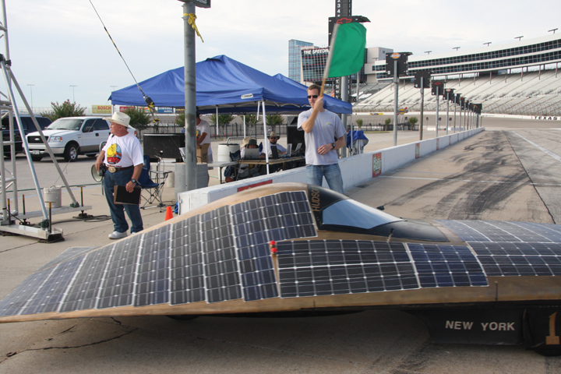
Laminated Cells

Slide 43
The Solar Array
Do-it-yourself solar array
Amazing learning experience
Learning curve is steep
Hard to find raw cells → work with SunPower directly
Takes a lot of manpower
Hard to watch when cells are continually breaking
Can fit exactly to your car

Slide 44
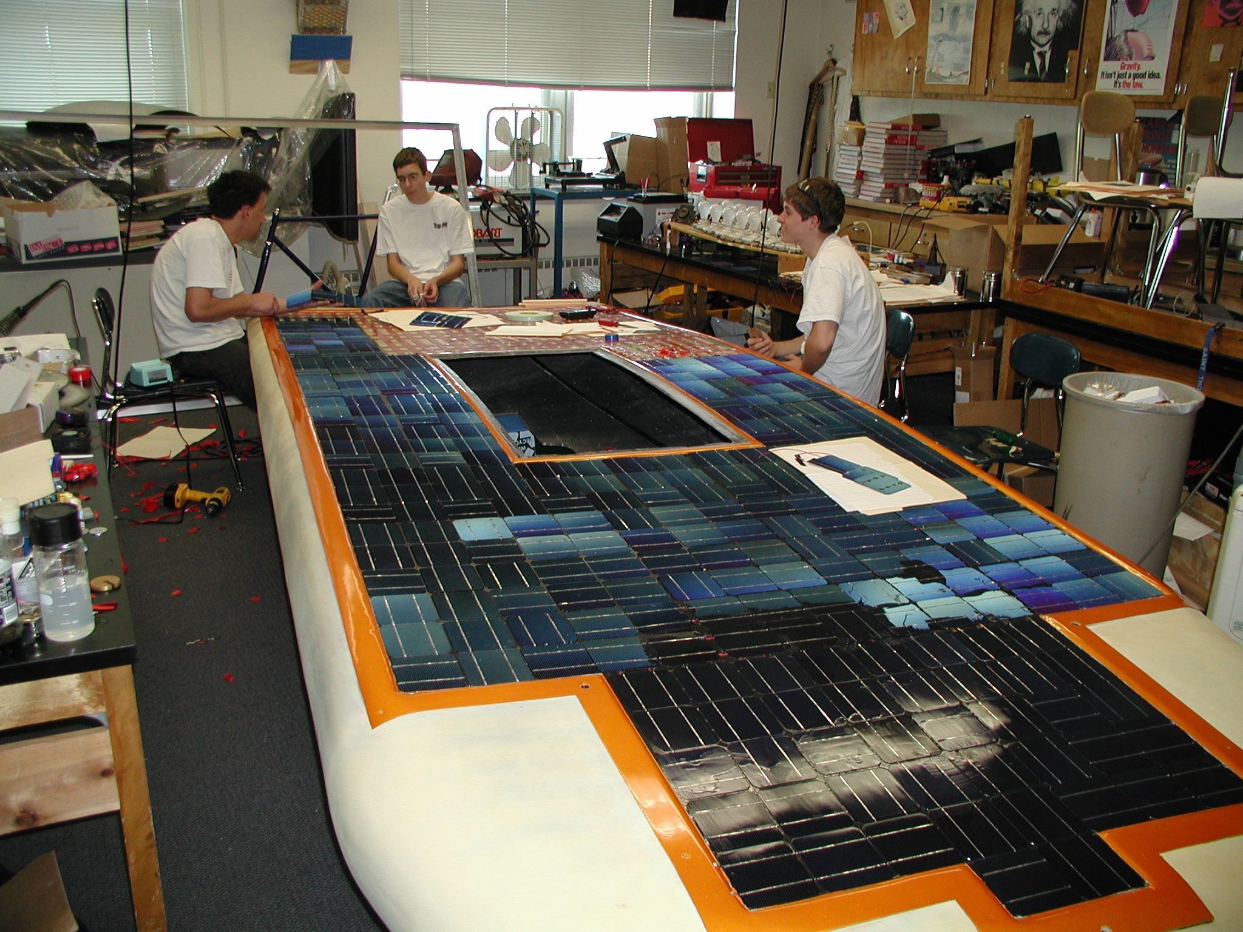
Do-it-yourself

Slide 45
Do-it-yourself

Slide 46
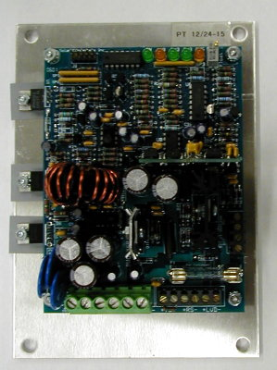
MPPT and DC-DC Choices
AERL (Australian Energy Research Laboratories) www.aerl.com.au
Solar Converters Inc
Outback (and other grid type MPPTs) www.midnightsolar.com
DC-DC Converters www.kellycontroller.com
Genasun www.genasun.com

Slide 47
AERL MPPTs

Slide 48
Low Voltage Indicator
Do-It-Yourself kit available at:
http://store.qkits.com/
Look for “Low Voltage Alarm”

Slide 49
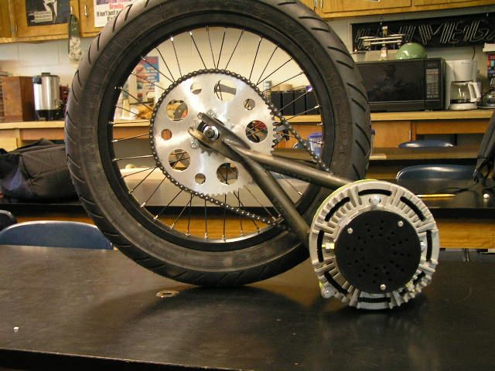
Electric Motors
Brushed Electric Motors
Inexpensive
Lower overall efficiency
Controller is inexpensive and easy to wire
Brushless Electric Motors
Very efficient
More expensive
Controller is more difficult to wire (typically 3 phase)

Slide 50
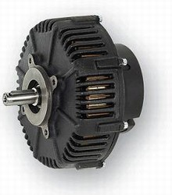
Brushed Motor Examples
Briggs and Stratton ETEK
Lynch LM200
PMG 132 Perm Motor
Cloud Electric www.cloudelectric.com
Electric Motorsport www.electricmotorsport.com
Thunderstruck Motors www.thunderstruck-ev.com
Robot Market Place www.robotmarketplace.com

Slide 51
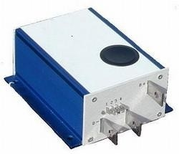
Brushed PWM Controller
Alltrax AXE
Easy to wire
0-5k Pot control
Programmable
Durable

Slide 52
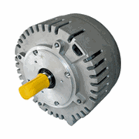
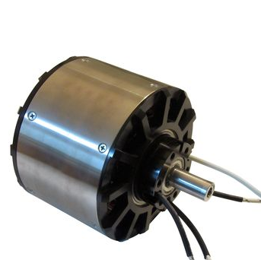
Brushless Motor Example
Motenergy ME0907 Brushless PMSM/BLDC www.evdrives.com
Revolt http://www.revolt.org.il

Slide 53
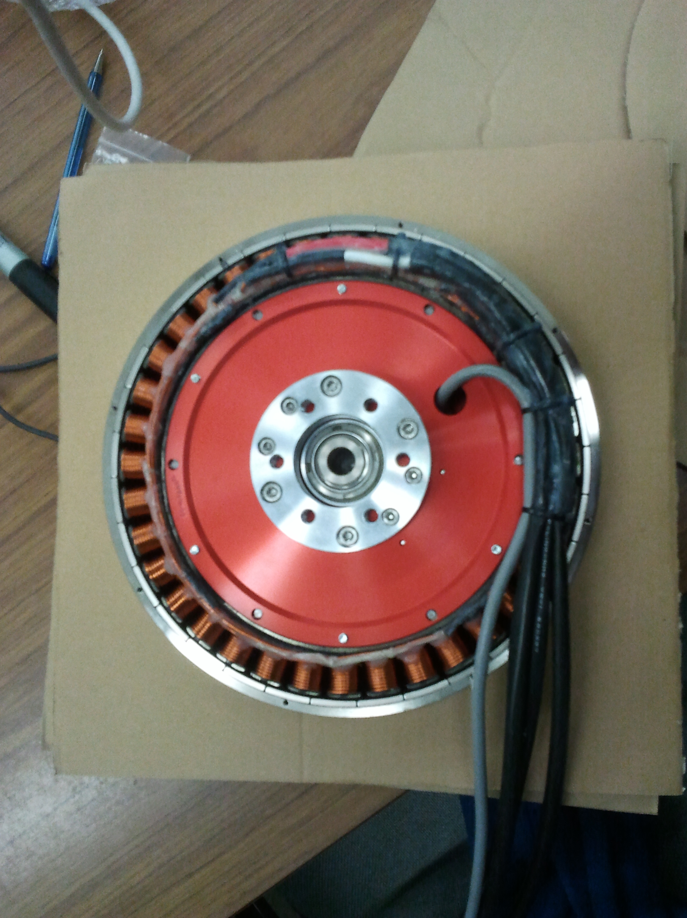
Hub Motor
NGM ‘Direct Drive’ high efficiency in-hub motor with variable air gap adjustment.
Super efficient over a broad range of speeds
No need for gears or chain
Very expensive (Motor + controller > $25,000)
Mitsuba / Nomuri hub motors replacing NGM as favored motor for solar car teams
Still ~$25,000

Slide 54
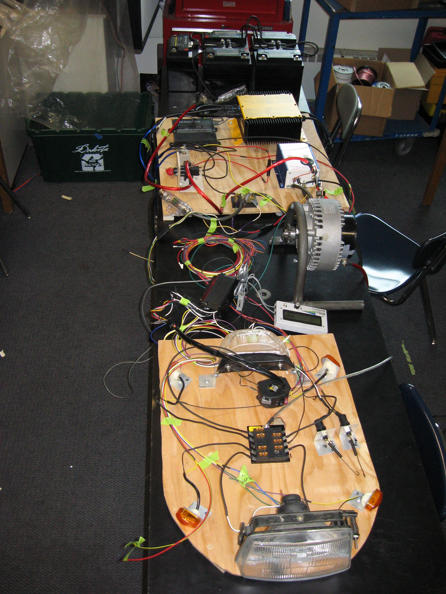
Electrical System
Main electrical system (the one that makes your car move)
Use the correct gauge wire for the job
Disconnect switches should be designed for DC
Fuses
Secondary electrical system (everything else on your car)
Lights
Fans
Horn

Slide 55
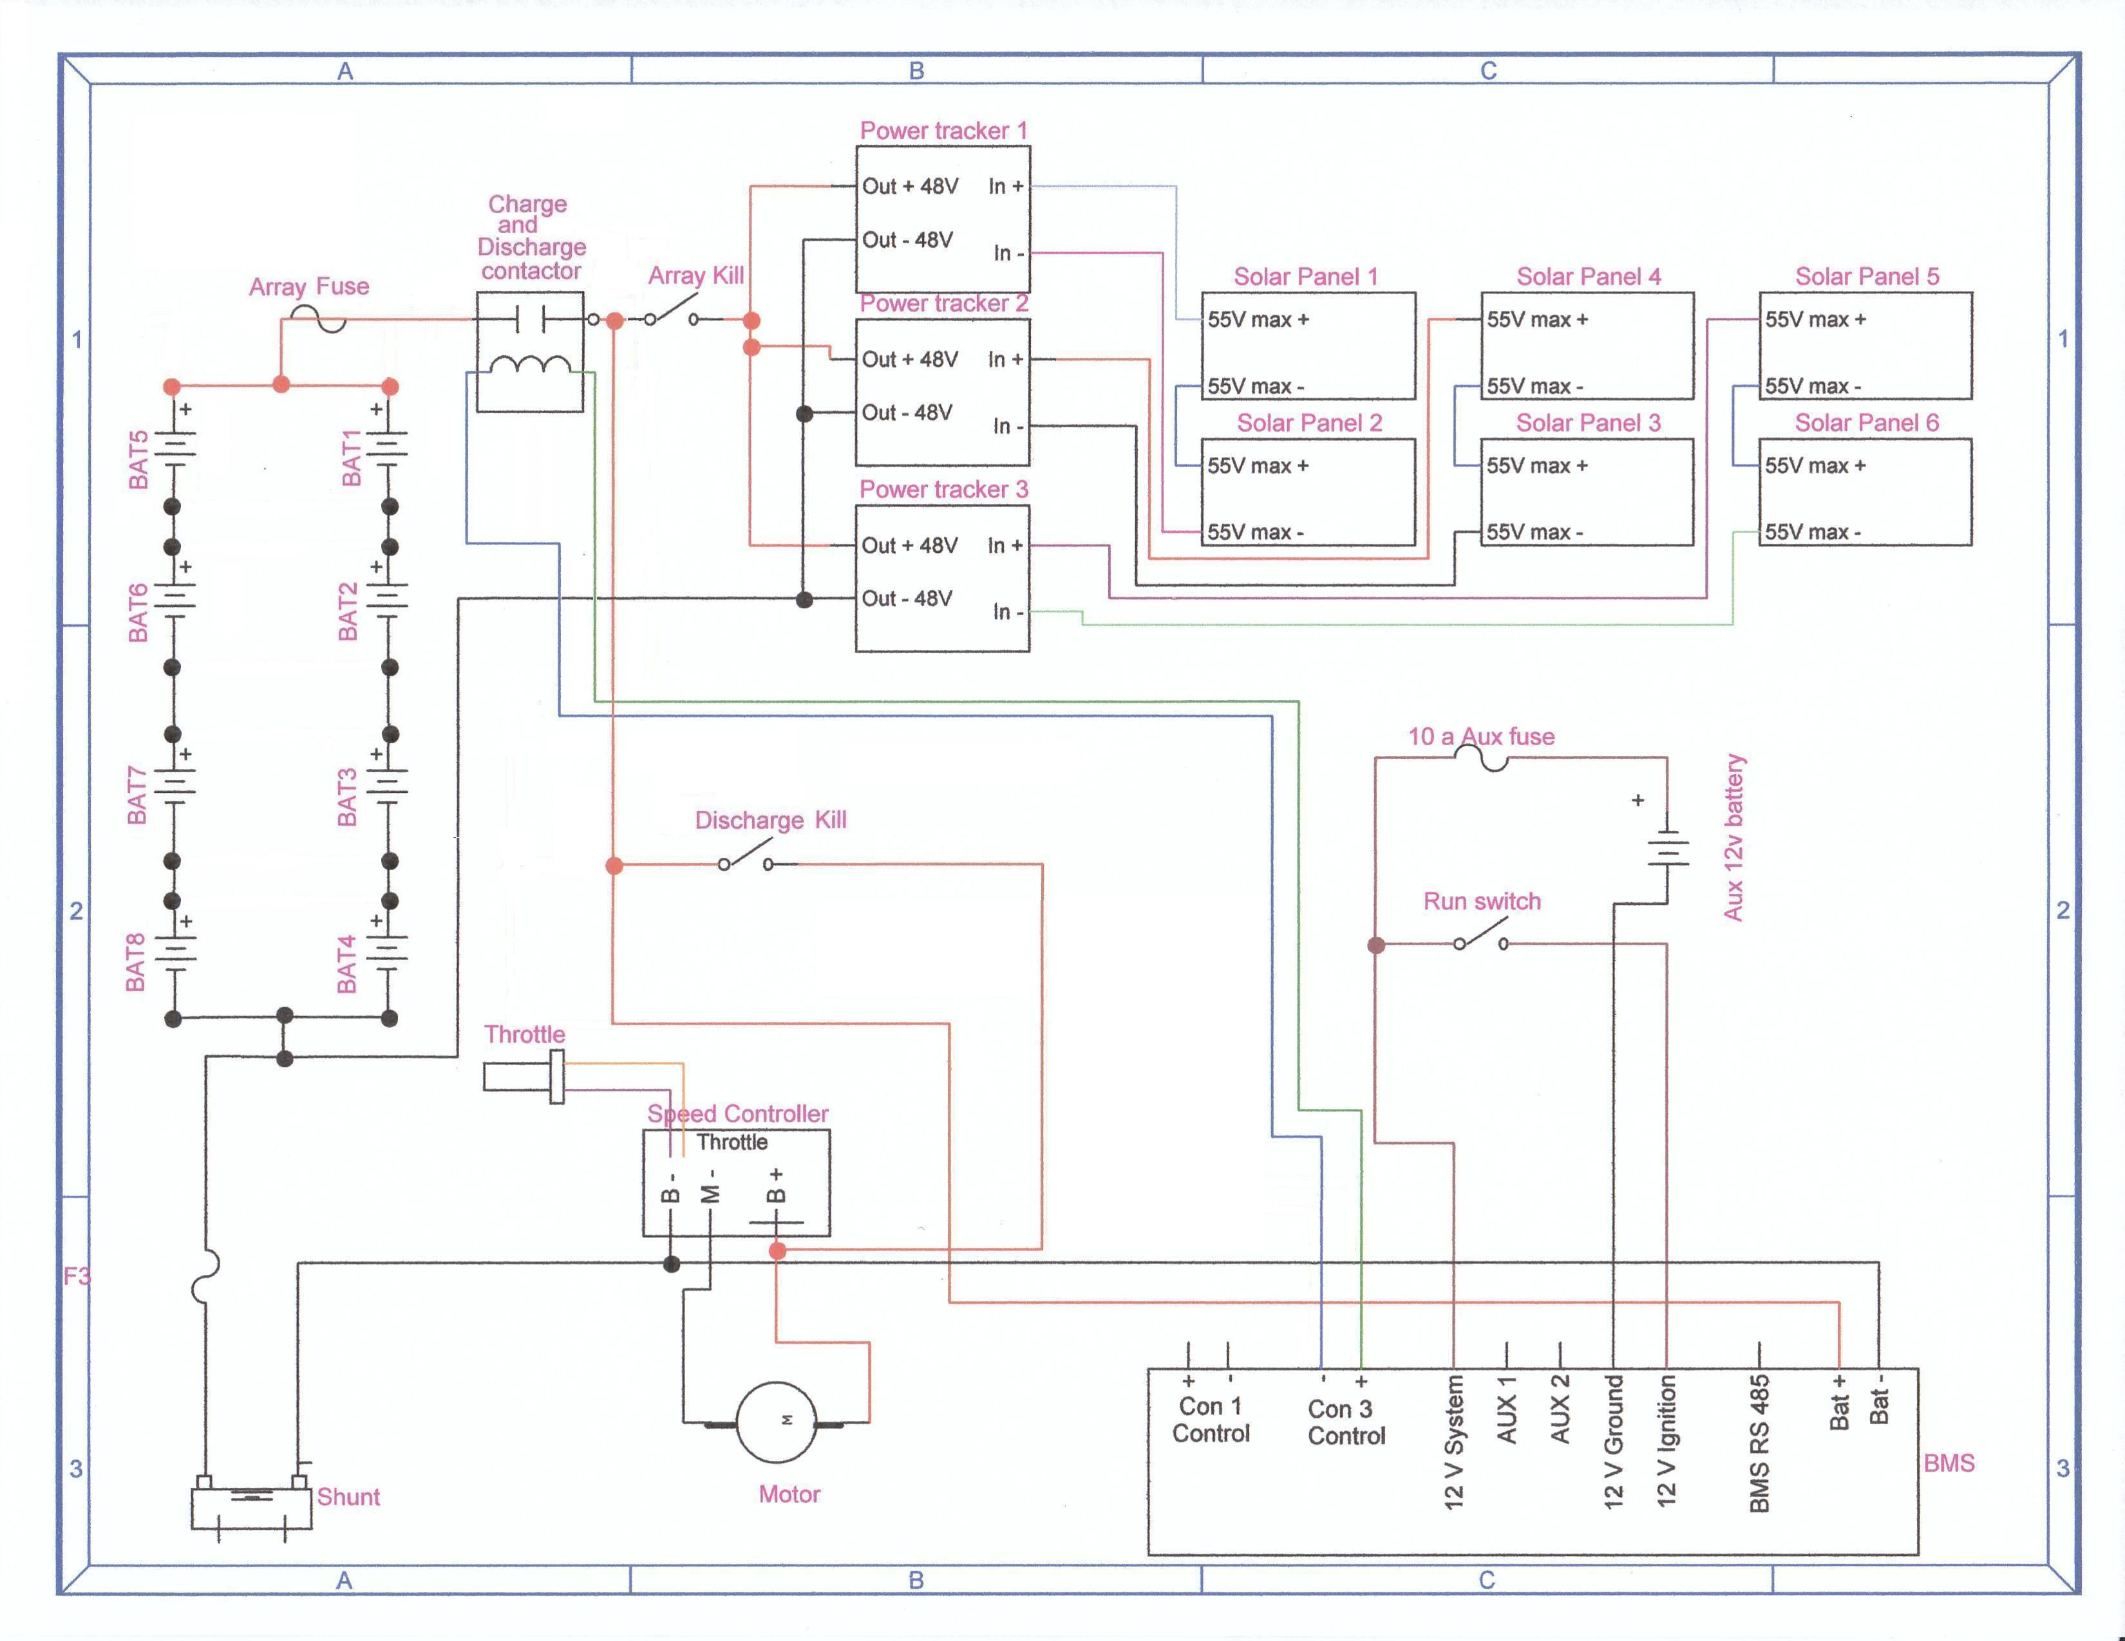
Electrical System Layout

Slide 56
Electrical System Layout
Schematic made with:
http://www.digikey.com/schemeit/
Or use Solid Edge to set schematic (can get wire lengths)

Slide 57
Electrical System

Slide 58
Batteries
Choose carefully young padawan!
Batteries are one of the areas where you get what you pay for.
Decisions to make:
What voltage does your car run at?
Higher voltage means lower current (smaller wires)
How much weight can you carry?
How much energy can you get at that weight?
Can your solar panels recharge the battery pack?
Is it a road race or a track race?

Slide 59
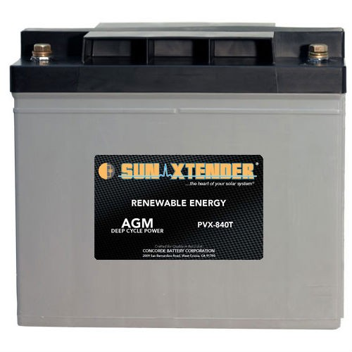
Batteries
The 5 kilowatt-hour rule
kw-h = Amp-hours x Voltage
(at the 20 hour discharge rate)
Example:
Four, 12 volt, 84 amp-hour batteries in series
84ah x 48 v = 4032 watt-hours or 4.032 kilowatt-hours
(this battery pack would weigh around 230 pounds)

Slide 60
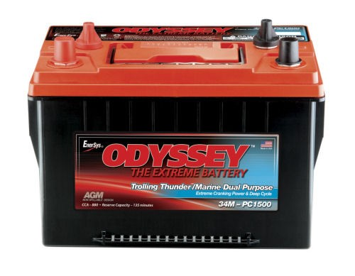
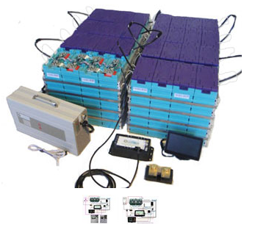
Batteries
Some of our favorites:
Concorde Sun Xtender series
84 Ah $245/battery www.wholesalesolar.com
EnerSys Odyssey Marine series
68 Ah $250/battery
Lithium Batteries Battery Space www.batteryspace.com

Slide 61
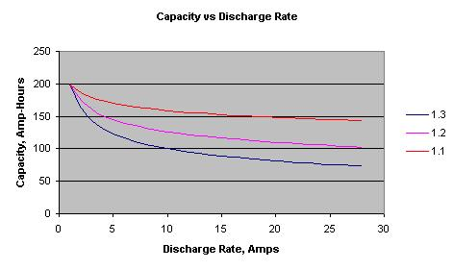
Batteries
Choosing batteries based on the Peukert number:
A typical sealed lead acid battery has a Peukert number between 1.1 and 1.3. (The closer to 1.0 the better!)

Slide 62
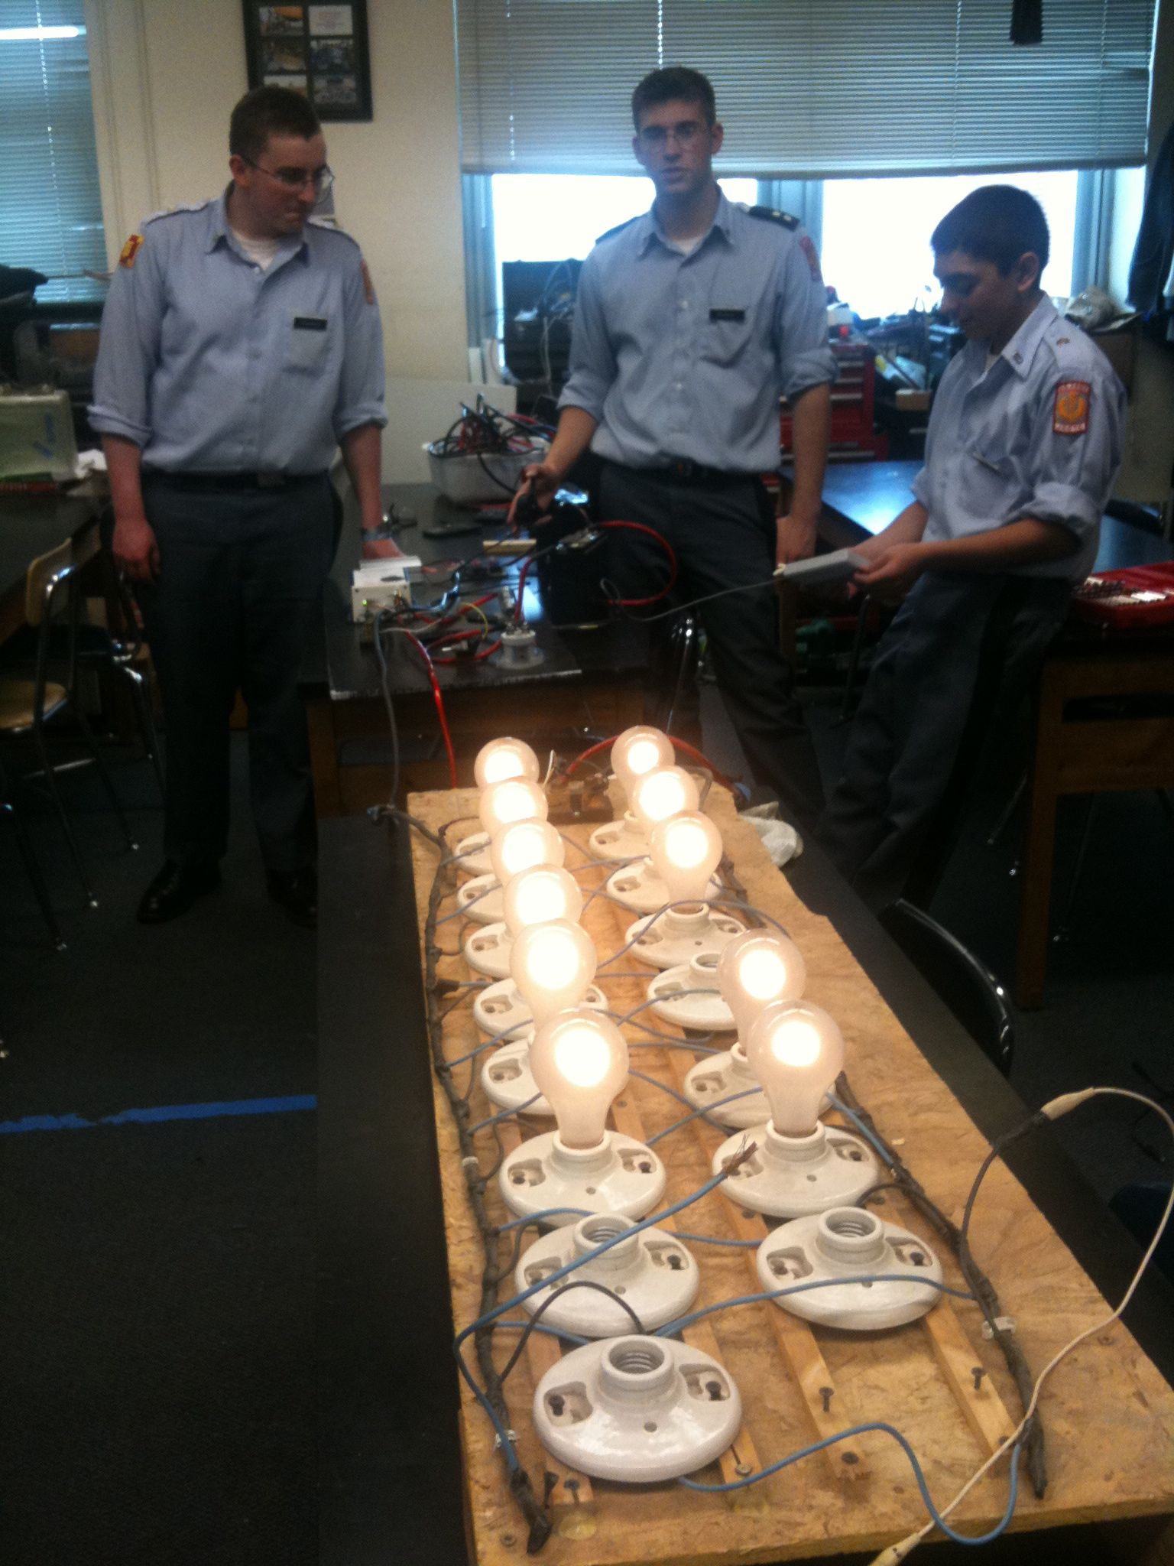
Batteries
Testing batteries:
Understanding how your batteries perform is one of the most important things you can know BEFORE the race starts.
Carefully recording voltage, current, and amp-hours will help your team make good decisions during the race

Slide 63
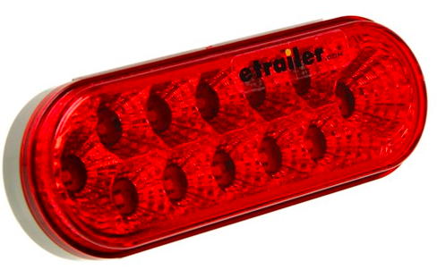
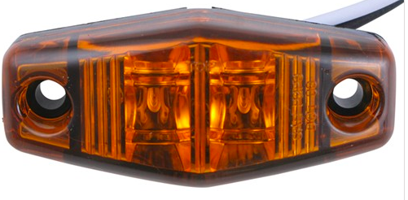
Lights/Turn signals
Low-draw LED lights are easy to find.
Etrailer www.etrailer.com
Grainger www.grainger.com (ECCO lights)
O’Reilly Auto Parts www.oreillyauto.com

Slide 64
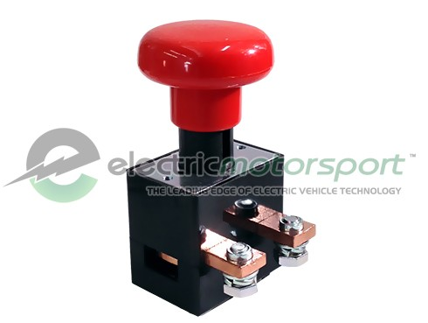
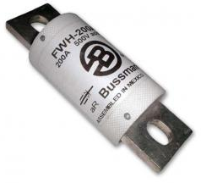
Switches/Fuses
There are a lot of resources for switches and fuses. Be sure they meet the race requirements before ordering!
Be sure they are rated for your DC system. (AC rating will not qualify!)
(Bussmann FWH Fuses are rated at 500V DC)
Electric Motorsport www.electricmotorsport.com
Tecknowledgey
http://www.tecknowledgey.com
Single Pole On/Off Rated load: 400 A Break Current: 1200 A @ 48 V DC (600 A @ 96 V DC)
500V DC @90 amp fuse is about $50

Slide 65
Specialty Workshop
Power Management

Slide 66
Power Management
How much power does it take to make your car go down the road?
The amount you will use depends on:
Aerodynamic drag
Rolling friction
Weight
Electrical system resistance

Slide 67
Power Management
A typical Solar Car Challenge vehicle array produces 800-1000 watts of power.
There is approximately 12 hours of usable sunlight during a race day.
800 watts x 12 hours = 9600 watt-hours of energy/day. (Assuming clear skies and good sun.)
A full-size, fully-charged battery pack has approximately 4000 watt-hours of energy.
It will take approximately 5000 watt-hours of energy to completely recharge the battery pack.

Slide 68
Power Management
Dead Batteries are dead weight
A 48 volt battery pack is “dead” at 42 volts.
It will take (at least) 5 hours of full sun to completely recharge a dead battery pack.
Hills, clouds, trees, wind, and children with sticky fingers all reduce your array efficiency.
The only way you will know how much energy your car will use is to test it.
Keep a record of current draw vs. mph (It is not linear!)

Slide 69
Strategic Decisions
First step in power management is deciding your high-level strategy (without looking at numbers)
Do you empty your battery pack each day and recharge as much as possible during off-hours?
Do you end the day with as much energy as you can recover during off-hours?
Do you run down a certain capacity each day so you end up with no energy left on the last day (e.g. run down ¼ of pack each day for 4 day event)?
Do you run based on net draw (motor – solar) or motor draw?
No right answers; just decisions the team must make

Slide 70
Set Targets Based on Strategy
If strategy is to empty battery pack each day, and you have a 100 Ah battery pack, how fast should the driver drive?
Trick question: Driver does not drive based on speed, but current draw.
OK, how much current should driver be taking from the battery?
100 Ah / 6 hours of racing (Classic Division) = 16.7 A, right?
Classic Division runs 9am-12pm, 2-5pm, with 2 hours lunchtime in between. How much charge will I get back during the two hours?
Assume 1000W panel, 48 V system = ~20 A → 40 Ah
After 3 hours of racing at 16.7A, would have (100Ah – 16.7A x 3 hrs = 49.9Ah)
After 2 hours of charge time, 49.9 Ah + 40 Ah = 89.9 Ah left
Rest of racing period = 89.9 Ah / 3 hrs = 30 A
To get the same current draw throughout the day, what should the current draw be?
100 Ah + 40 Ah = 140 Ah / 6 hours = 23.3 A

Slide 71
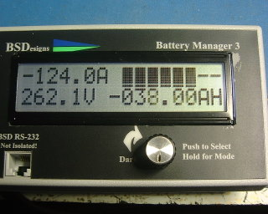
Collecting Data
How to measure what your car is doing:
Voltmeter and/or ammeter
Batman measurement system (Bruce Sherry Design)
Link (e-meter)

Slide 72
What Data is Important?
Different teams have different answers to this!
Typical measurements include:
Battery Voltage (measured under load)
Motor current draw (the rate that you are taking energy out)
Array current (the rate that you are putting energy back in)
Amp-hours or Watt-hours (how much total energy you have taken out or put back in)

Slide 73
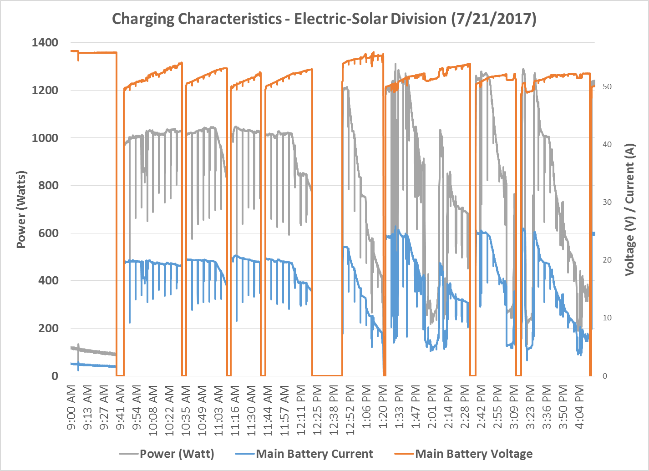
What’s Interesting About This Data?

Slide 74
Charging Characteristics
Power stays fairly constant throughout racing period (~1000 W)
Power input drops near end of charging period (takes more power to fill pack)
Battery voltage remains fairly stable, even when current changes (because of MPPT)

Slide 75
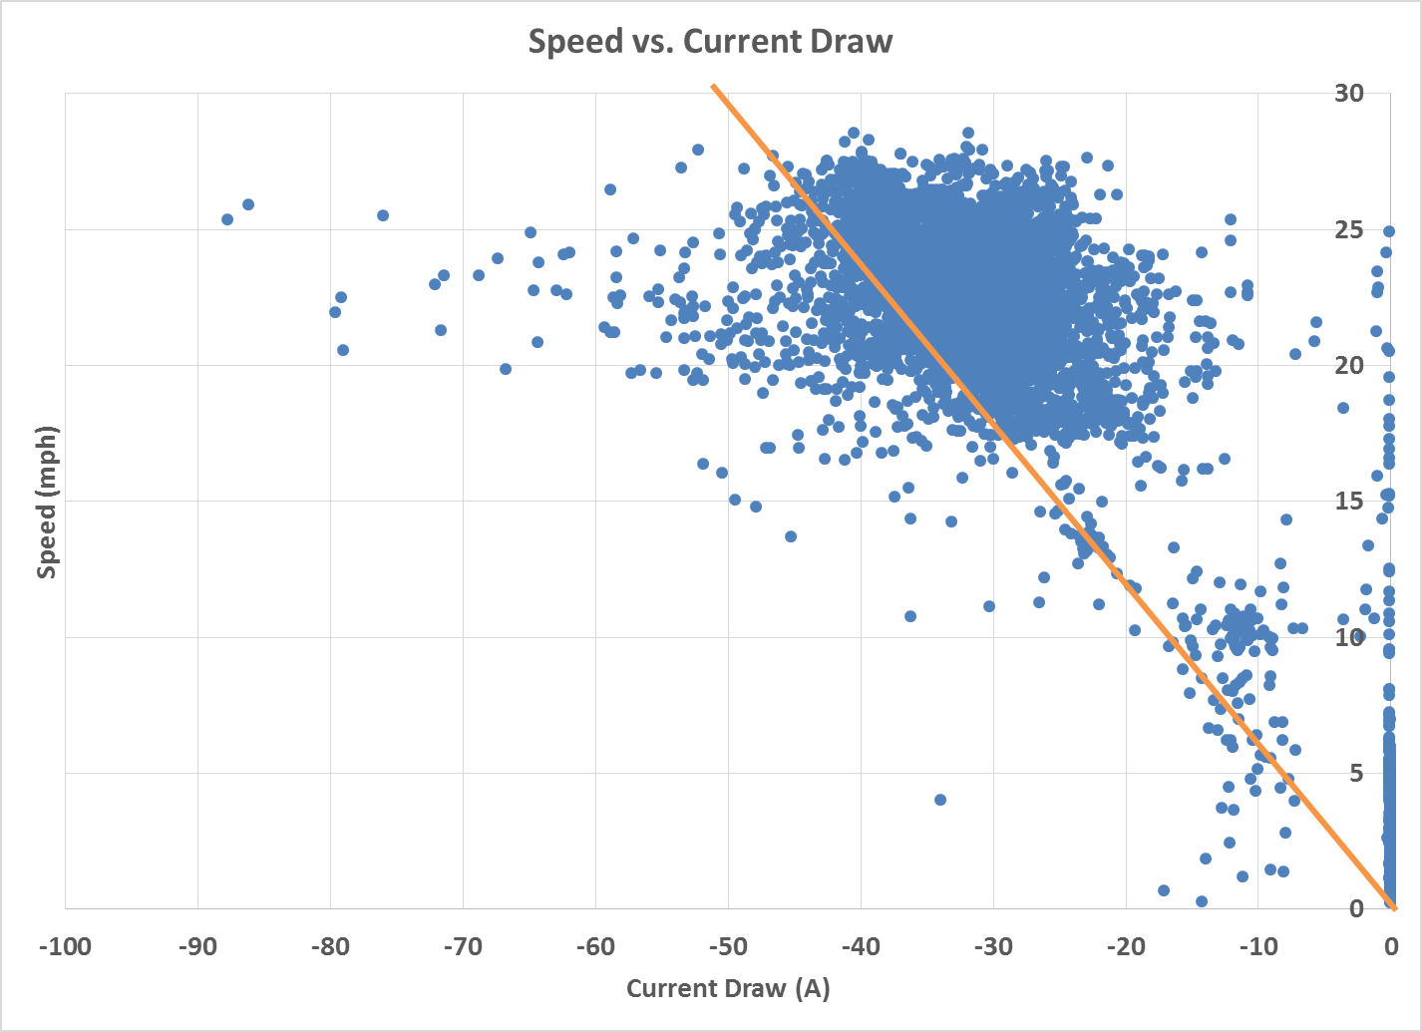
What’s Interesting About This Data?

Slide 76
Discharge Characteristics
Current draw is not directly correlated to speed; associated with acceleration
Wide range of current draw for specific speed, including outliers

Slide 77
How Do I Get The Right Data
Test! Test! Test!
Multiple runs at different speeds
Test both uphill and downhill (at different grades)
Simulated race days

Slide 78
Making Decisions

Slide 79
Getting Data to the Right People
Driver should not need to make decisions other than driving.
Pit crew should inform driver about “speeding up” or “slowing down”.
One person should be responsible for communicating with the driver.
Telemetry systems

Slide 80
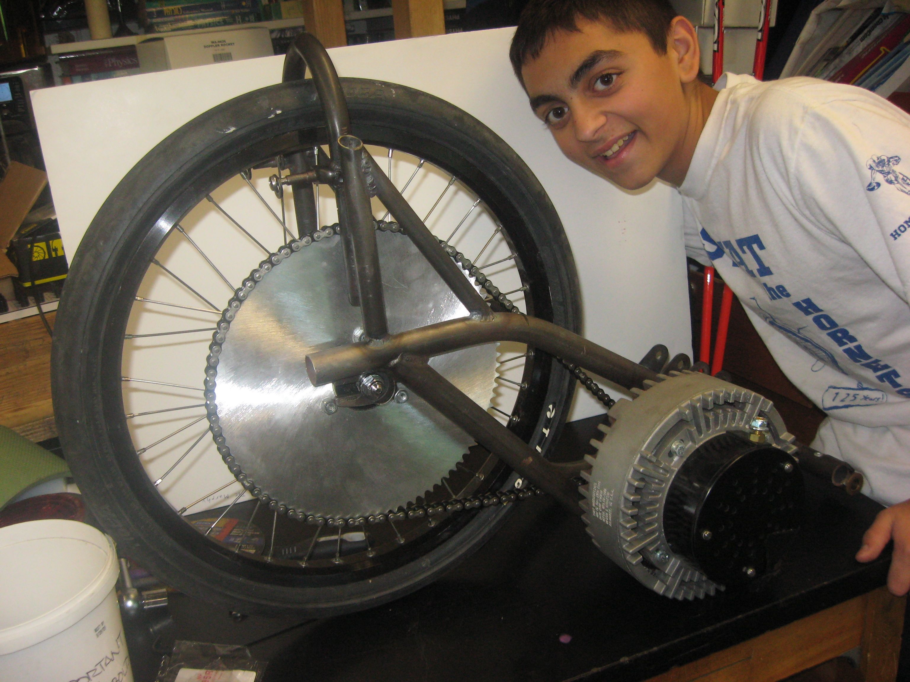
Choose the Correct Gears
Don’t gear a car for 50 mph if you are going to drive it at 25 mph. Be realistic about your cars speed!
Chain drive systems can be very efficient if gears are aligned and lubricated.
Pictured: 48V system, 15 tooth front, 70 tooth rear. Max speed = 36 mph

Slide 81
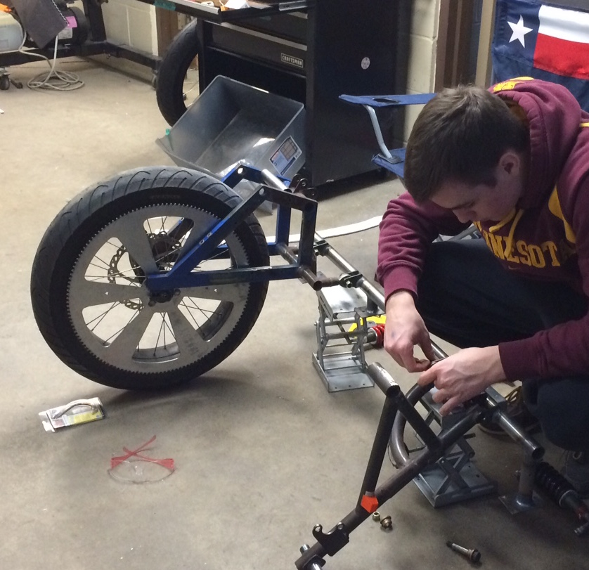
Choose the Correct Gears
Custom Sprockets:
Rocket Sprockets www.rocketsprocket.net
PMP Sprockets www.pmpsprocket.com

Slide 82
Other Power Management Considerations to Research & Test
How does weather affect charging?
How much power do you get at different angles of sun?
How does different array shapes/angles affect charging?
How does the route topology (or track layout) affect power usage?
Other Considerations?

Slide 83
Specialty Workshop
Aerodynamics & Friction

Slide 84
Rolling Resistance
Bearings can be opened, cleaned, and filled with a light oil.
Tires with thin “supple” casings roll better than thick casings. (Higher risk of flats)
Fat tires roll better than thin tires. (But weigh more.)
If it rotates: lubricate!
Wheel alignment is critical to reducing rolling resistance.

Slide 85
Aerodynamic Drag
Reducing drag is the least expensive way to improve your solar car.
The extra weight of drag reducing fairings is easily made up for in aerodynamic efficiency.

Slide 86
Shrink Wrap Body Cover
Made from 7-mil shrink-wrap that is used to protect boats in the winter.
Shrink-wrap is cut to shape and taped to the car with inexpensive tape that is made for the material.
A common heat gun can be used to shrink the material.
The material cools and maintains a semi-rigid surface.
Easily repaired with tape.

Slide 87
Cut and Tape the Material

Slide 88
Reinforce and Heat

Slide 89
Trim to fit around fairings
Shrink Wrap
Big Shrink www.bigshrink.com
Comes in a variety of colors and thicknesses

Slide 90
Specialty Workshop
Solar Car Challenge

