Slide 1
Solar Car Power Management
William Shih, Deputy Race Director

Slide 2
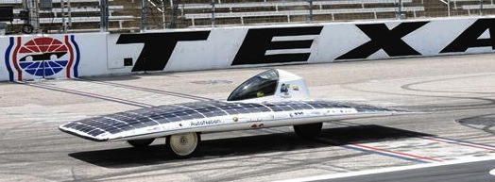
Power Management
How much power does it take to make your car go down the road? The amount you will use depends on:
  Aerodynamic drag
  Rolling friction
  Weight
  Electrical system resistance
  Driver skill/style

Slide 3
How Much Power Do I Have?
A typical Solar Car Challenge vehicle array produces 800-1000 watts of power.
There is approximately 12 hours of usable sunlight during a race day.
800 watts x 12 hours = 9600 watt-hours of energy/day. (Assuming clear skies and good sun.)
A full-size, fully-charged battery pack has approximately 4000 watt-hours of energy.
It will take approximately 5000 watt-hours of energy to completely recharge the battery pack.

Slide 4
Power Management Considerations
Dead Batteries are dead weight
  A 48 volt battery pack is “dead” at 42 volts.
It will take (at least) 5 hours of full sun to completely recharge a dead battery pack.
Hills, clouds, trees, wind, and children with sticky fingers all reduce your array efficiency.
The only way you will know how much energy your car will use is to test it.
Keep a record of current draw vs. mph (It is not linear!)

Slide 5
Strategic Decisions
First step in power management is deciding your high-level strategy (without looking at numbers)
  Do you empty your battery pack each day and recharge as much as possible during off-hours?
  Do you end the day with as much energy as you can recover during off-hours?
  Do you run down a certain capacity each day so you end up with no energy left on the last day (e.g. run down ¼ of pack each day for 4 day event)?
Do you run based on net draw (motor – solar) or motor draw?
No right answers; just decisions the team must make

Slide 6
Set Targets Based on Strategy
If strategy is to empty battery pack each day, and you have a 100 Ah battery pack, how fast should the driver drive?
  Trick question: Driver does not drive based on speed, but current draw.
OK, how much current should driver be taking from the battery?
  100 Ah / 6 hours of racing (Classic Division) = 16.7 A, right?
  Excluding lower capacity for Pb-Acid batteries due to Peukert’s exponent
Classic Division runs 9am-12pm, 2-5pm, with 2 hours lunchtime in between. How much charge will I get back during the two hours?
  Assume 1000W panel, 48 V system = ~20 A → 40 Ah
  After 3 hours of racing at 16.7A, would have (100Ah – 16.7A x 3 hrs = 49.9Ah)
  After 2 hours of charge time, 49.9 Ah + 40 Ah = 89.9 Ah left
  Rest of racing period = 89.9 Ah / 3 hrs = 30 A
To get the same current draw throughout the day, what should the current draw be?
  100 Ah + 40 Ah = 140 Ah / 6 hours = 23.3 A

Slide 7
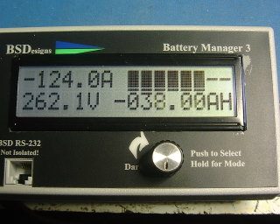
Collecting Data
How to measure what your car is doing:
  Voltmeter and/or ammeter
  Batman measurement system (Bruce Sherry Design)
  Link 10 (e-meter)
Data collected via:
  Telemetry systems
  Driver report

Slide 8
What Data is Important?
Different teams have different answers to this!
Typical measurements include:
  Battery Voltage (measured under load)
  Motor current draw (the rate that you are taking energy out)
  Array current (the rate that you are putting energy back in)
  Amp-hours or Watt-hours (how much total energy you have taken out or put back in)

Slide 9
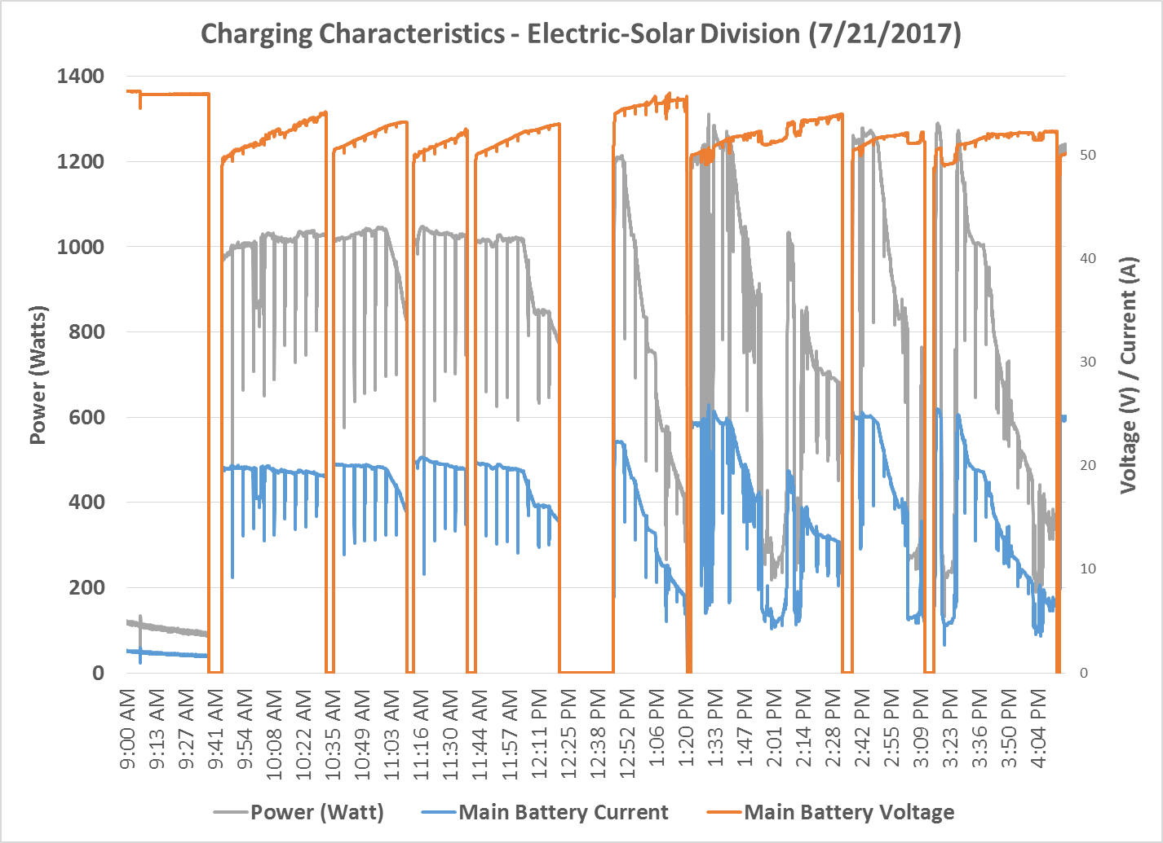
What’s Interesting About This Data?

Slide 10
Charging Characteristics
Power stays fairly constant throughout racing period (~1000 W)
Power input drops near end of charging period (takes more power to fill pack)
Battery voltage remains fairly stable, even when current changes (because of MPPT)

Slide 11
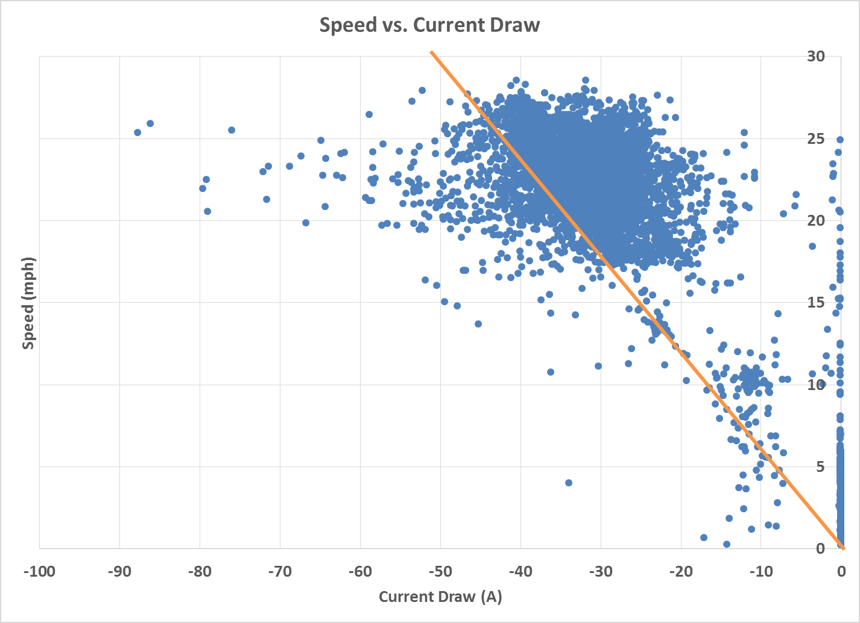
What’s Interesting About This Data?

Slide 12
Discharge Characteristics
Current draw is not directly correlated to speed; associated with acceleration
Wide range of current draw for specific speed, including outliers

Slide 13
How Do I Get The Right Data
Test! Test! Test!
Multiple runs at different speeds
Test both uphill and downhill (at different grades)
Simulated race days

Slide 14
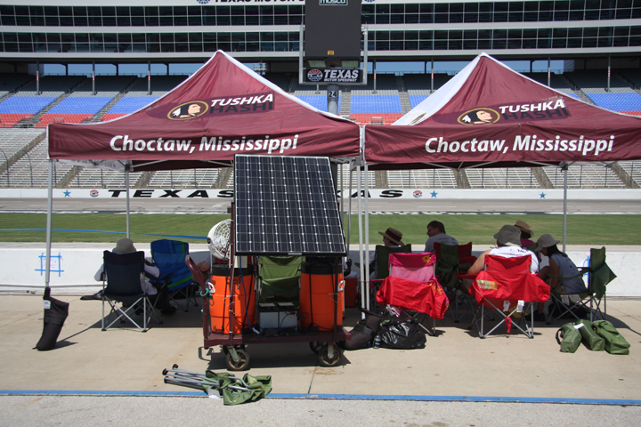
Making Decisions

Slide 15
Getting Data to the Right People
Driver should not need to make decisions other than driving.
Pit crew should inform driver about “speeding up” or “slowing down”.
One person should be responsible for communicating with the driver.
Telemetry systems can be used not only to collect input data, but also determine optimal output (current draw, speed, etc.).

Slide 16
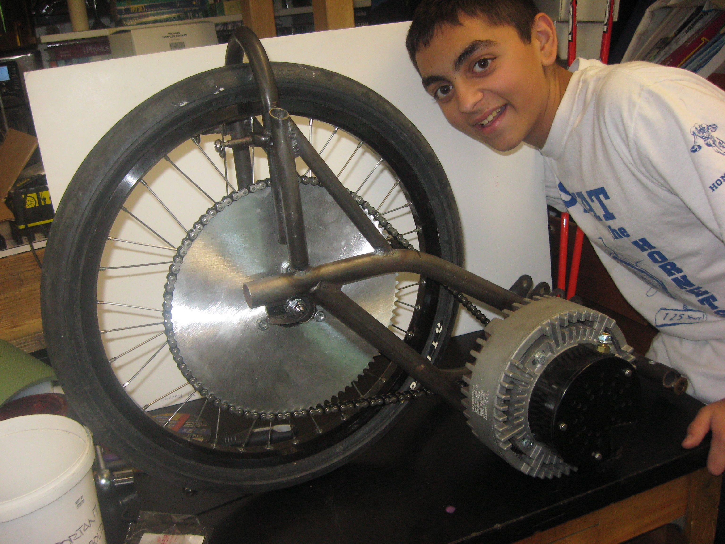
Choose the Correct Gears
Don’t gear a car for 50 mph if you are going to drive it at 25 mph. Be realistic about your cars speed!
Chain drive systems can be very efficient if gears are aligned and lubricated.
Pictured: 48V system, 15 tooth front, 70 tooth rear. Max speed = 36 mph

Slide 17
Other Power Management Considerations to Research & Test
How does weather affect charging?
How much power do you get at different angles of sun?
How does different array shapes/angles affect charging?
How does the route topology (or track layout) affect power usage?
Other Considerations?

Slide 18
Summary
Determine high-level strategy for how best to use collected solar energy
Test, test, test to collect data need to convert high-level strategy to tactical decisions
Analyze test data for trends; characterize data for your solar car
Train strategy team to look at real-time data and make decisions
Execute your plan

Slide 19
Solar Car Power Management
William Shih, Deputy Race Director

