Slide 1
Specialty Workshop
Aerodynamics, Weight, & Friction

Slide 2
Aerodynamics vs. Weight
If I were to choose one thing, what would I focus on?
Dependent on speed
Track vs. road race
“Uphills/Downhills” on turns

Slide 3
Aerodynamic Drag
Reducing drag is the least expensive way to improve your solar car.

Slide 4
Aerodynamic Drag

Slide 5
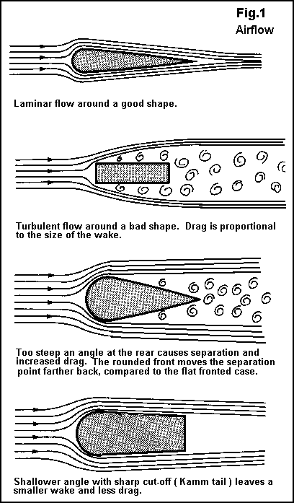
Aerodynamic Drag
Drag starts at the back of the vehicle, not the front. Hence the name “drag”.
Choose shapes that release airflow smoothly.
Fairings can be made from many common and light weight materials.

Slide 6
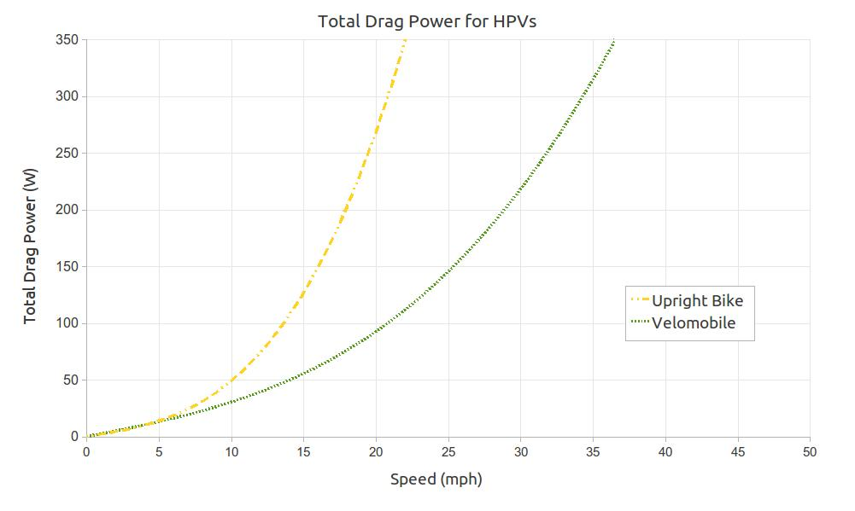
Aerodynamic Drag
This is the enemy number one to a solar car’s efficiency.

Slide 7
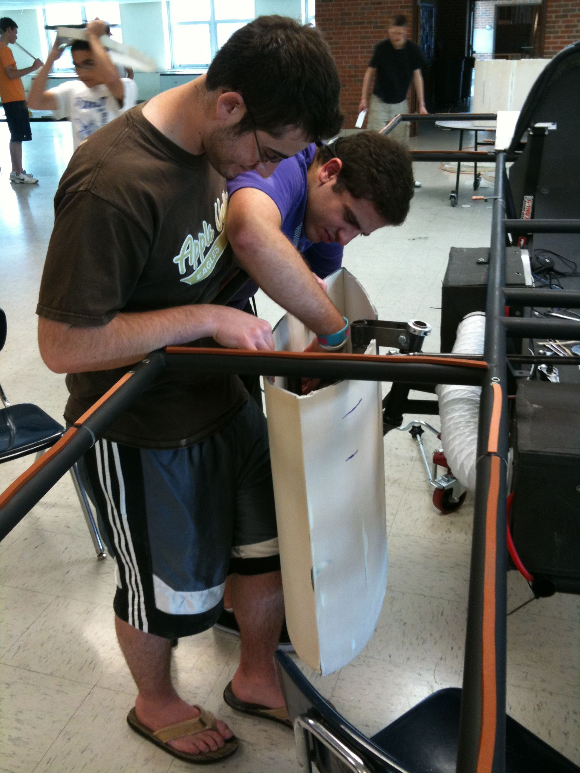
Inexpensive Wheel Fairing
Things you need:
Foam core board
Razor Blade
Hot glue
Carbon fiber or Fiberglass reinforcement
Epoxy resin
Creativity
Body filler

Slide 8
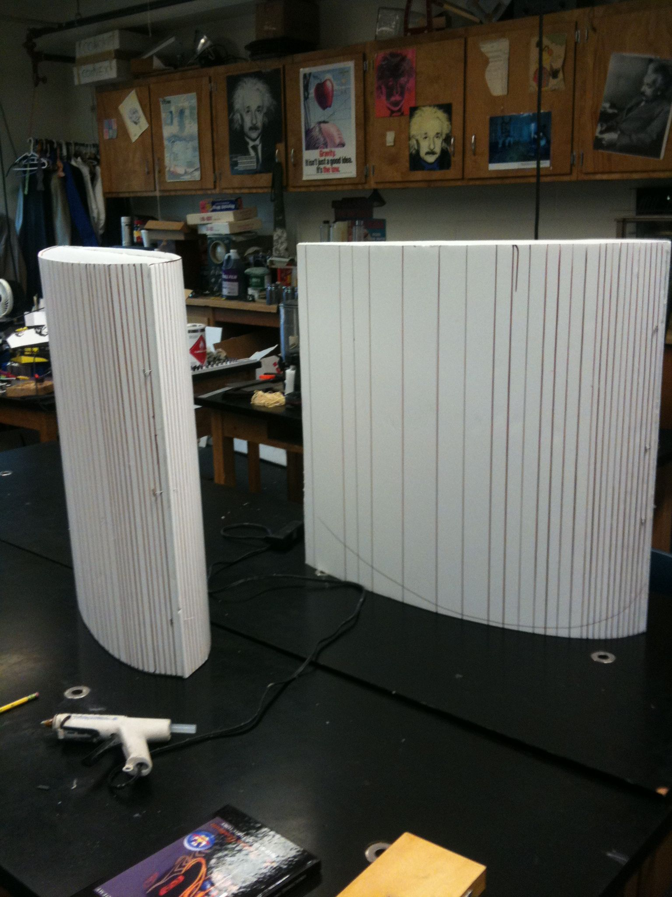
Wheel Fairings
Cut foam core board to shape
Score with a razor blade
Bend to shape
Glue

Slide 9
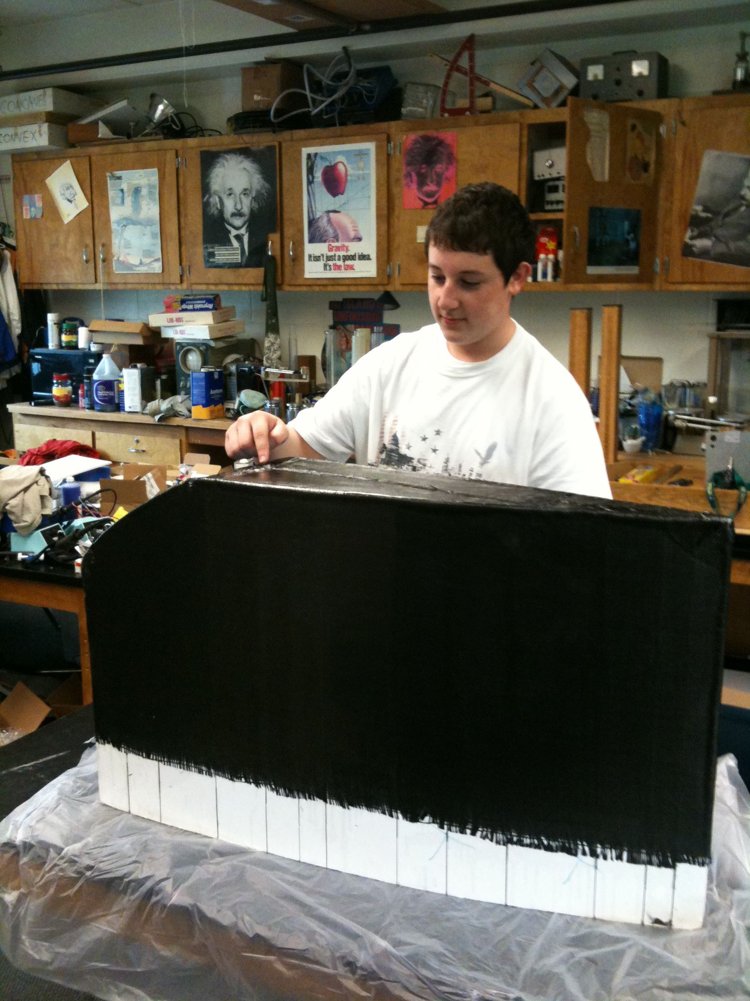
Adding Reinforcement
One or two layers of Carbon or Fiberglass cloth is enough.
Epoxy resin won’t eat through the foam core.
Squeege excess resin from fabric.

Slide 10
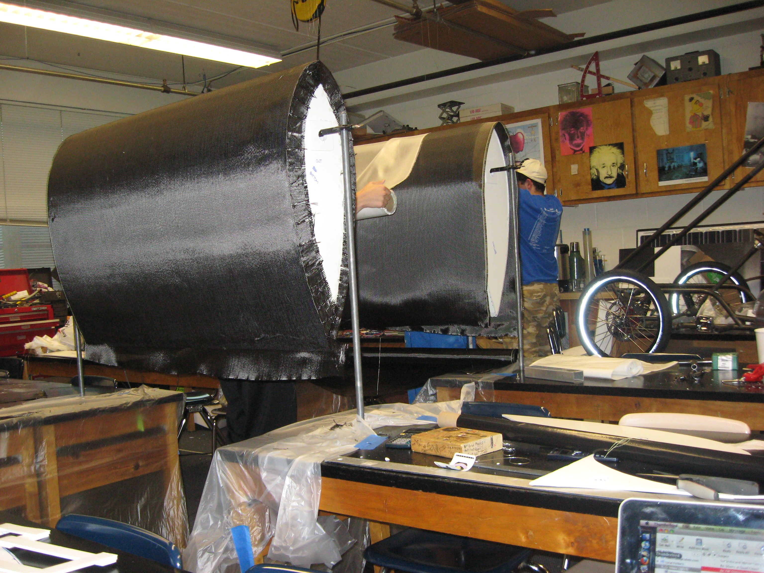
Adding Reinforcement
Add some carbon fiber squares on the inside at attachment points to strengthen foam core board.
Trim with a common jigsaw to fit.

Slide 11
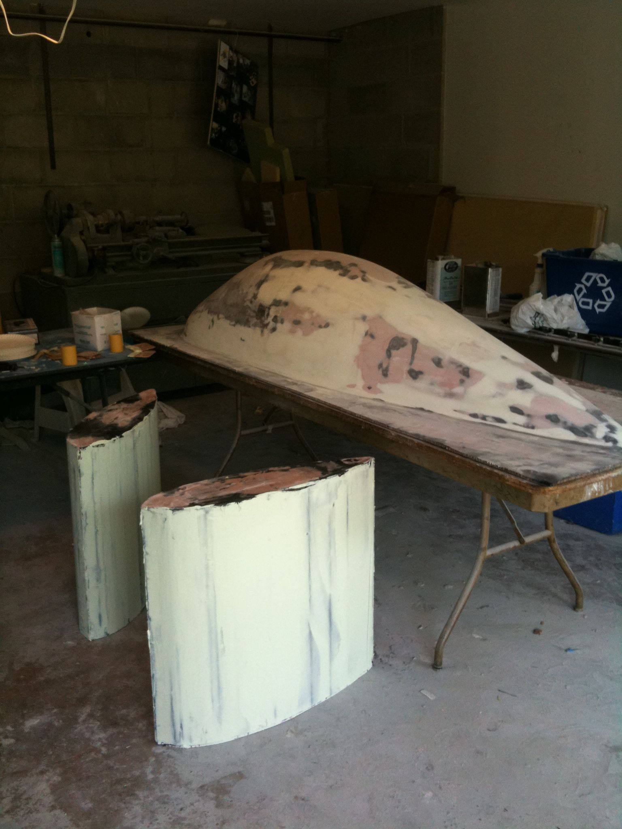
Finishing
Reinforcement is covered with a light-weight body filler and sanded smooth.
Prime and paint
(A good painter can cover a lot of flaws!)

Slide 12
Final product

Slide 13
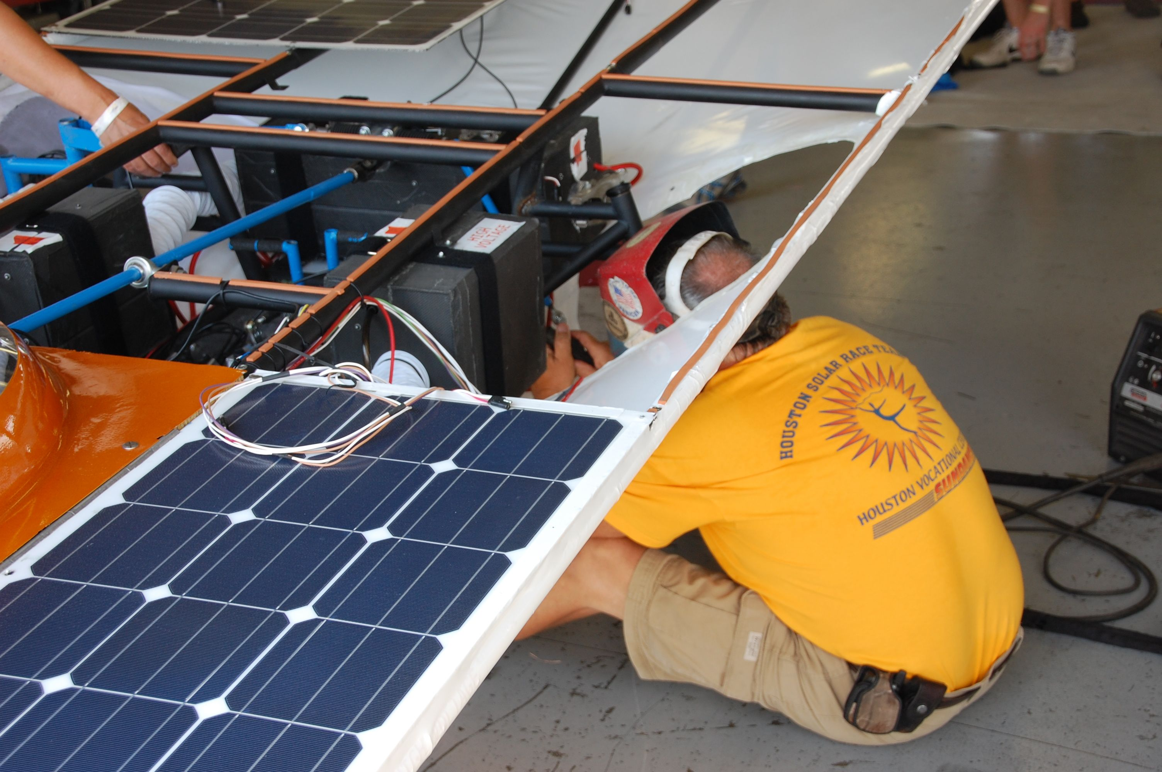
Weight
Heavier cars have more rolling resistance and take more energy to accelerate. (Much bigger problem in a road race.)
Do not reduce weight at the cost of safety.
Making things too light will force you to find an expert welder because things WILL break.

Slide 14
Rolling Resistance
Bearings can be opened, cleaned, and filled with a light oil.
Tall, skinny, high pressure tires reduce rolling resistance but sacrifice handling.
Tire Proper pressure
If it rotates: lubricate!
Wheel alignment is critical to reducing rolling resistance.

Slide 15
Specialty Workshop
Solar Car Challenge

