Slide 1
OKEMOS SOLAR RACING CLUB TELEMETRY PRESENTATION
Notes:
Introduce ourselves

Slide 2
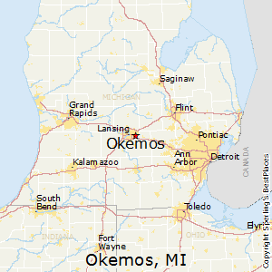
Notes:
Introduce yourself
Name
Location
Role
How your team did
Why you’re here
Conned friends father, certain amount of luck & persistence

Slide 3
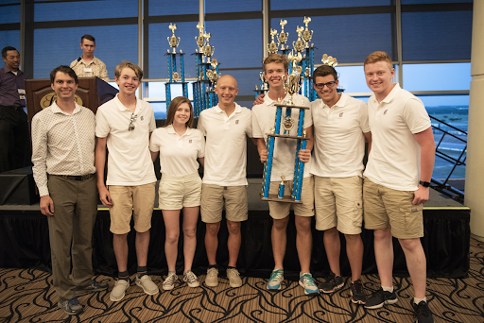
Notes:
Talk through achievements
Engineering Award
Telemetry Award
Third through scrutineering
Explain how incredibly cool it was to go down and compete
Ask group how do you get here?
How did we achieve the success we did

Slide 4
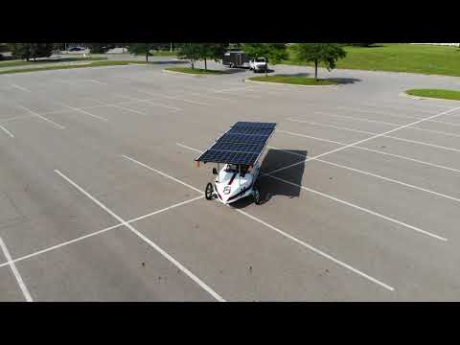
Notes:
Show car

Slide 5
What does a telemetry system do?
Notes:
Explain what a telemetry system does

Slide 6
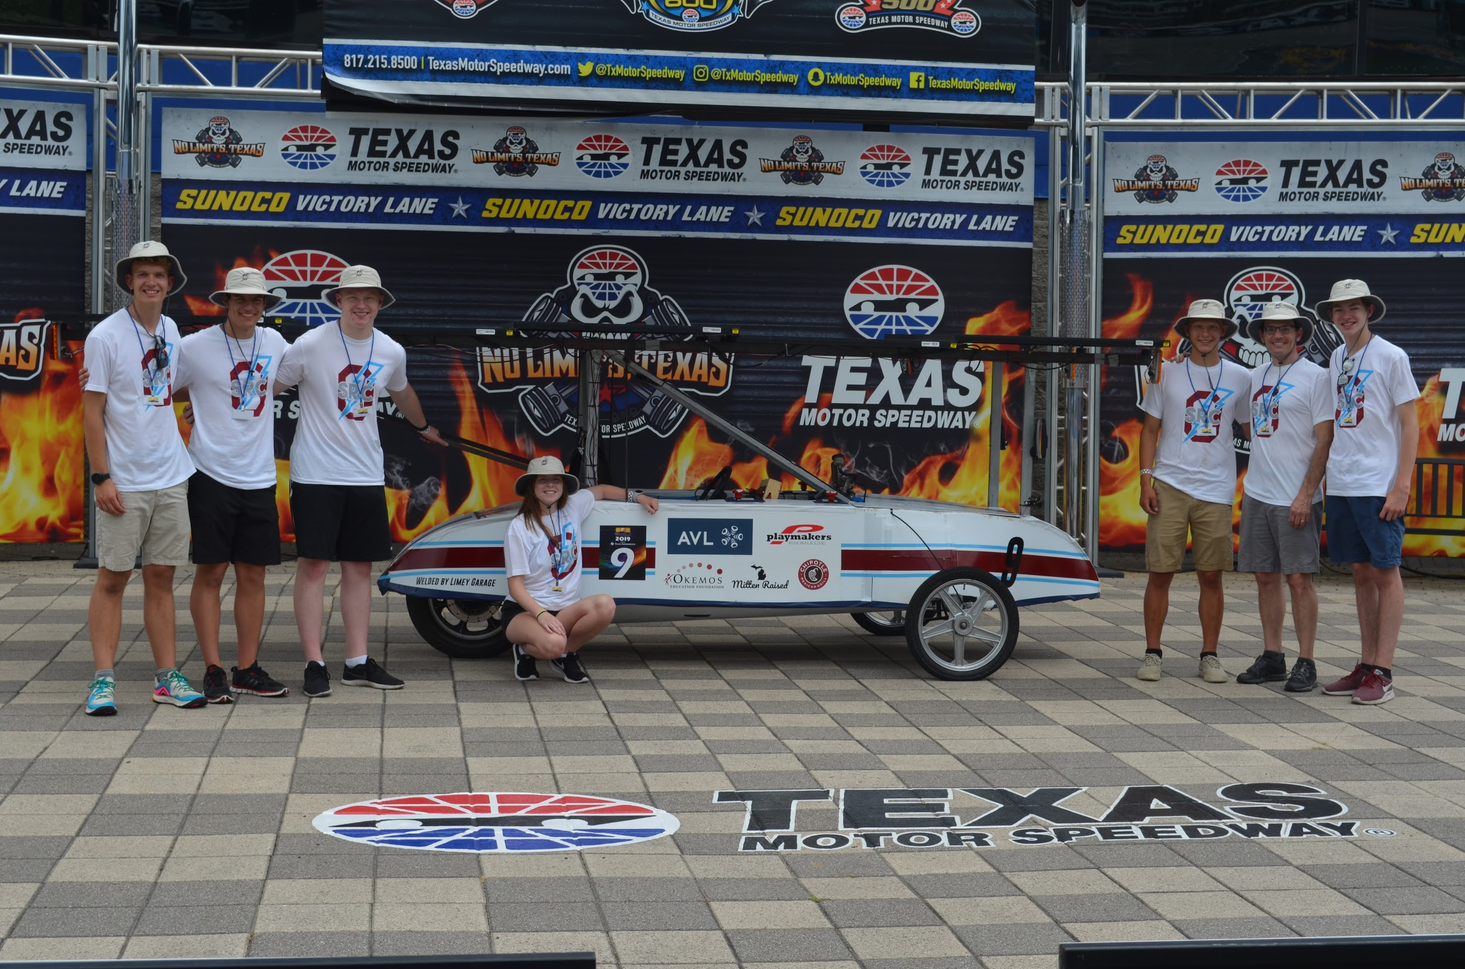
Notes:
Caution importance of telemetry system

Slide 7
Why do you want a telemetry system?
Strategy
Health of car
Driver communications
Excellent challenge
Great next step

Slide 8
Most basic needed information
Voltage
Car speed
Driver communication (required by SCC)

Slide 9
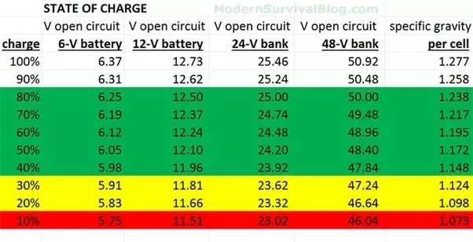

Slide 10
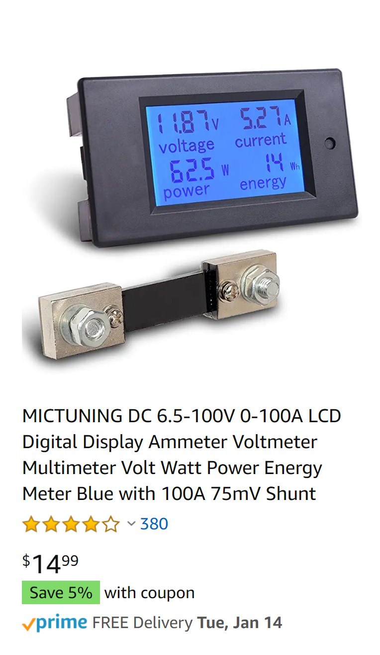
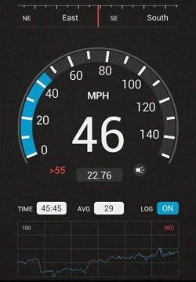
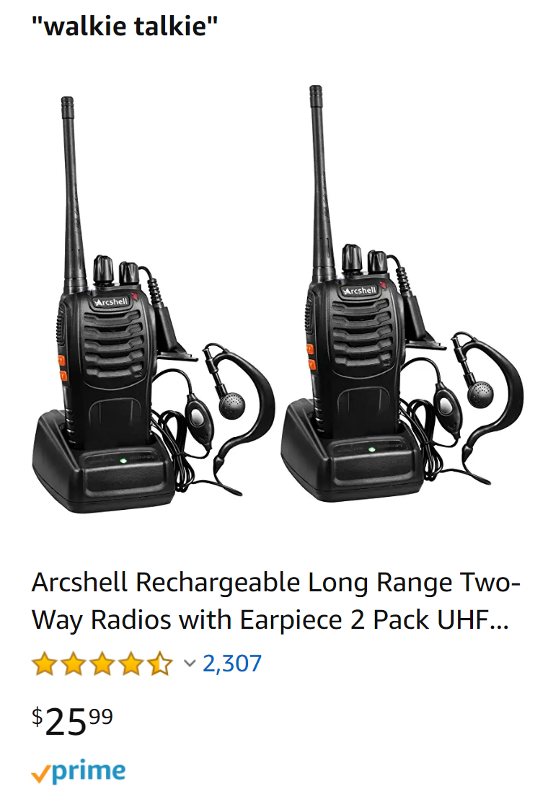

Slide 11
A very quick word on strategy
On most sunny days expect panels to collect around 6.25x rated capacity
Example a 1500 watt array would collect 1500 * 6.25 = 9375 watt hours per day
Using data from shunt, determine watt hours per mile
Example your car travels 10 miles and uses 1,000 watt hours, 100 wh/mile
Total energy collection for four days = 9375 watt hours * 4 days = 37,500 watt hours
37,500 watt hours / (100 wh / mile) = 375 miles / 23 hours = 16.3 MPH

Slide 12
Data from our racing
1475 watt array * 6.25 = 9,219 watt hours / day or 36,875 watt hours for the competition
We averaged around 80 wh / mile
Total estimated distance = 36875 / 80 = 460.9375 miles
Actual distance traveled during SCC 460.5 miles

Slide 13
Our system
Arduino
↓
Raspberry Pi
↓
Google Cloud
↓
Firebase Database
↓
Google Cloud
↓
Frontend Devices
Data being logged:
Voltage
Speed
Lap time
Distance
Messaging
Demos:
Home Base
Driver View
Website

Slide 14
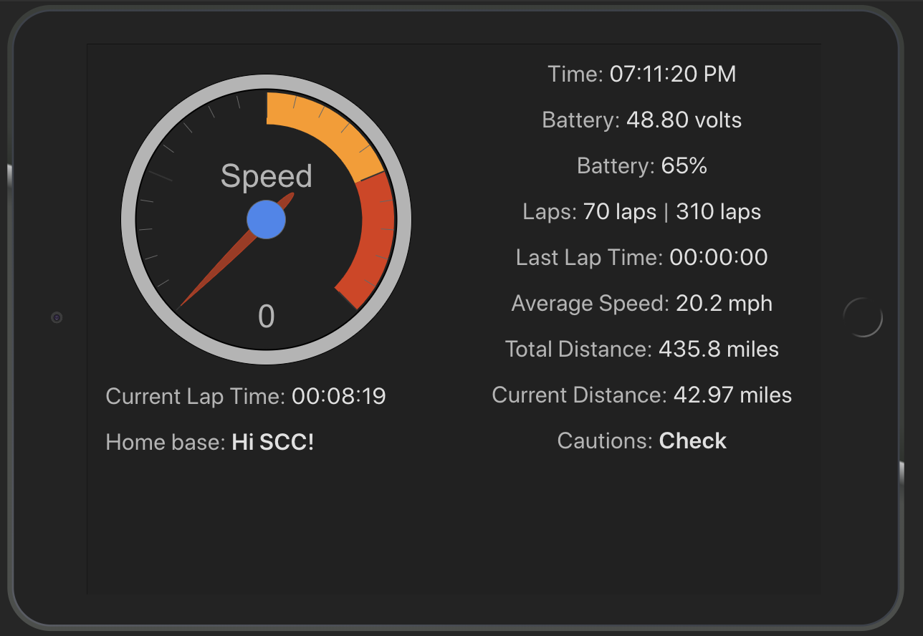

Slide 15
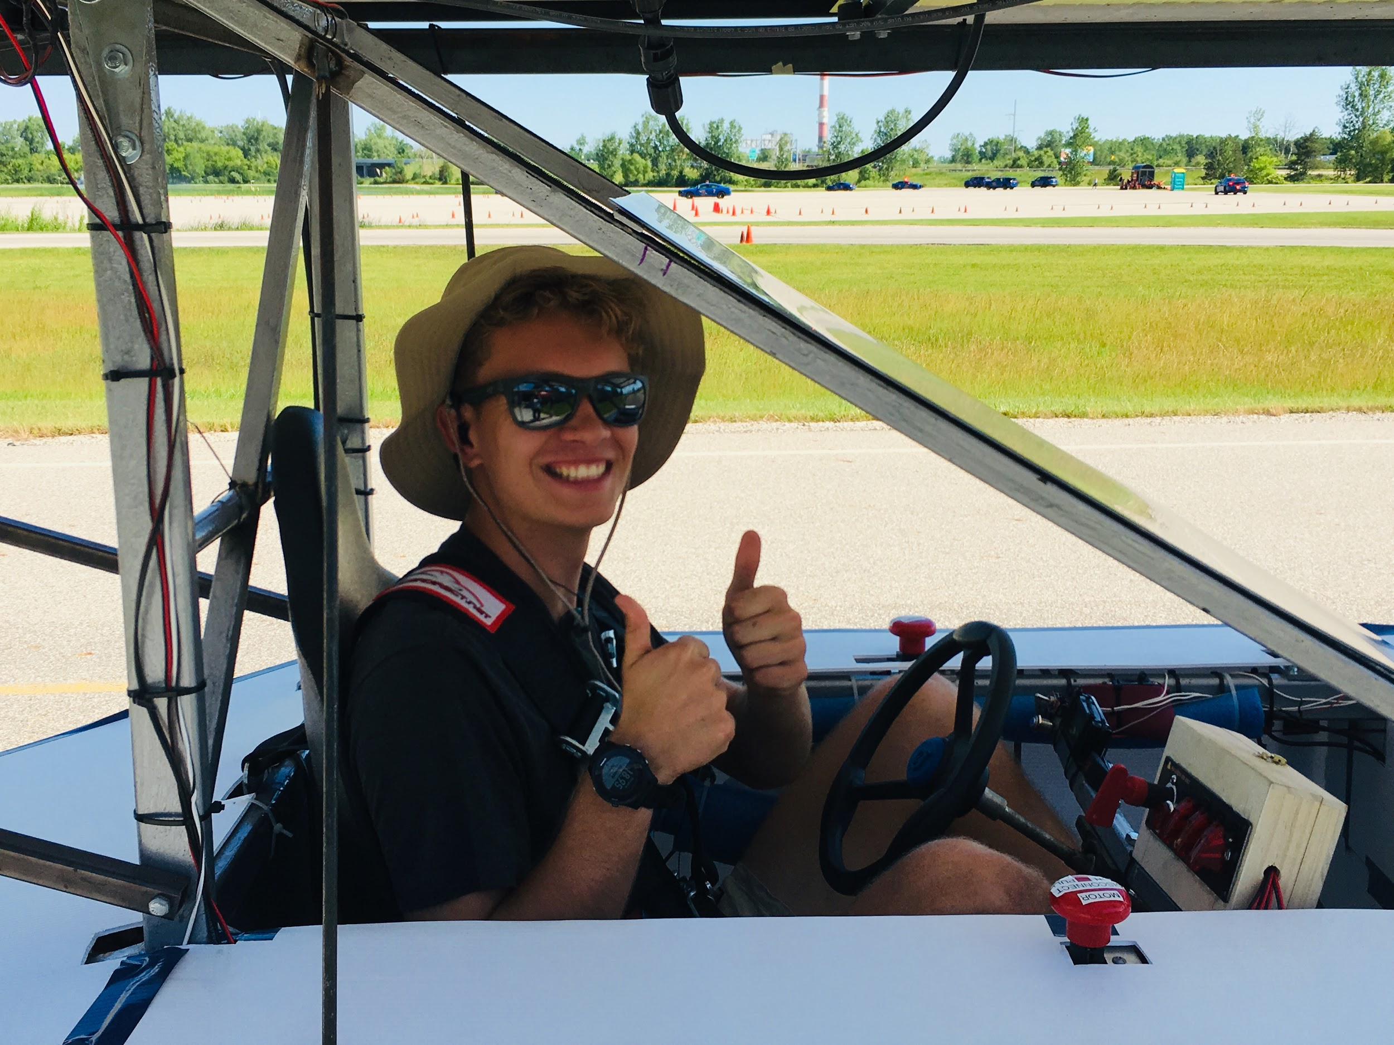
This is where our iPad sat for the driver to easily see at a glance - it was plugged into an inverter in the supplemental system to keep charged

Slide 16
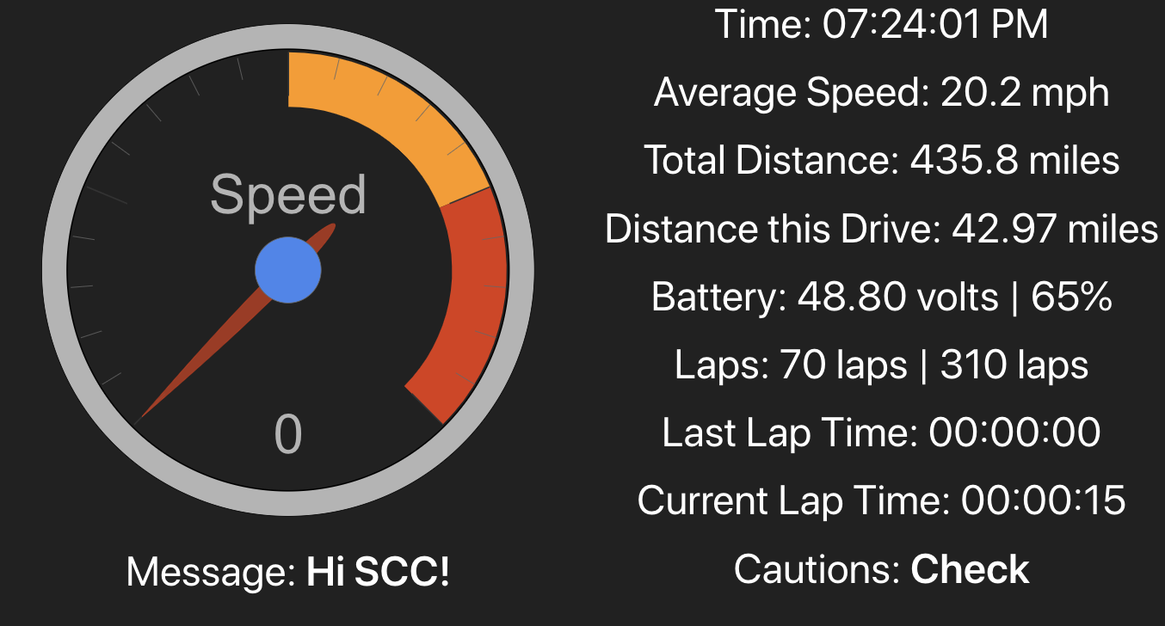

Slide 17
System Laid Out
Server
Database
Wi-Fi hotspot
Display
Arduino
Raspberry Pi
Voltage Divider
Hall Effect Sensor
Supplemental Power source
48v Main System Battery

Slide 18
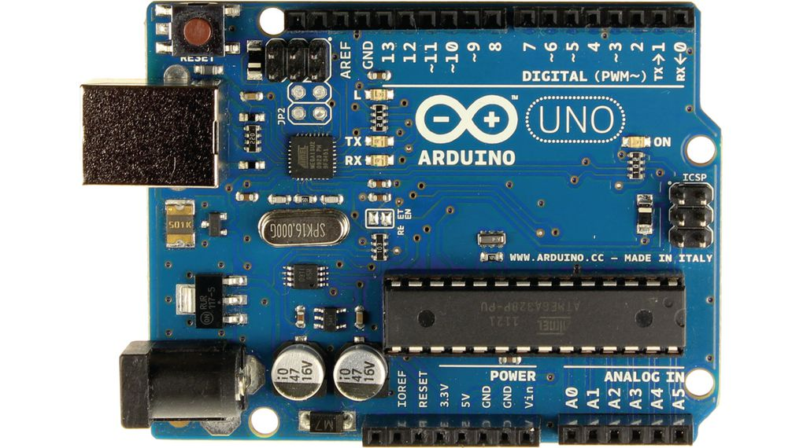
Our system
Arduino’s Role:
Takes analog voltage data and sends it to the Raspberry Pi over USB Serial Communications Port
Data being logged:
Voltage
Speed
Lap time
Distance
Messaging
Demos:
Home Base
Driver View
Website

Slide 19
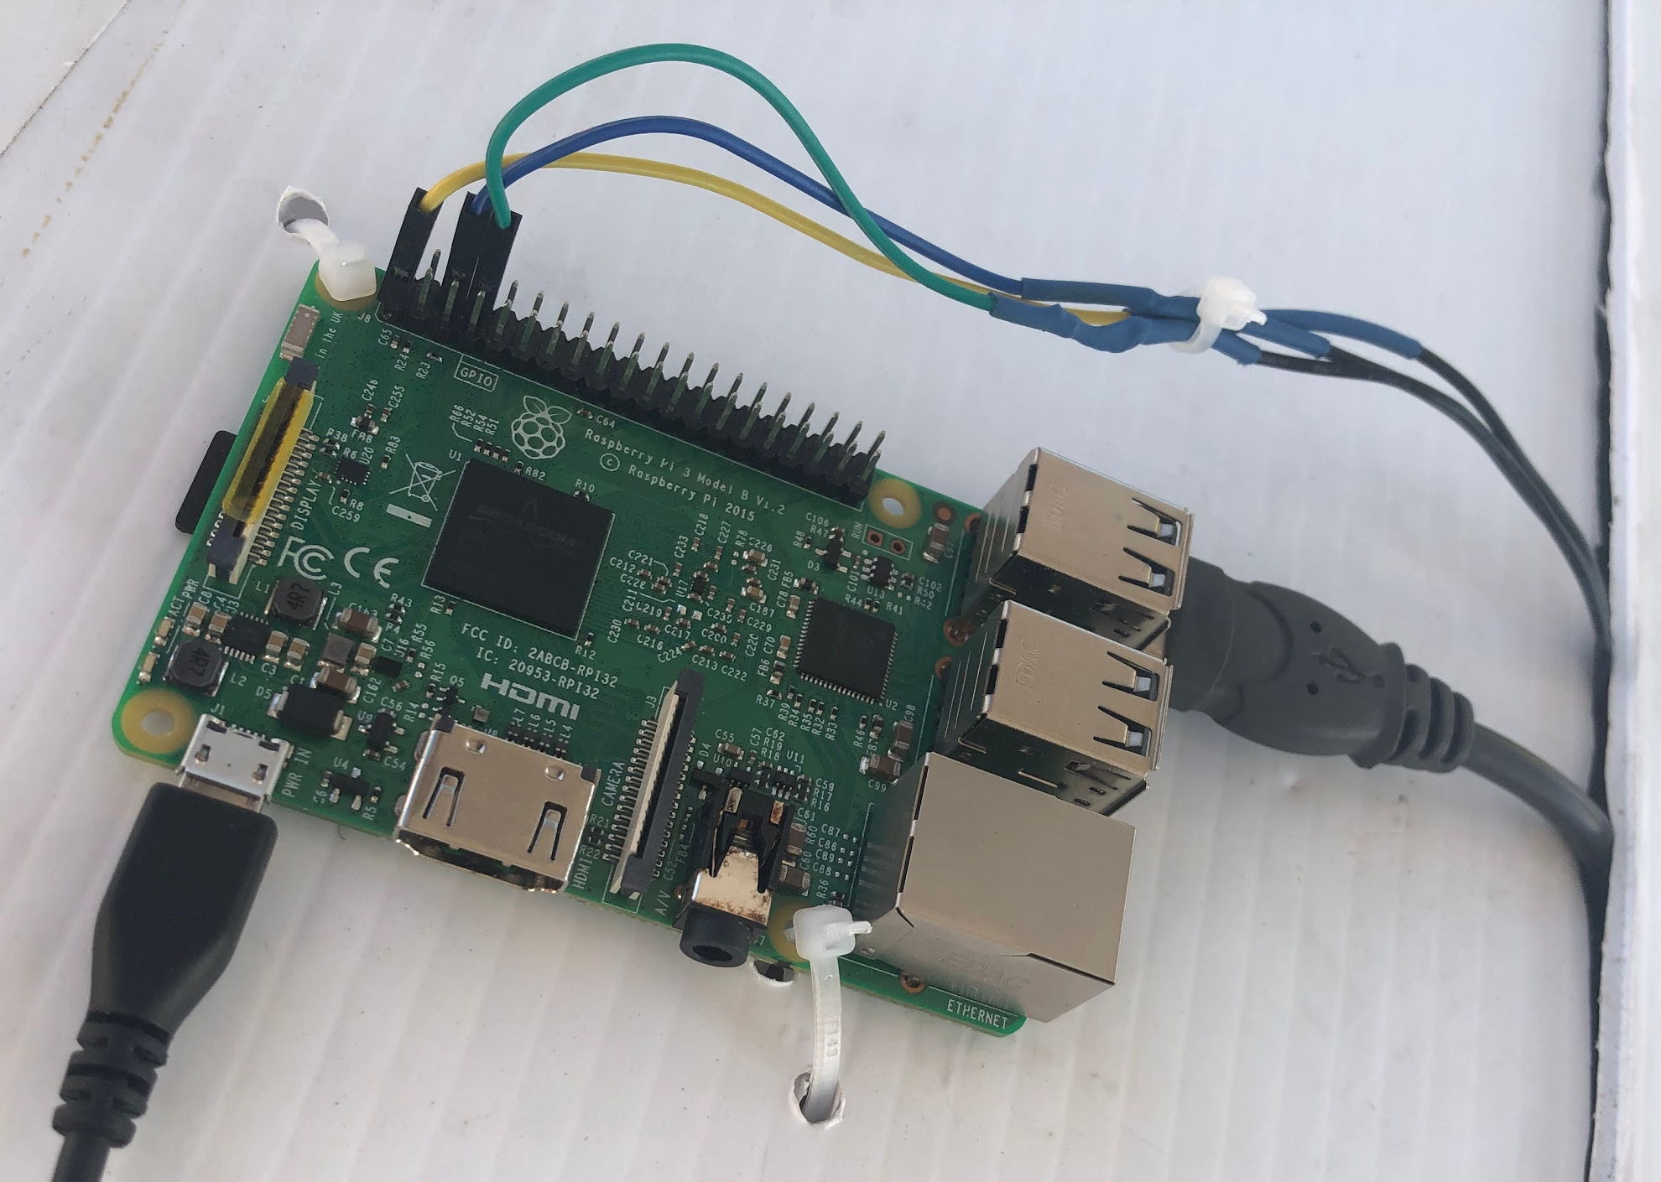
Our system
Raspberry Pi:
Takes all inputs from the car and uploads them to our server via hotspot on a phone
Data being logged:
Voltage
Speed
Lap time
Distance
Messaging
Demos:
Home Base
Driver View
Website

Slide 20
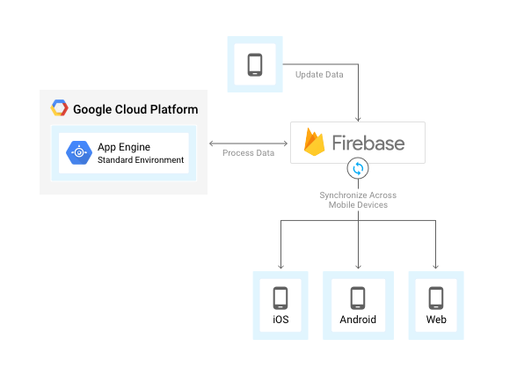
Our system
Google Cloud Server:
Receives sensor data, analyzes it, verifies it, sends it to our database
Data being logged:
Voltage
Speed
Lap time
Distance
Messaging
Demos:
Home Base
Driver View
Website

Slide 21
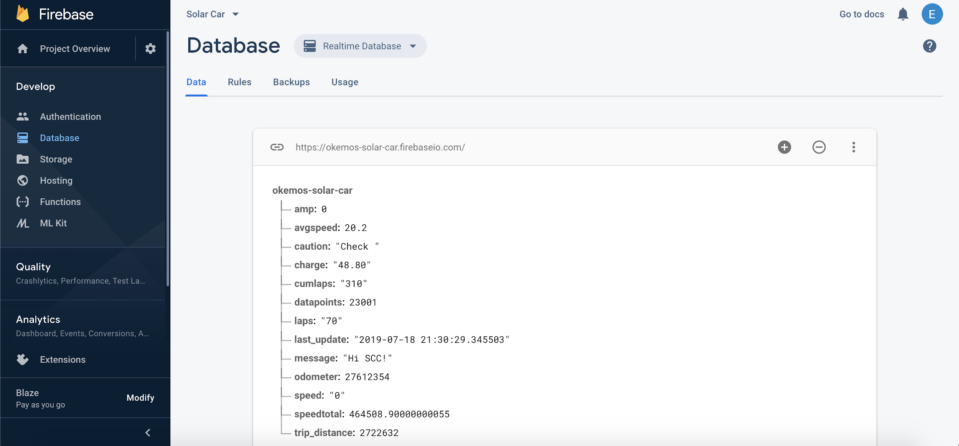
Our system
Firebase Realtime Database:
Receives data live and updates every instance that that data is being streamed
Data being logged:
Voltage
Speed
Lap time
Distance
Messaging
Demos:
Home Base
Driver View
Website

Slide 22
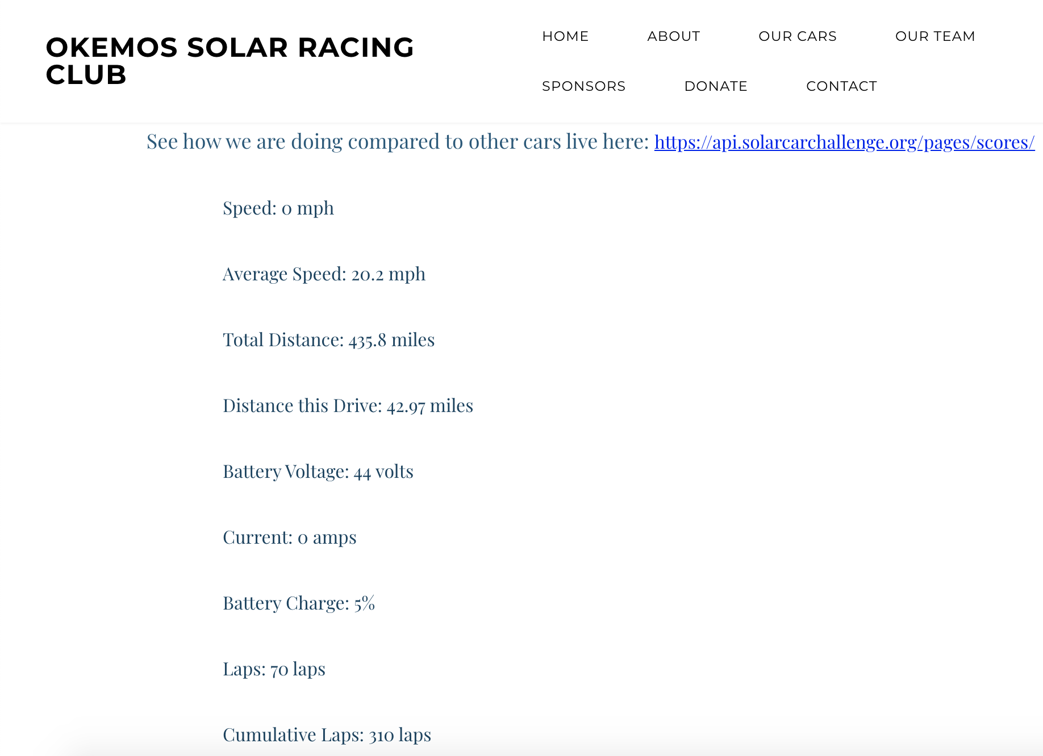
Our system
Google Cloud Server (again):
Hosts the webpages the pit crew’s monitors run on, the car’s dashboard, and our coms systems
Data being logged:
Voltage
Speed
Lap time
Distance
Messaging
Demos:
Home Base
Driver View
Website

Slide 23
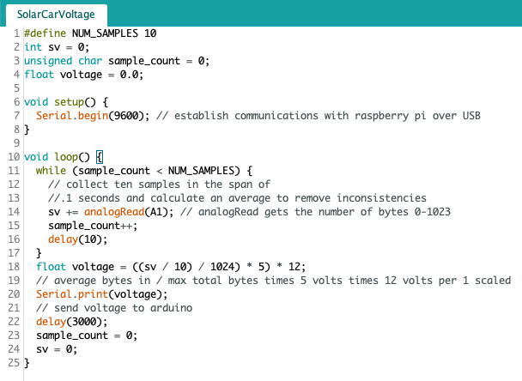
Voltage
Arduino reads analog input and converts to voltage based on scaling of voltage divider circuit. Voltage then sent to raspberry pi for analysis.

Slide 24
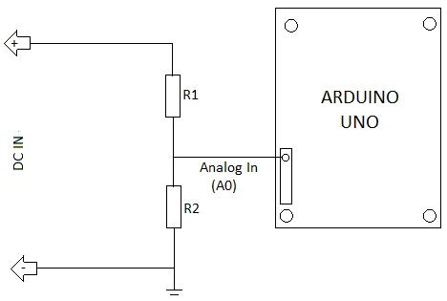
Voltage divider circuit

Slide 25
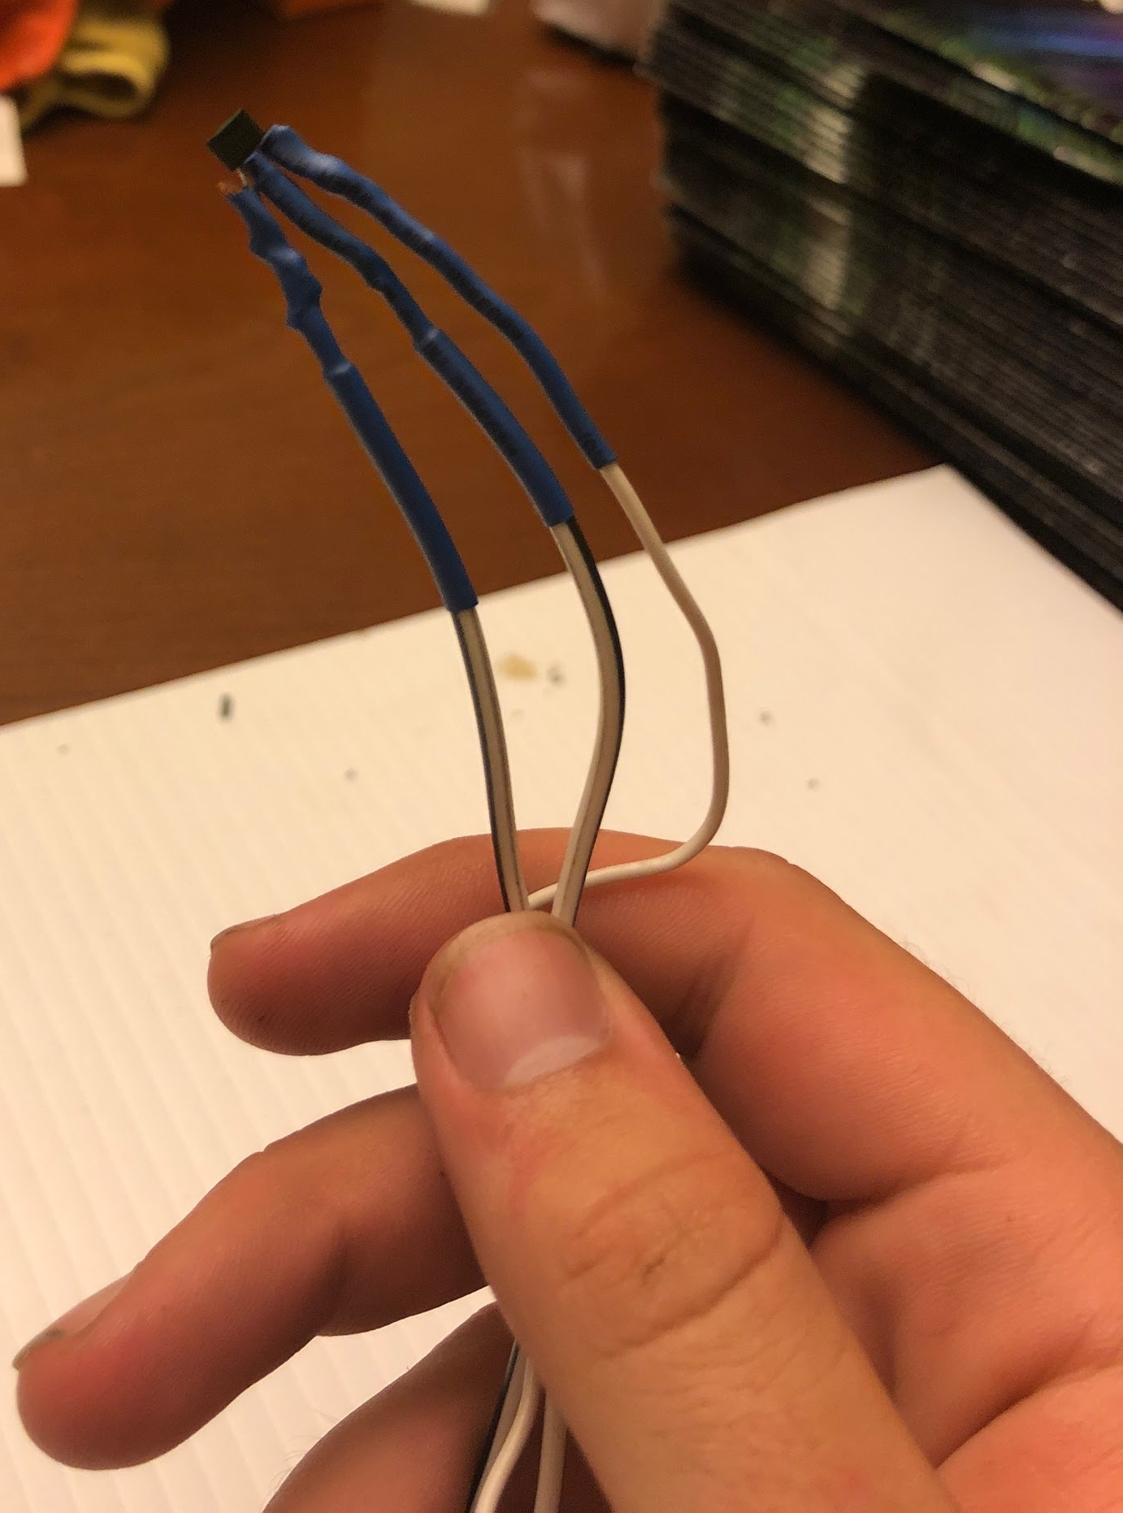
Speed and distance
Hall effects sensor to Pi everytime the magnet attached to the wheel passes by
Using this data we can set a simple timer to extrapolate speed and distance.
Distance is used to calculate efficiency (Wh/Mile)

Slide 26
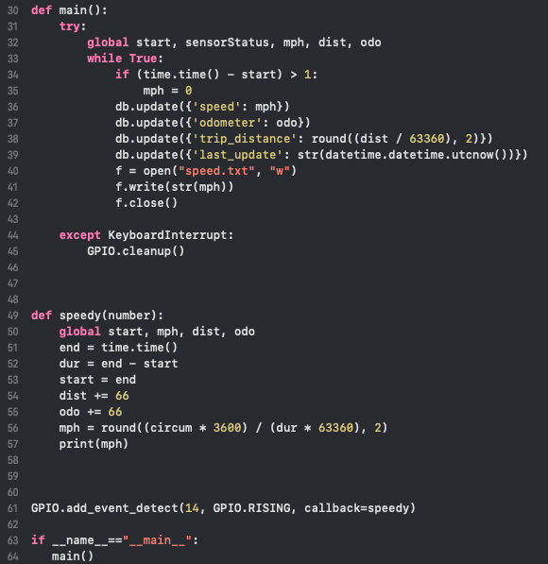
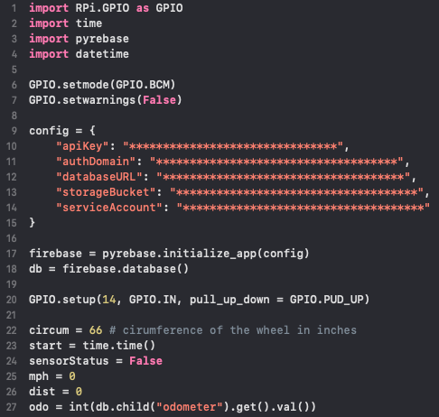
Wheel Rotation Code

Slide 27
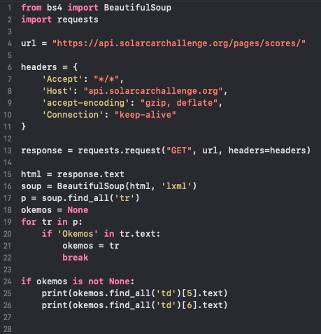
Lap times
After the first day we found it was important and a useful tool for pacing
Quickly built web scraper onto telemetry system night of second racing to pull the data from the official solar car race stats page: https://api.solarcarchallenge.org/pages/scores/
Keeps track of lap time, penalties, laps in a day, and keeps track of the competition all automatically

Slide 28
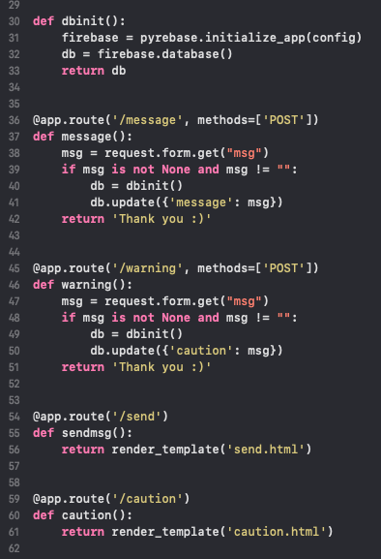
Messaging
Crucial piece of telemetry for driver
Safer conditions for driver
Improved communications
Server receives data from the message webform or caution webform, parses it, and sends it to the database
Displays are updated to show new message and/or caution on the track
LIVE DEMO from driver's perspective
Send a message from: bit.ly/osrc-send
Send a caution from: bit.ly/osrc-caution

Slide 29
Costs
Raspberry Pi: $35
Arduino: $8
Hall Effects Sensor and Magnets: <$1
Voltage Divider: <$1
iPad/Tablet: Used ~ $100
TV Monitor: $100
Server and Database: Free with
Google Cloud Grants
Wifi Hotspot: Local Library for Free OR a phone
Total Cost we Spent: $10

Slide 30
Future plans
Amp draw from motor
Temperature readings
Wattage output from panels
Adaptive cruise control
Use equations mentioned to keep car at ideal speed
Less current draw
More reliable
GPS for lap times and speed
Live graphs

Slide 31
Questions?

Slide 32
Contact
Will Jones
Email: wbjones@umich.edu
Phone: 517-897-5060
Eric Andrechek
Email: eric@andrechek.com
Phone: 517-512-0419

