Slide 1
Engineering our Future
Y
Eleanor Nave
Lockheed martin aeronautics

Slide 2
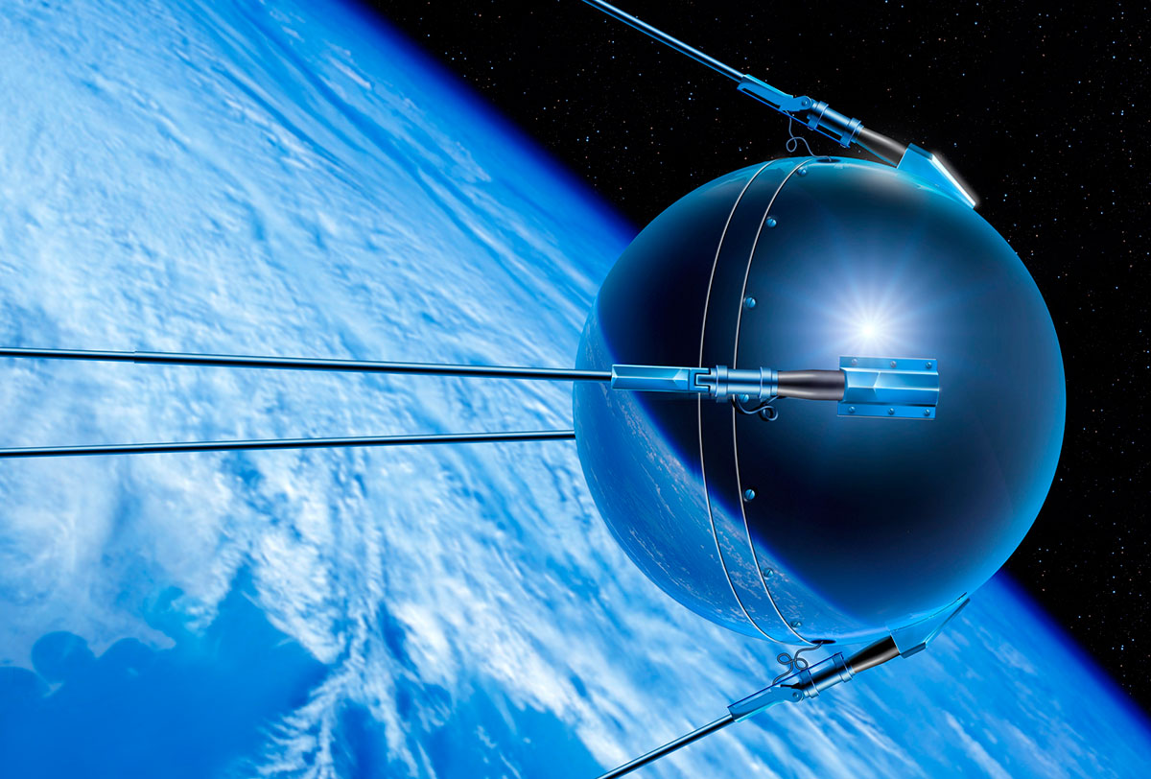
A look back
Sputnik
NASA
First Cell Phone
World Wide Web
5th Generation Fighter Jet
1950s
1980s
1990s
2000s
Notes:
The Sputnik Era The spark that put the U.S. on the path to technology and innovation was the launch of the Russian satellite, Sputnik, into space. The year was 1957, and Americans put their competitive spirit into motion. Under the leadership of Presidents Dwight D. Eisenhower and John F. Kennedy, Americans were challenged to step up and become leaders in science, technology, engineering and math.
NASA In 1958, President Eisenhower proposed the creation of the National Aeronautics and Space Administration, NASA. The legislation was signed to create the new government agency, and a space program was born. When Eisenhower left office in 1961, President Kennedy continued to push for innovation in the areas of STEM – putting the first American on the moon, among other accomplishments.
1970s/1980s The 1970s and 80s continued to see a push that encouraged science education, and many national science programs were established to further advance the topic. The 1980s also brought about big achievements in science and technology – the first cell phone, the first permanent artificial heart, the first Space Shuttle launch, and the first personal computer
1990s In the 1990s, many education councils, such as the National Science Education Standards and the National Council of Teachers of Mathematics, helped guide U.S. educators’ classrooms with standards and guidelines that shaped their curriculum to better prepare K-12 students in STEM.
2000s
The first F-35A, was rolled out in Fort Worth, Texas by Lockheed Martin Aeronuatics , on 19 February 2006 and first flew on 15 December 2006. The F-35 is an American family of single-seat, single-engine, all-weather stealth multirole combat aircraft that is intended to perform both air superiority and strike missions/
Each of these initiatives and

Slide 3
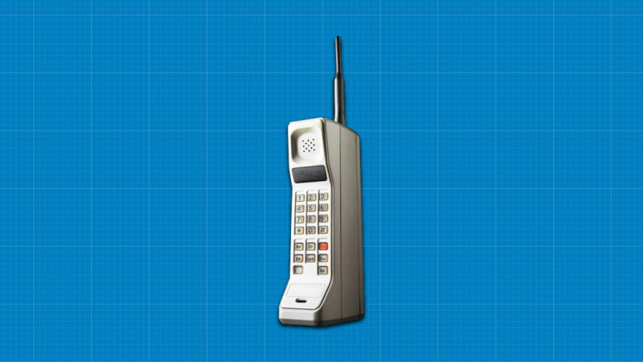
A look back
Sputnik
NASA
First Cell Phone
World Wide Web
5th Generation Fighter Jet
1950s
1990s
2000s
1980s
Notes:
The Sputnik Era The spark that put the U.S. on the path to technology and innovation was the launch of the Russian satellite, Sputnik, into space. The year was 1957, and Americans put their competitive spirit into motion. Under the leadership of Presidents Dwight D. Eisenhower and John F. Kennedy, Americans were challenged to step up and become leaders in science, technology, engineering and math.
NASA In 1958, President Eisenhower proposed the creation of the National Aeronautics and Space Administration, NASA. The legislation was signed to create the new government agency, and a space program was born. When Eisenhower left office in 1961, President Kennedy continued to push for innovation in the areas of STEM – putting the first American on the moon, among other accomplishments.
1970s/1980s The 1970s and 80s continued to see a push that encouraged science education, and many national science programs were established to further advance the topic. The 1980s also brought about big achievements in science and technology – the first cell phone, the first permanent artificial heart, the first Space Shuttle launch, and the first personal computer
1990s In the 1990s, many education councils, such as the National Science Education Standards and the National Council of Teachers of Mathematics, helped guide U.S. educators’ classrooms with standards and guidelines that shaped their curriculum to better prepare K-12 students in STEM.
2000s
The first F-35A, designated AA-1, was rolled out in Fort Worth, Texas, on 19 February 2006 and first flew on 15 December 2006. The F-35n American family of single-seat, single-engine, all-weather stealth multirole combat aircraft that is intended to perform both air superiority and strike missions.
Each of these initiatives and

Slide 4
A look back
Sputnik
NASA
First Cell Phone
World Wide Web
5th Generation Fighter Jet
1950s
1980s
1990s
2000s
Notes:
The Sputnik Era The spark that put the U.S. on the path to technology and innovation was the launch of the Russian satellite, Sputnik, into space. The year was 1957, and Americans put their competitive spirit into motion. Under the leadership of Presidents Dwight D. Eisenhower and John F. Kennedy, Americans were challenged to step up and become leaders in science, technology, engineering and math.
NASA In 1958, President Eisenhower proposed the creation of the National Aeronautics and Space Administration, NASA. The legislation was signed to create the new government agency, and a space program was born. When Eisenhower left office in 1961, President Kennedy continued to push for innovation in the areas of STEM – putting the first American on the moon, among other accomplishments.
1970s/1980s The 1970s and 80s continued to see a push that encouraged science education, and many national science programs were established to further advance the topic. The 1980s also brought about big achievements in science and technology – the first cell phone, the first permanent artificial heart, the first Space Shuttle launch, and the first personal computer
1990s In the 1990s, many education councils, such as the National Science Education Standards and the National Council of Teachers of Mathematics, helped guide U.S. educators’ classrooms with standards and guidelines that shaped their curriculum to better prepare K-12 students in STEM.
2000s
The first F-35A, designated AA-1, was rolled out in Fort Worth, Texas, on 19 February 2006 and first flew on 15 December 2006. The F-35n American family of single-seat, single-engine, all-weather stealth multirole combat aircraft that is intended to perform both air superiority and strike missions.
Each of these initiatives and

Slide 5
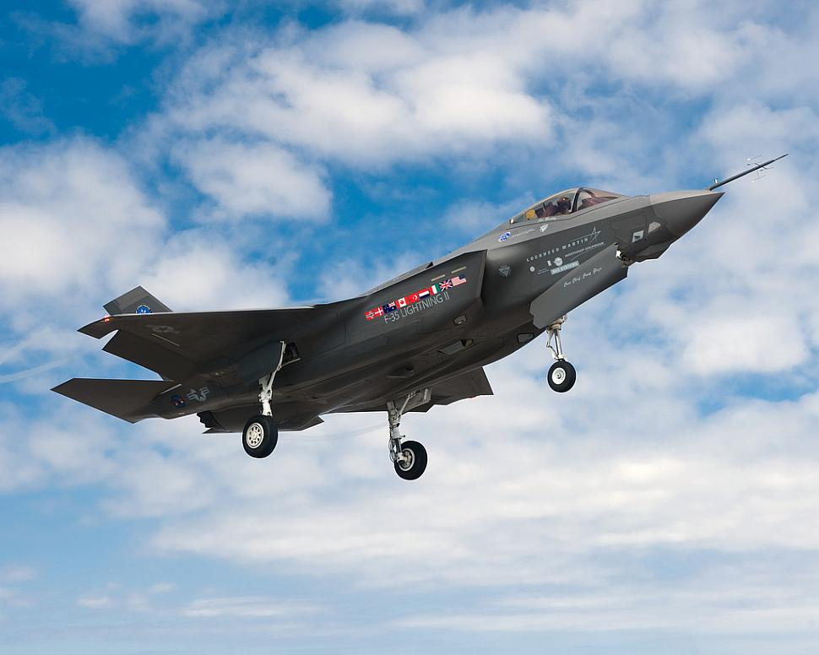
A look back
Sputnik
NASA
First Cell Phone
World Wide Web
5th Generation Fighter Jet
1950s
1980s
1990s
2000s
Notes:
The Sputnik Era The spark that put the U.S. on the path to technology and innovation was the launch of the Russian satellite, Sputnik, into space. The year was 1957, and Americans put their competitive spirit into motion. Under the leadership of Presidents Dwight D. Eisenhower and John F. Kennedy, Americans were challenged to step up and become leaders in science, technology, engineering and math.
NASA In 1958, President Eisenhower proposed the creation of the National Aeronautics and Space Administration, NASA. The legislation was signed to create the new government agency, and a space program was born. When Eisenhower left office in 1961, President Kennedy continued to push for innovation in the areas of STEM – putting the first American on the moon, among other accomplishments.
1970s/1980s The 1970s and 80s continued to see a push that encouraged science education, and many national science programs were established to further advance the topic. The 1980s also brought about big achievements in science and technology – the first cell phone, the first permanent artificial heart, the first Space Shuttle launch, and the first personal computer
1990s In the 1990s, many education councils, such as the National Science Education Standards and the National Council of Teachers of Mathematics, helped guide U.S. educators’ classrooms with standards and guidelines that shaped their curriculum to better prepare K-12 students in STEM.
2000s
The first F-35A, designated AA-1, was rolled out in Fort Worth, Texas, on 19 February 2006 and first flew on 15 December 2006. The F-35 is an American family of single-seat, single-engine, all-weather stealth multirole combat aircraft that is intended to perform both air superiority and strike missions.
Each of these initiatives and

Slide 6
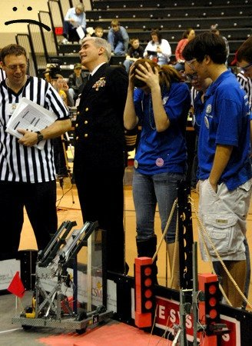
my Reflection
4-H Robotics
Everything Isn’t Perfect
Gathering Data
Learning

Slide 7
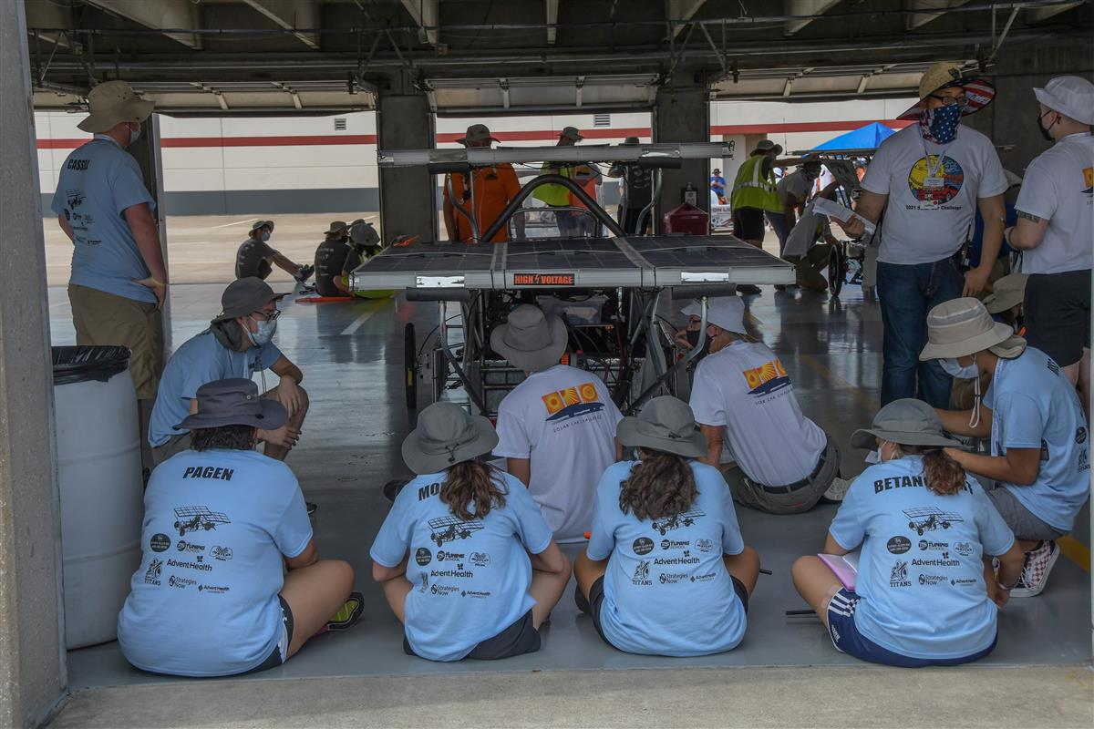
Your Reflection
Design
Prototyping
FAIL
First Attempt in Learning

Slide 8
Technology & innovation on the rise
Only 16% of high school interested in STEM career
57% of freshman lose interest before college
Notes:
The U.S. Dept. of Education states that only 16% of high school students are interested in a STEM career and have proven a proficiency in mathematics
57% of high school freshmen who declare an interest in a STEM-related field lose interest before they graduate high school

Slide 9
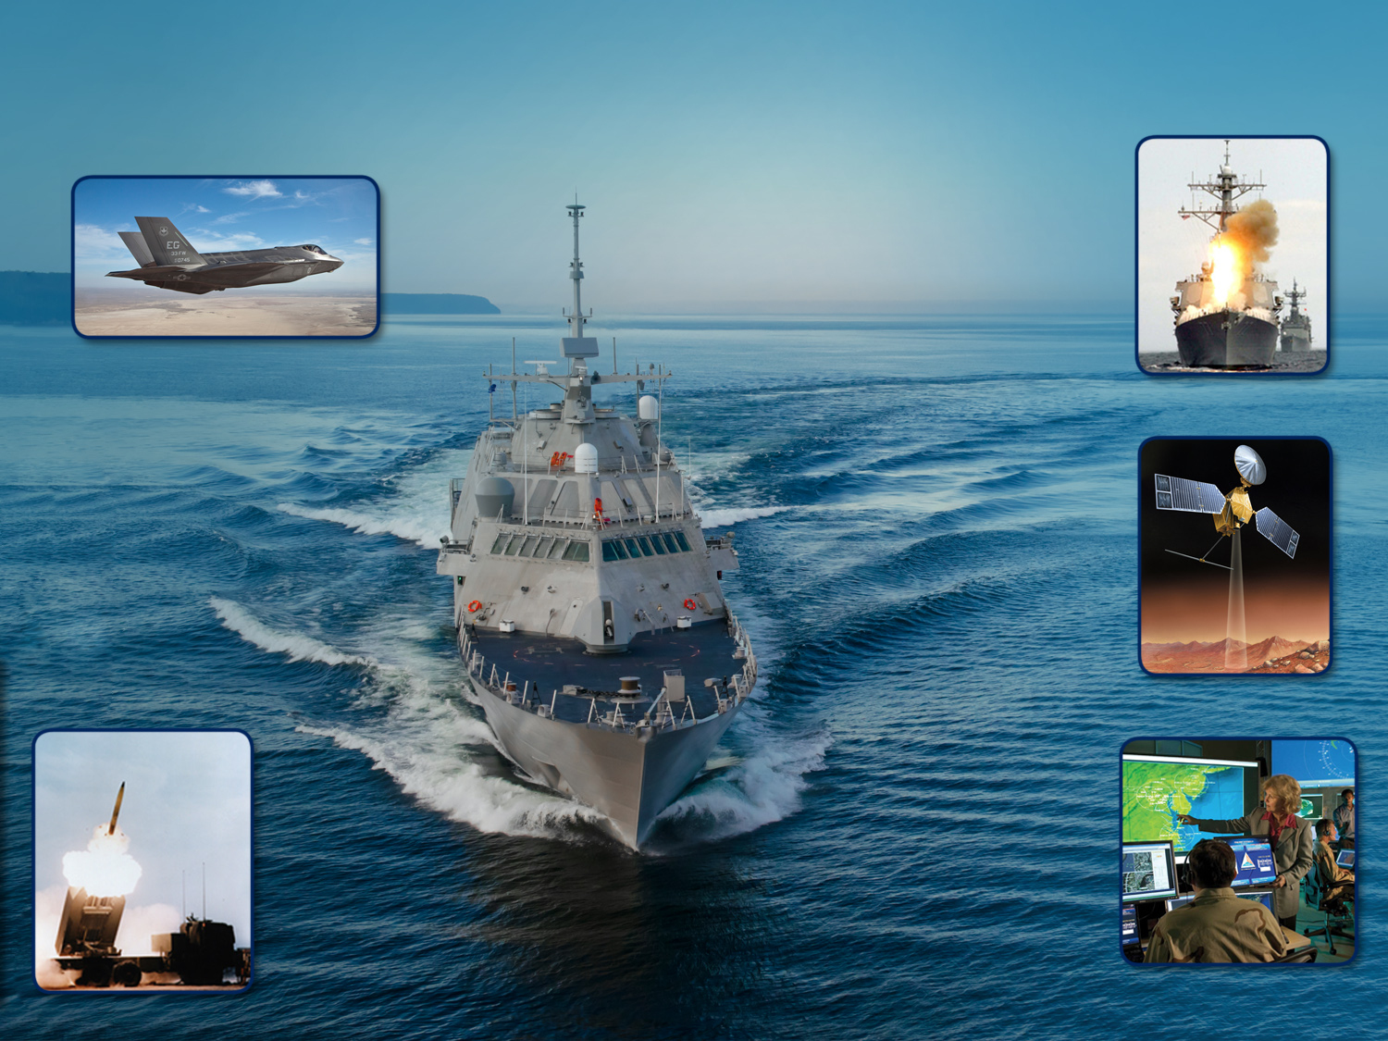
Lockheed Martin Corporation
ROTARY AND MISSION SYSTEMS
Radar and surveillance systems
Training and logistics solutions
Simulation technologies
AERONAUTICS
Tactical fighters
Tactical and strategic airlift
Advanced Development
SPACE
Surveillance and navigation
Global communications
Human space flight
Strategic and defensive systems
CORPORATE HEADQUARTERS
Finance, Business Operations
Leadership
Bethesda, Maryland
MISSILES & FIRE CONTROL
Air and missile defense
Fire control and situational awareness
Nuclear systems and solutions
A13-39529A_9
Notes:
Lockheed Martin is a global security company with more than 120,000 employees worldwide.
As you can see here, the Corporation consists of five core business areas: Aeronautics;; Missiles & Fire Control; Rotary and Mission Systems, Space, and Corporate Headquarters
Mission Systems and Training (MST) provides systems engineering, software development, complex program management, supply chain solutions and logistics, and training and simulation technologies for global security, civil and commercial markets.
Space Systems Company designs, develops, tests, manufactures and operates a full spectrum of advanced-technology systems for national security, civil and commercial customers. Chief products include human space flight systems; a full range of remote sensing, navigation, meteorological and communications satellites and instruments; space observatories and interplanetary spacecraft; laser radar; fleet ballistic missiles; missile defense systems and nanotechnology and solar research and development.
Information Systems & Global Solutions, or IS&GS, brings together the full range of the corporation’s information competencies with an expansive global delivery capability. It is a leading federal services and information technology contractor with a strong heritage of delivering world-class solutions and delivering advanced technology across a broad spectrum of domains. Whether it's providing real-time data to warfighters, benefits to seniors, or managing the safe movement of cargo around the world, IS&GS offers a broad range of capabilities to deliver solutions with speed and agility.
Missiles and Fire Control (MFC) is a recognized designer, developer and manufacturer of precision engagement aerospace and defense systems for the U.S. and allied militaries. MFC develops, manufactures and supports advanced combat, missile, rocket, manned and unmanned systems for military customers that include the U.S. Army, Navy, Air Force, Marine Corps, NASA and dozens of foreign allies. MFC also offers a wide range of products and services for the global civil nuclear power industry and the military’s green power initiatives.
Finally, Aeronautics is engaged in the research, design, development, manufacture, integration, sustainment, support, and upgrade all of our advanced military aircraft. This includes combat and air mobility aircraft, unmanned air vehicles, and related technologies. This is where my program, the F-35 is.

Slide 10
Your Present
Reactions Teamwork
Innovation Creativity
Dedication Technology

Slide 11
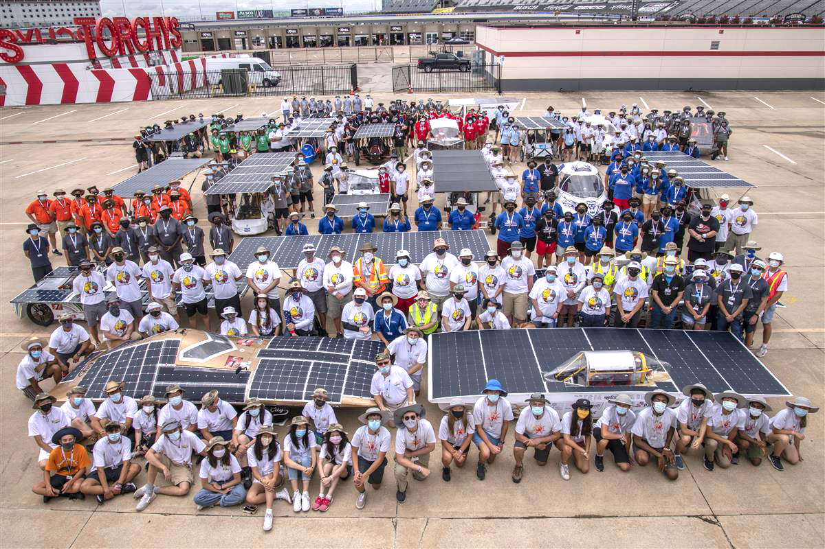
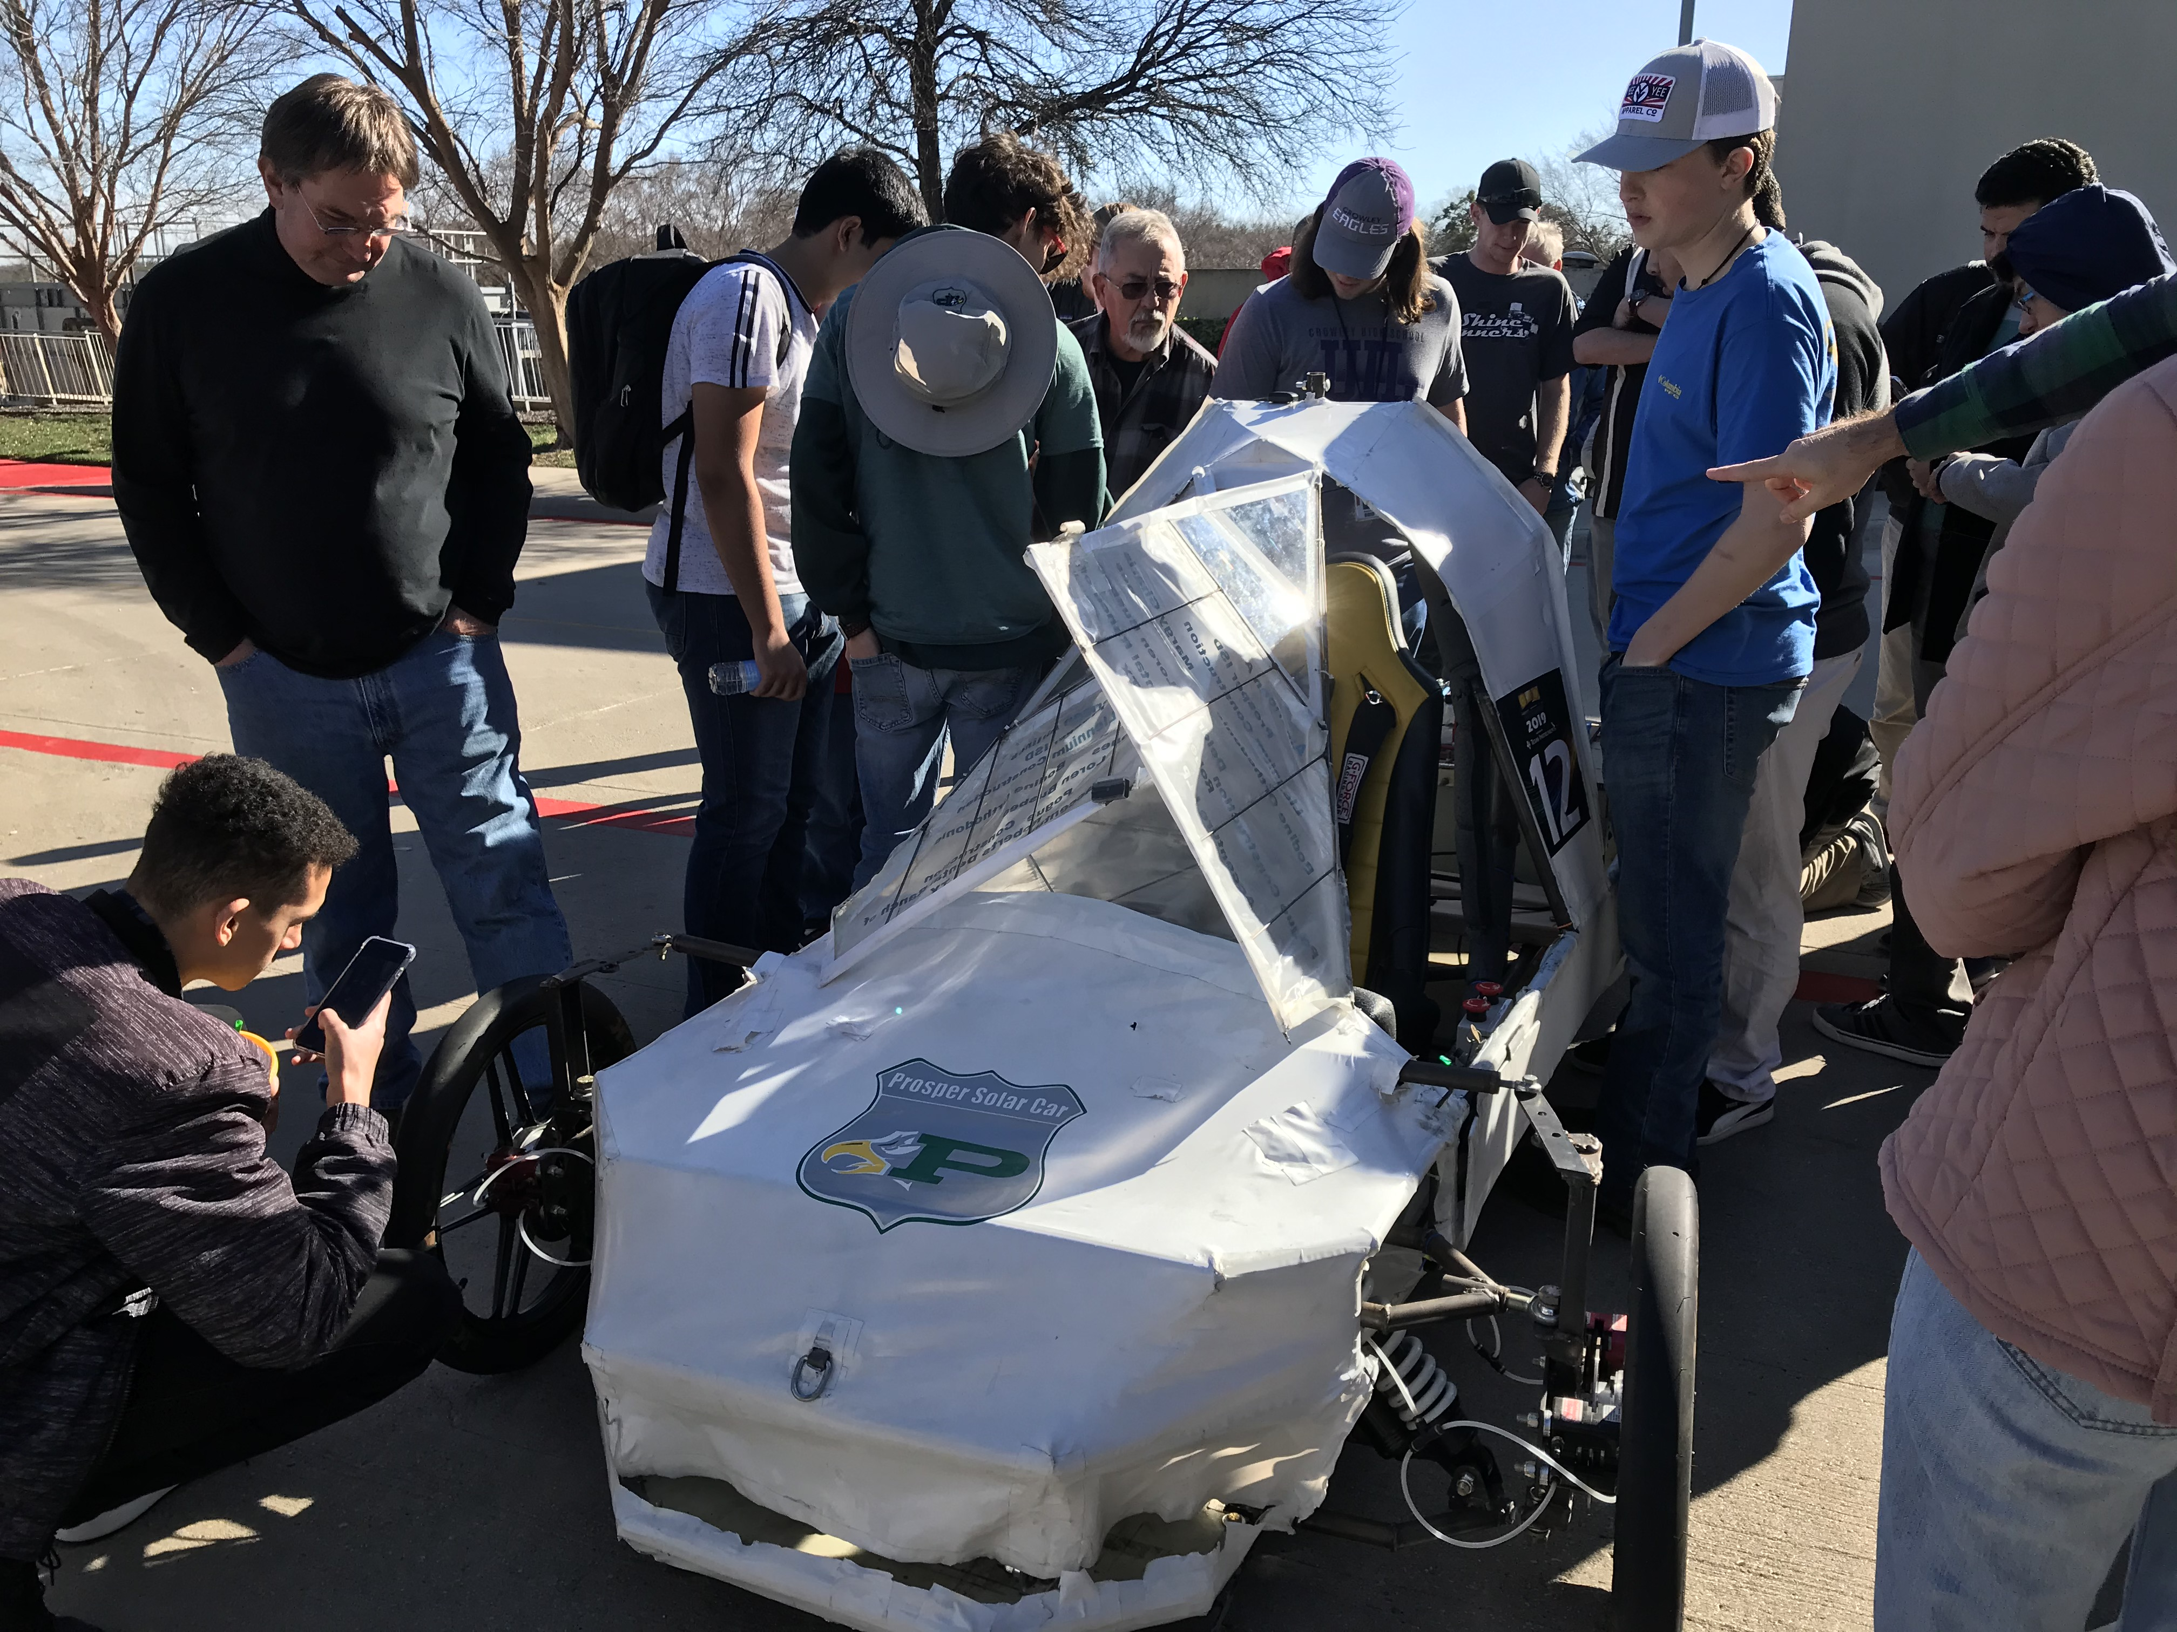
Renewable energy = sustainable future
YOU are Engineering Our Future
Notes:
By instilling this into the current generation, it won’t just be talk – it won’t just be a challenge – it is reality and it starts with each and everyone of you. How will this experience shape your future – how are you Engineering Our Future?

Slide 12
Engineering our Future
Y
Eleanor Nave
Lockheed martin aeronautics

