Slide 1
Electrical Safety and You
Jarrett Dunn

Slide 2
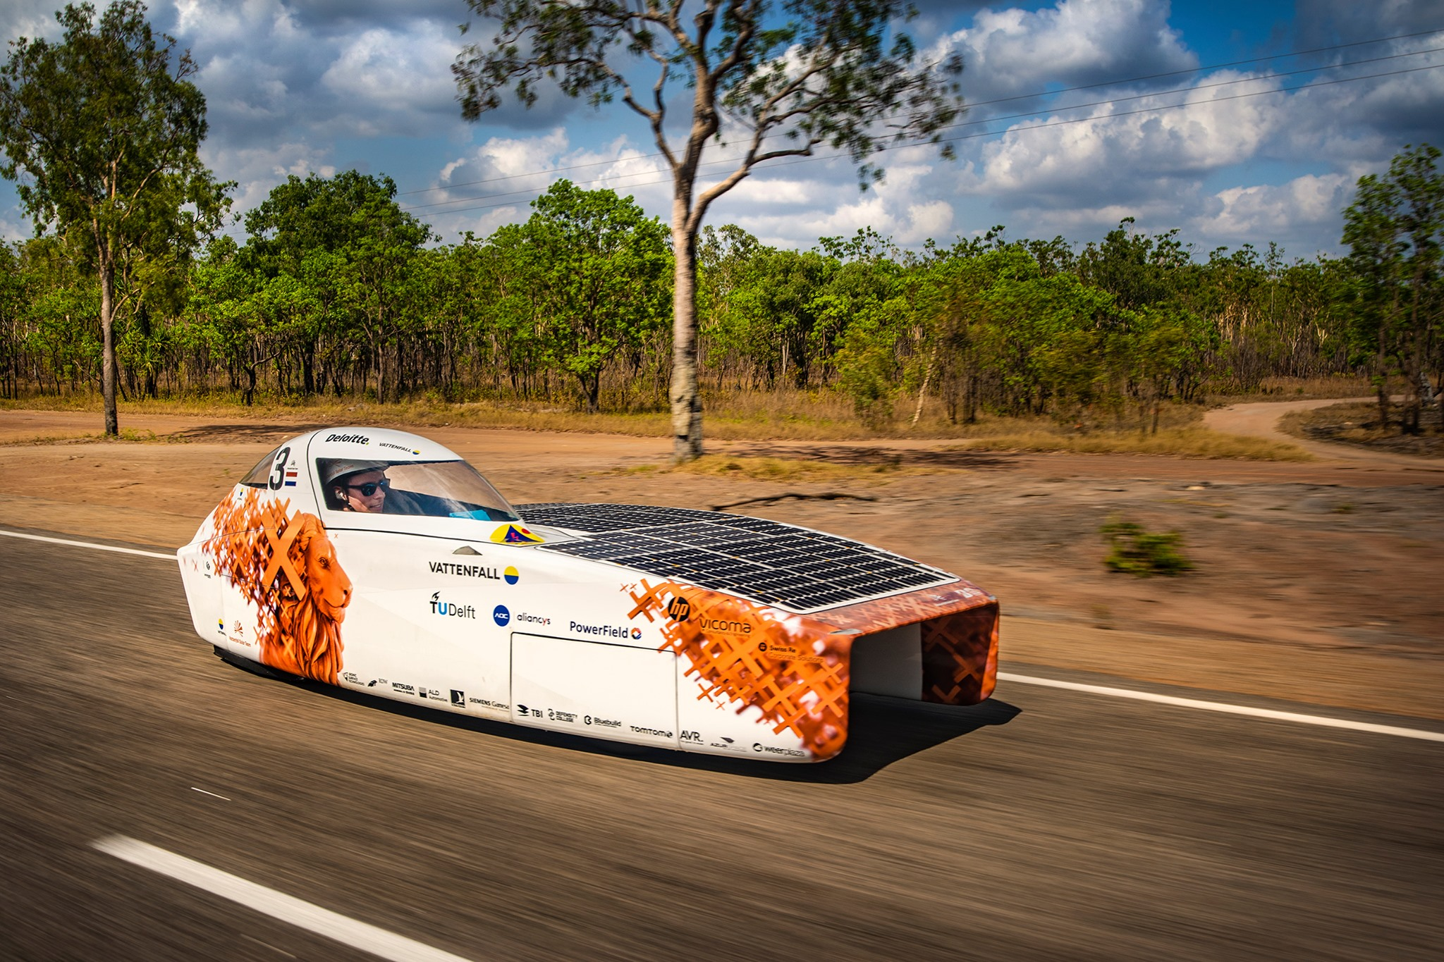
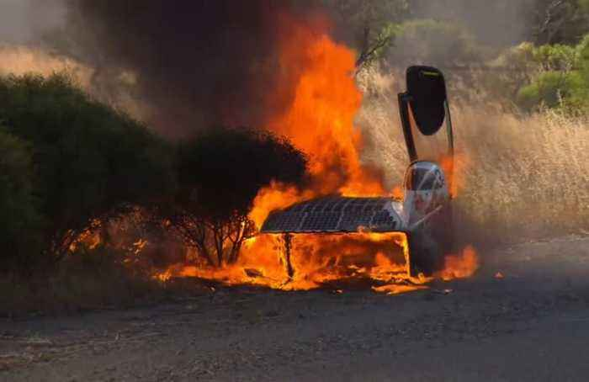
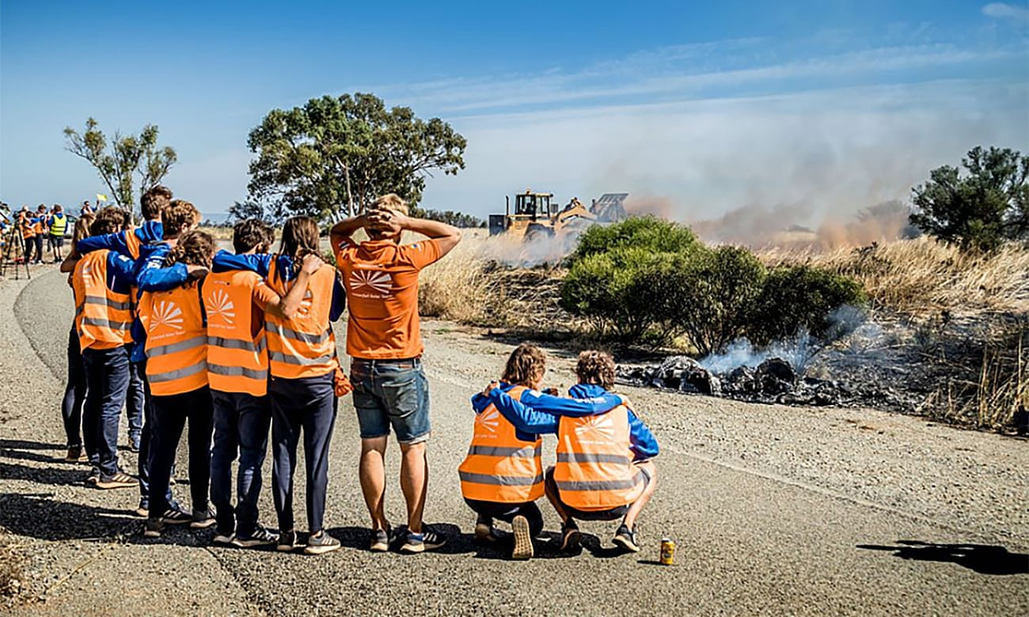
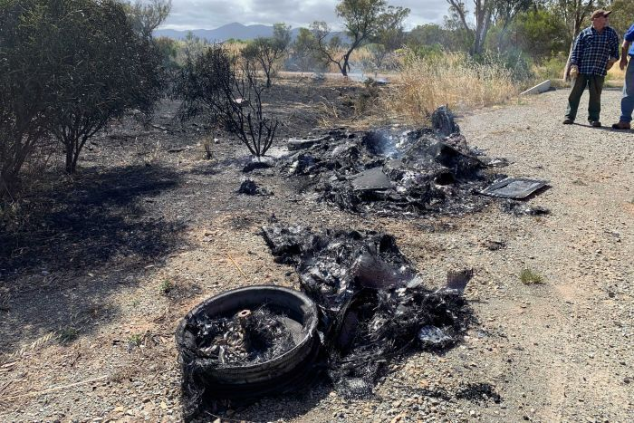
Why Should you Care?
Nuna Solar Car
Notes:
Dutch Solar car team Nuna is a power house in solar car racing
Six time World Champion, 2 time second place.
They know solar cars.
2019 Oct 16 driver radios that there is a strange smell in the car.
Within 5 minutes the team pulls off the highway, and the driver makes an emergency exit and the car looks like this <slide>
20 minutes later the car looks like this <slide>
And the final results 45 minutes later <slide>
We don’t yet know exactly what happened. They have excellent telemetry and hope to discover what happened. What we do know is that it was a very close race in very difficult conditions. Teams where pushing the limits and potentially making bad decisions. The result

Slide 3
Why Should you Care?
Notes:
Another incident from this years race. Stanford solar car.
They where able to remove the battery pack from the car. There is amazing video on Reddit of the battery pack shooting 1860 cells into the sky.

Slide 4
Why Should you Care?
2018 Palmdale Fire
2018 All Saints Melted Battery Terminal
2019 Rocketeers Fire
2019 Energy Odyssey loose main power
Notes:
A little closer to home, the Solar Car Challenge has not been immune to fires and near misses.

Slide 5
Do
Not
Panic
Keep
Calm
Solar
On
Wait!
Notes:
At this point it would be fair to be wondering, what have I got myself into?
<slide>
<slide>
<slide>
<slide>
The reality is that there is danger associated with Solar car racing. There is danger in everything we do. It was dangerous to drive here to this meeting. There have been thousands of solar cars built and successfully raced across all the different competitions. Incidents are exceedingly rare. There are some some basic good practices you can use to keep yourself safe and avoid becoming a statistic.

Slide 6
Electrical Connections
Notes:
The largest problem we see is loose connections. Loose connections present two hazards. The first is they can come completely free. This is what happened to Energy Odyssy. This creates the potential for a direct short. Direct shorts allow extremely high currents which are dangerous in and of themselves. However they also create a lot of heat which can create additional problems. One of the ways we mitigate this risk is not allowing the frame to be grounded. However a loose wire at a battery, motor, or controller can easily land somewhere it should not and create a short.
Loose connections are by definition loose. As a result the mating surfaces of a connection my not be held firmly together. Only the high points of the surface may be in contact. This can create a very high resistance point in the circuit. Everyone here is familiar with a hair drier. All a hair drier is is a high resistance wire that electricity is passed through. A welder is the the same thing. By passing current through a high resistance point, you can get temperatures hot enough to melt steel. A single car battery and some jumper cables can make a simple welder. String 4 or 5 of them together and you have an extremely large power source capable of generating a lot of heat.

Slide 7
Best Practice
Battery Data Sheets

Slide 8
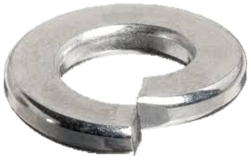
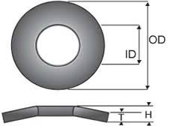
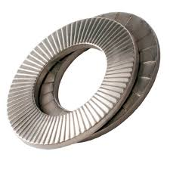
Best Practices
Locking Hardware
Lock nuts
Lock Washers
Bellville Washers
Nord Lock

Slide 9
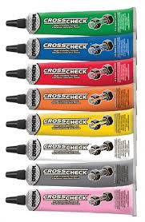
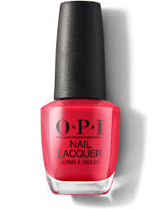
Best practices
Check torque
Recheck torque
Preventive maintenance
Establish a schedule
Event based
Time
Mileage
Record keeping!!!!
Indicators
Commercial
Nail Polish

Slide 10
General Safety
Electrical Connections
5.7.1 Wire – All wires must be properly rated for voltage and temperature. Wires must be properly sized to expected continuous system current. Wires must be properly and neatly secured to prevent movement or snags during solar car operation. Wires must be secured by a protective grommet when passing through a bulkhead. Starting in 2021, no wire conducting more than 36 volts may be located within the driver’s compartment.

Slide 11
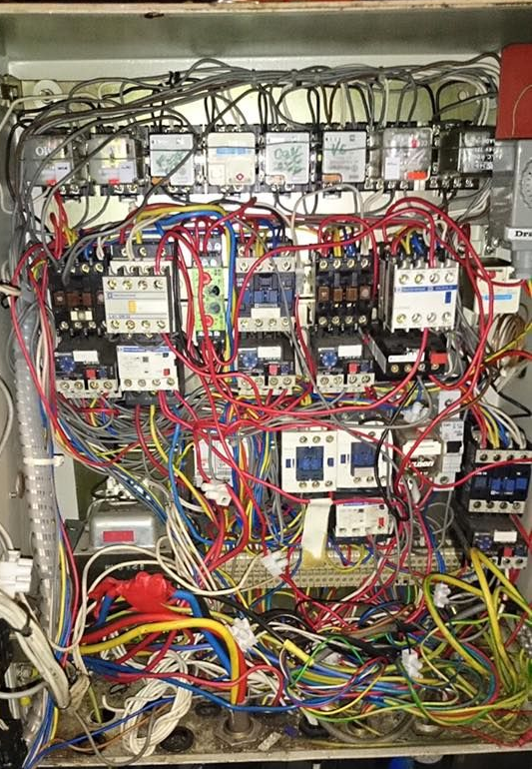
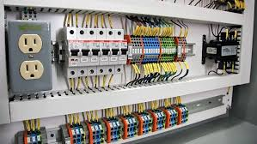
Best Practices
Notes:
Bad wiring
Wire can come loose
Difficult to see what is going on
Can not identify problems early
Johns story.
Good wiring
Labeled
Color Coordinated
Wires are protected
Easy to trouble shoot

Slide 12
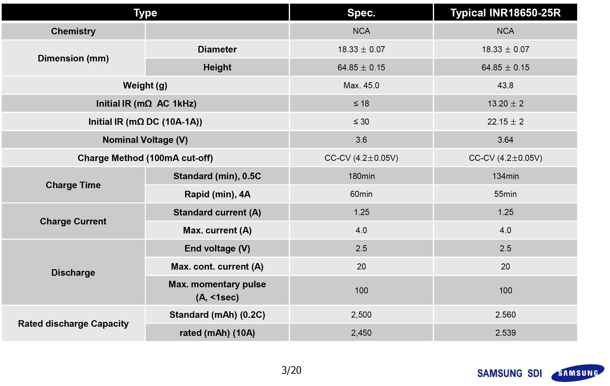
Lithium Safety
Know your batteries
Chemistry
LiFePO4
LIFeMnPO4
Lion Polymer
LION
18650
21700
Critical Information
Charge Profile
Discharge Current
Voltage
Notes:
Lots of variety in batteries depending on the chemistry, even in a given chemistry there is a lot of variety. Panasonic makes 18650 cells that are capable of 8 amps to 30 amps. In general

Slide 13
Lithium Safety
Applicable Rule
10.1.3 - Teams using lithium battery packs must have battery protection monitored at the cell level
Critical
Over voltage protection
Desired
Over voltage
Temperature
Over Current

